Slide 1
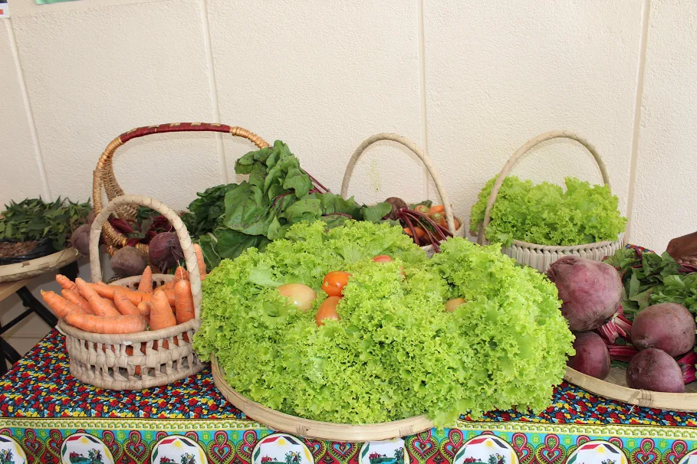

New Member
About ABIODES
Alzira Mahalambe
Maputo, 05th June 2024

Slide 2

A national, non-profit association set up in 1995 and legalized in 1998.
Mission - Promote sustainable and inclusive development through agriculture and rational use of natural resources.
Structurally organized into General Assembly, the Fiscal Council and the Board of Directors.
Two offices and collaborators/Human resources 22 (9 F + 13 M):
  Head office in Maputo (country's capital ): 15 = 7 F e 8M
  Office in Nampula (north of the country): 7 = 2F e 5M
Who we are?

Slide 3


Agriculture and Food Security
Environmental and Natural Resources
Lobbying and Advocacy
Intervention areas

Slide 4






Accompanying the Agroecological Transition as components of Participatory Agricultural Training, Urban Agriculture Plan and networking with other actors.
ESSOR/AFD
Enhancing livelihoods, climate resilience and women's empowerment.
Madre Corage/AACID
Youth participation in local economic development, with components of small business development, small markets, agro-ecological gardens in schools, support for access to water and more sustainable irrigation systems (use of solar panels).
TDH
Projects and Partners
"Mangaction - Preservation and valorization of environmental heritage for sustainable and resilient development in Maputo Bay."
WeWorld GVC/AICS
Unlocking a Sustainable Blue Economy in the South West Indian Coast
WWF (Mozambique and Madagascar). NORAD

Slide 5
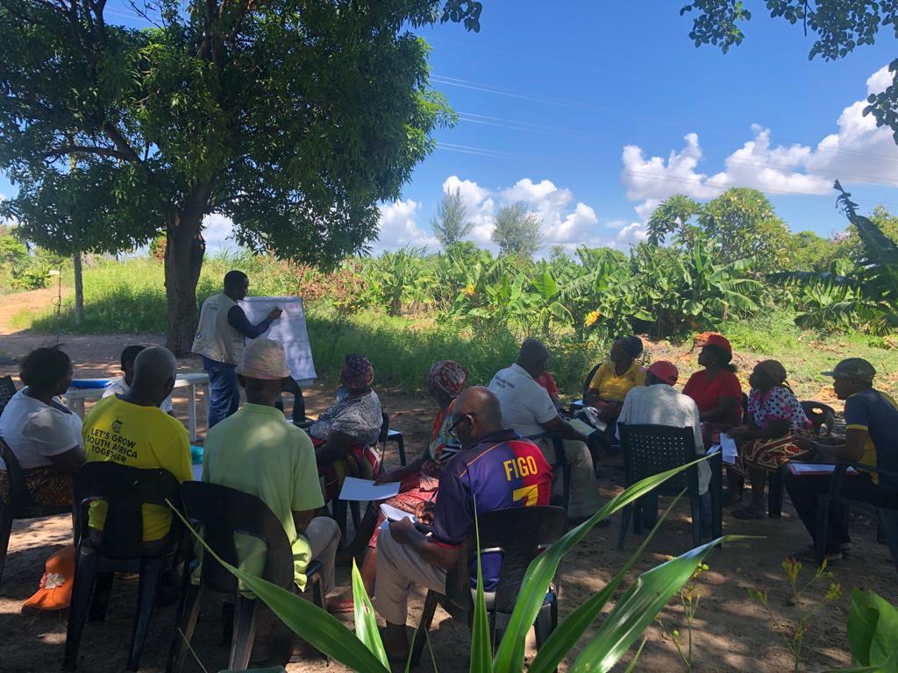
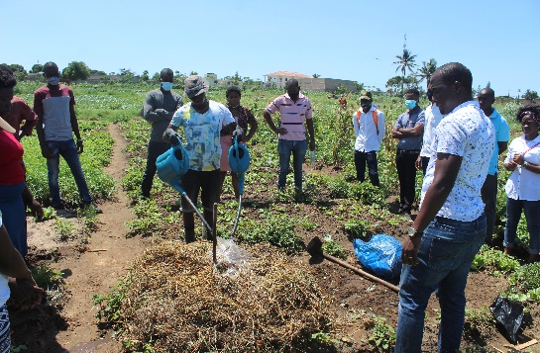
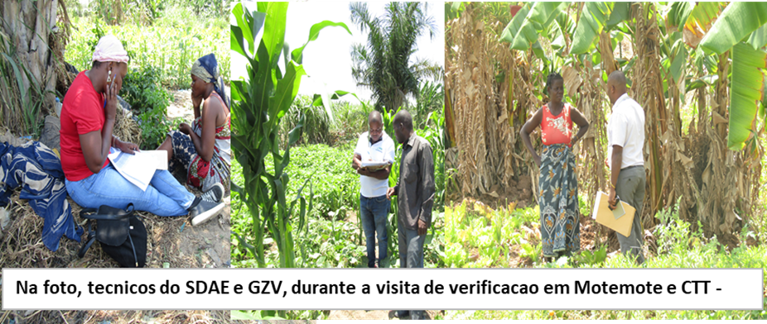
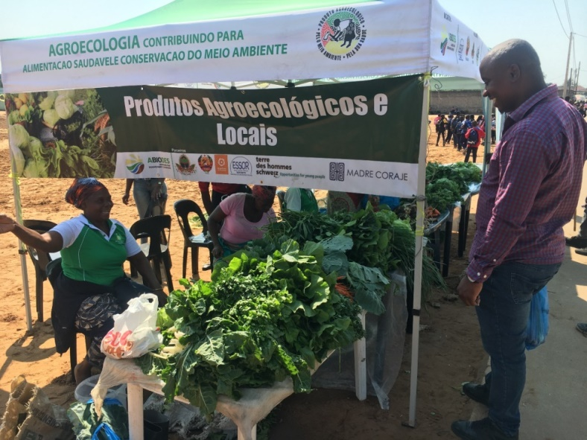
Activities
Agriculture and Food Security
Promotion of agro-ecological production/FAP
Production and promotion of inputs (biopesticides, organic compost and biofertilizers, use of animal manure, etc.)
Support for agricultural marketing/fairs/SPG certification/points of sale
Creation and strengthening of a network of agroecology promoters

Slide 6
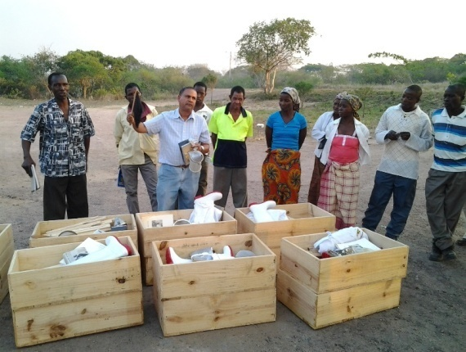
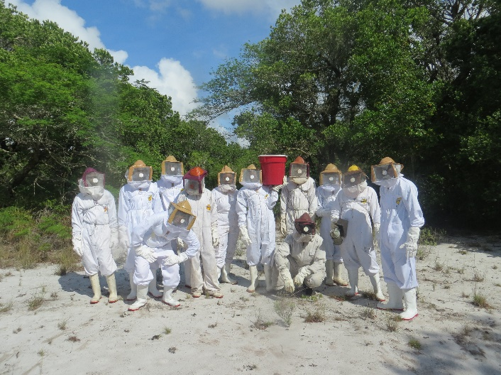
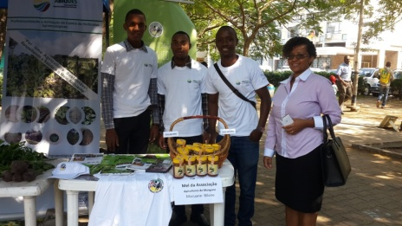
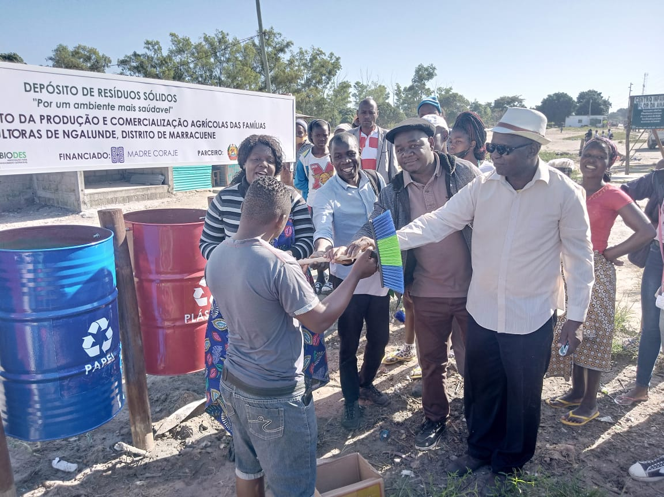
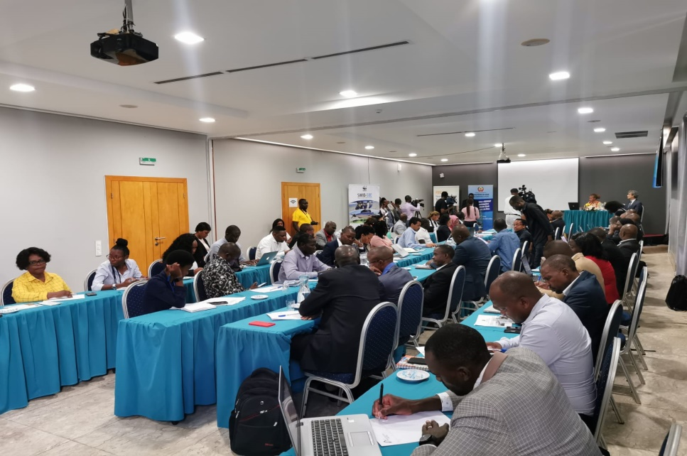
Activities (Cont.)
2. Environment and natural resources
Beekeeping/decreasing forestry pressure
Environmental Education - Good Environmental and Natural Resource Management Practices/Solid Waste Management
Lobbying&Advocacy::
National Meeting between the Government and Civil Society Organizations working in the Marine and Coastal Area (GOSCMAR)

Slide 7
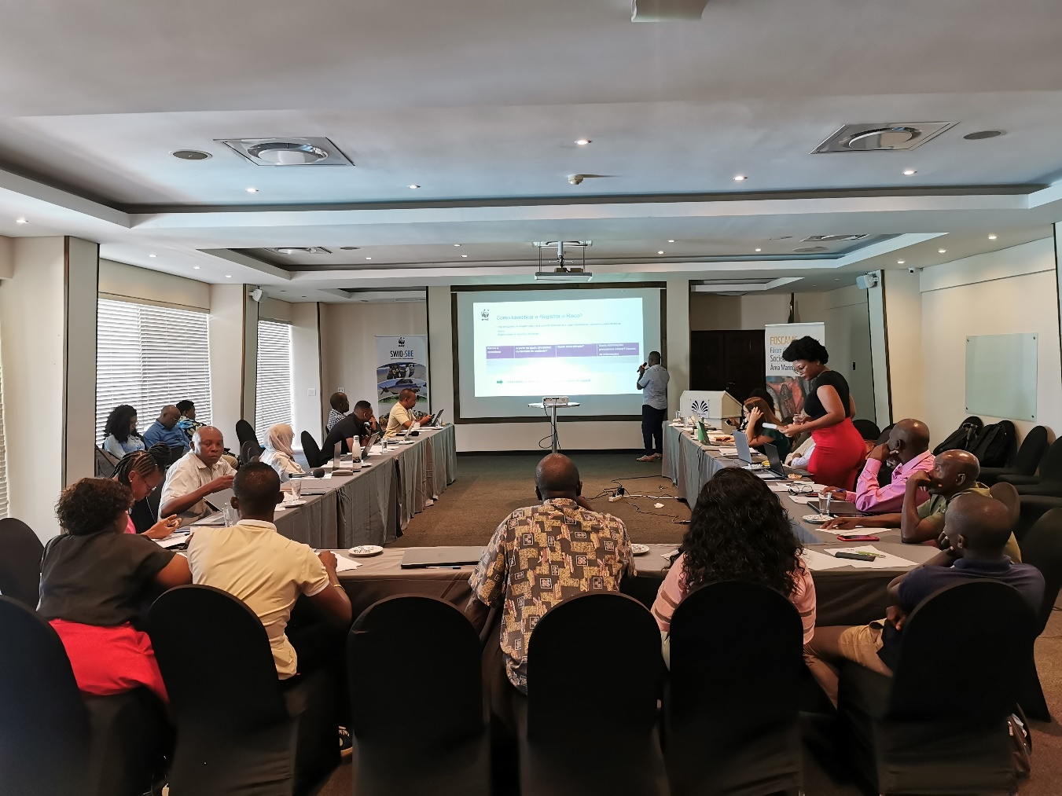
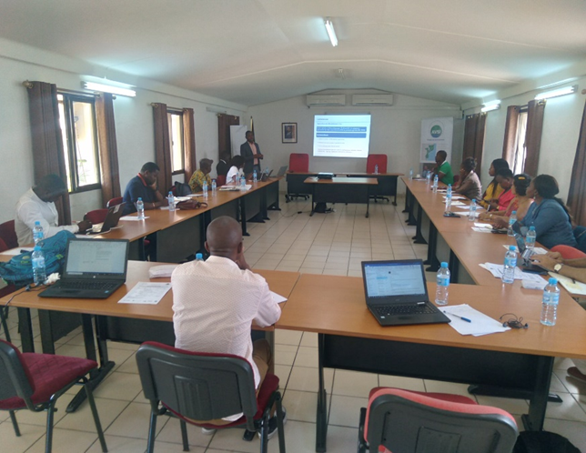
Activities (Cont.)
PAU (Urban Agriculture Plan)
Participation in networks/
FOSCAMC
Agroecology
ROSA
IFOAM
SAN (Now)

Slide 8
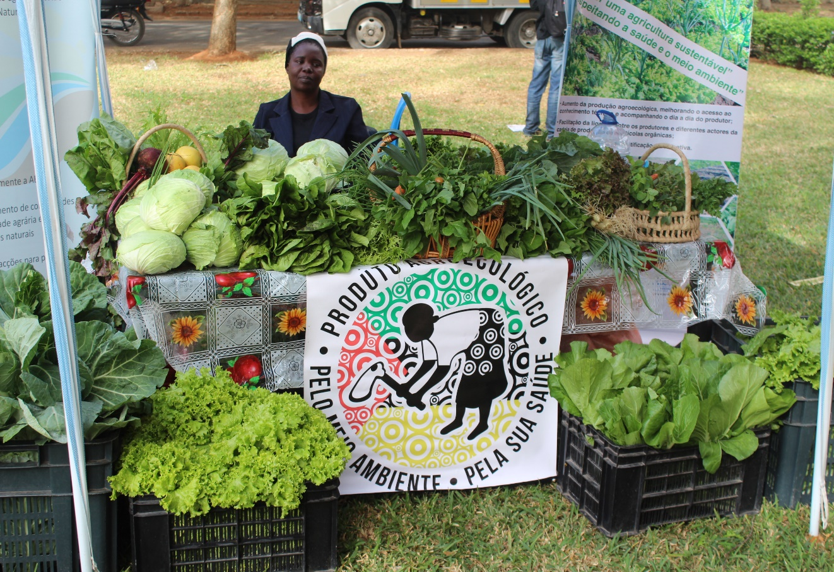











Thank You!
Contact (Head Office: Maputo city):
Phone: +25821417691
Email: info@abiodes.org.mz
www.abiodes.org.mz
Some Partners and networks:
Some Funders:

