Slide 1





Corporate Services Report for the Board of Directors
June 4th, 2024

Slide 2







Combined Financial Statements
Audited Financial Statements 2023

Slide 3

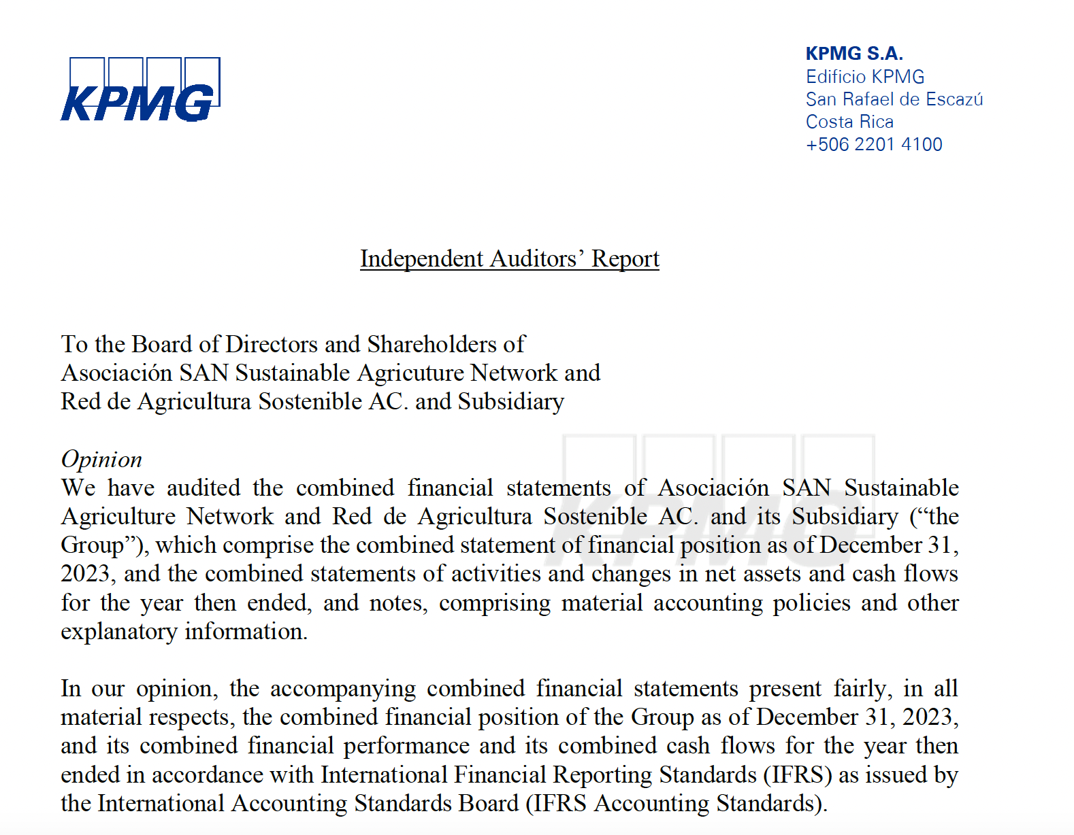
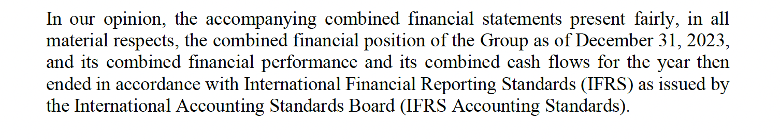

External Auditors Opinion

Slide 4
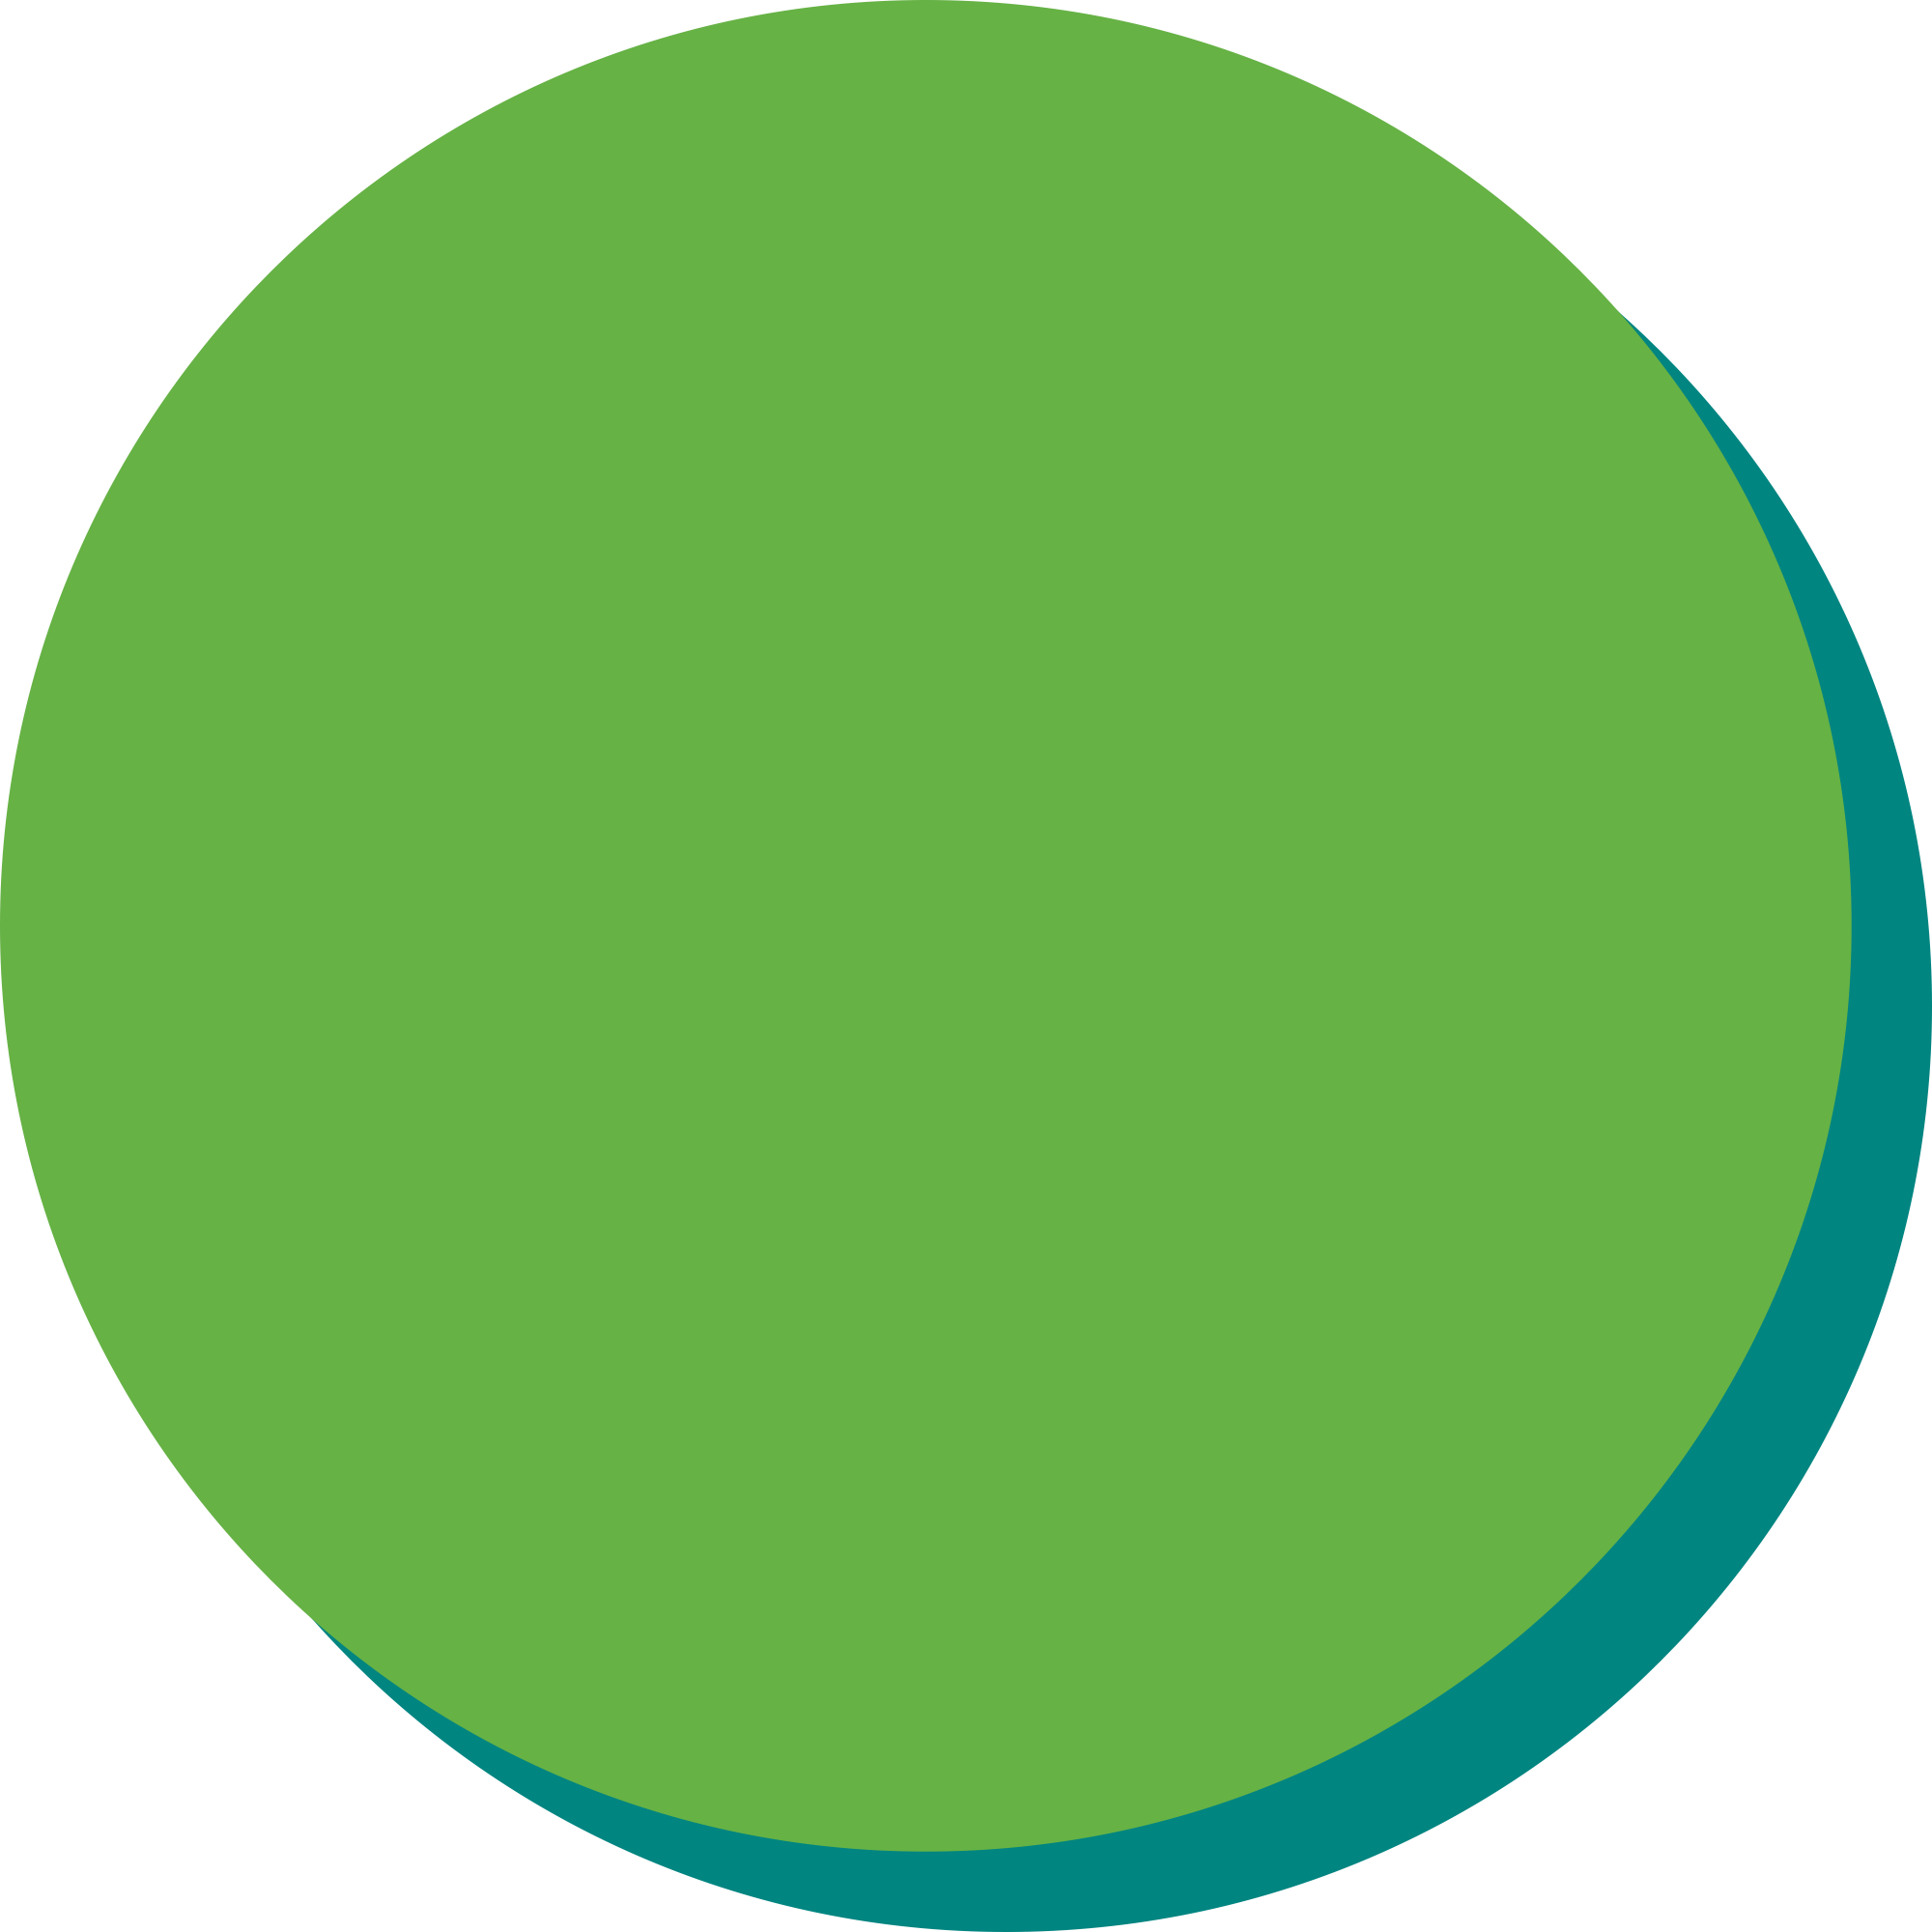
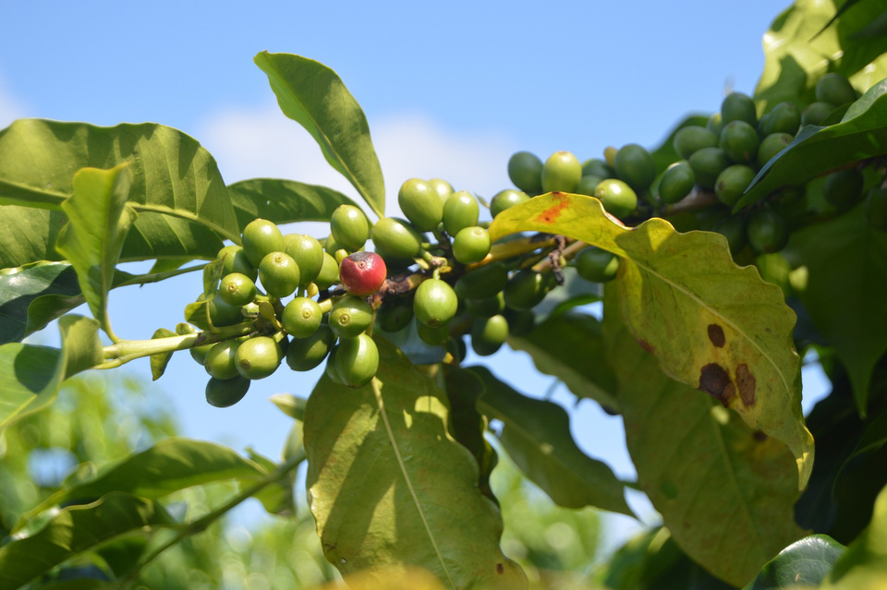
2023 Project Execution: Project implementation continues to be paramount
2022 Project Execution => USD 3,462,217

Slide 5
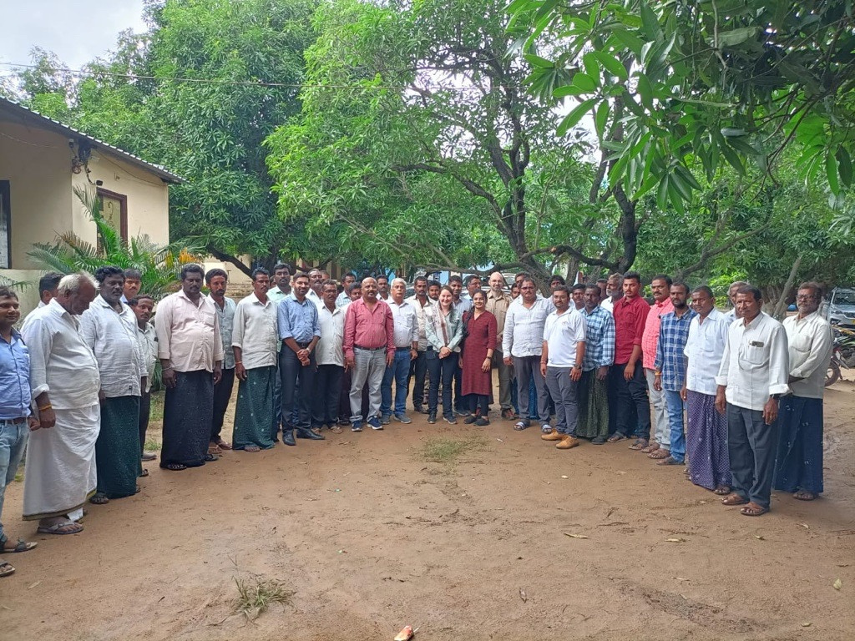
Net Contribution of SAN 2023 (Audited Statements)
A continous
    ascending path to financial sustaniability

Slide 6

Balance Sheet SAN 2023 (Audited Statements)
Solid Financial Position with healthy assets and increased reserves.

Slide 7
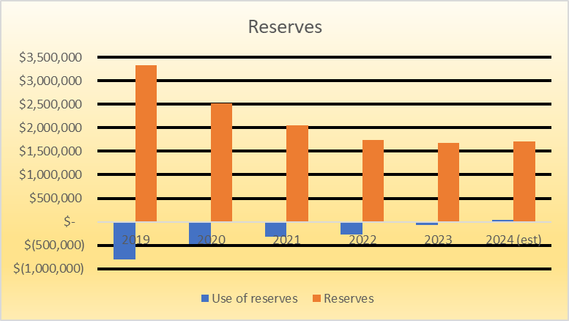

Reserves: Effective use of reserves helped consolidate the new business model
Net Reserves December 2023 => USD 1,672,311

Slide 8
2024 Budget vs. 2023
No use of reserves

Slide 9

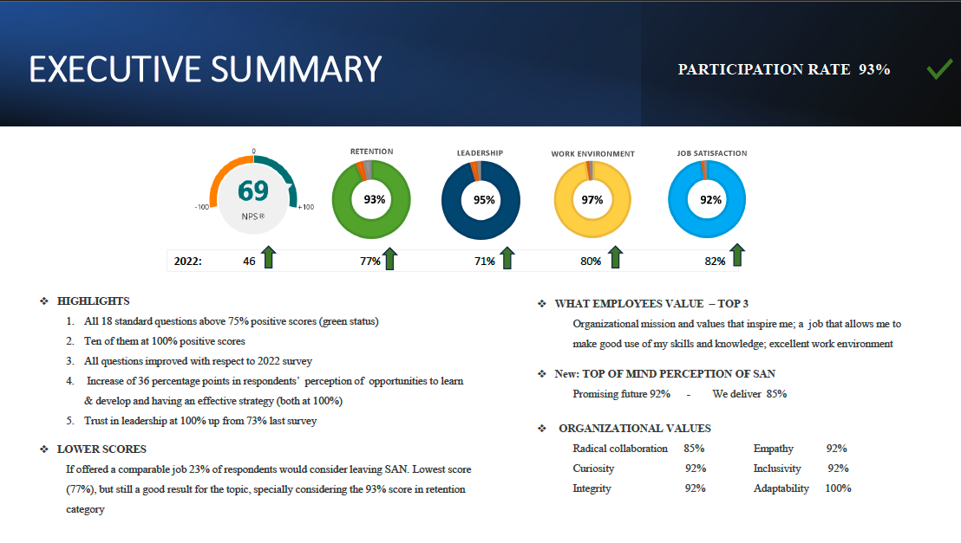
Employee Experience Survey
Building a collaborative team by design, fit for purpose and ready to grow!!

Slide 10
Questions?

