Slide 1
Systematic Reviews for Sustainable Agriculture
SAN General Assembly, Oxford
5th June, 2024
Dr. Gillian Petrokofsky

Slide 2
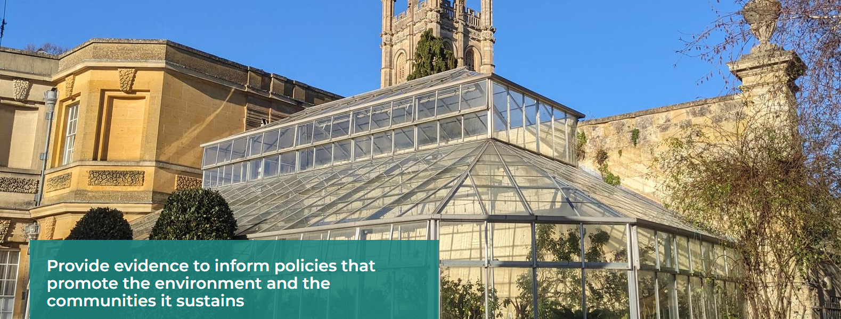
Oxford Long-Term Ecology Lab
Introduction
oxlel.web.ox.ac.uk
Notes:
Hi, I am Gill and I have been conducting systematic reviews and systematic maps for over 10 years. I have a particular interest in exploring the use of efficient ways to undertake systematic evaluation that suit the policy timeframes of decision-makers. I have published more than 20 systematic maps and reviews on a wide variety of topics, from marine stewardship eco-labelling to the effects of prescribed burning in temperate and boreal forest. I work closely with colleagues in the Collaboration for Environmental Evidence and am the co-author of the Guidelines and Standards for Evidence Synthesis in Environmental Management. I am an Associate Researcher with the Oxford Long-term Ecology Group at University of Oxford and a lecturer on the MSc course in the School of Geography. I am a founder member of Oxford Systematic Reviews (OXSREV).

Slide 3
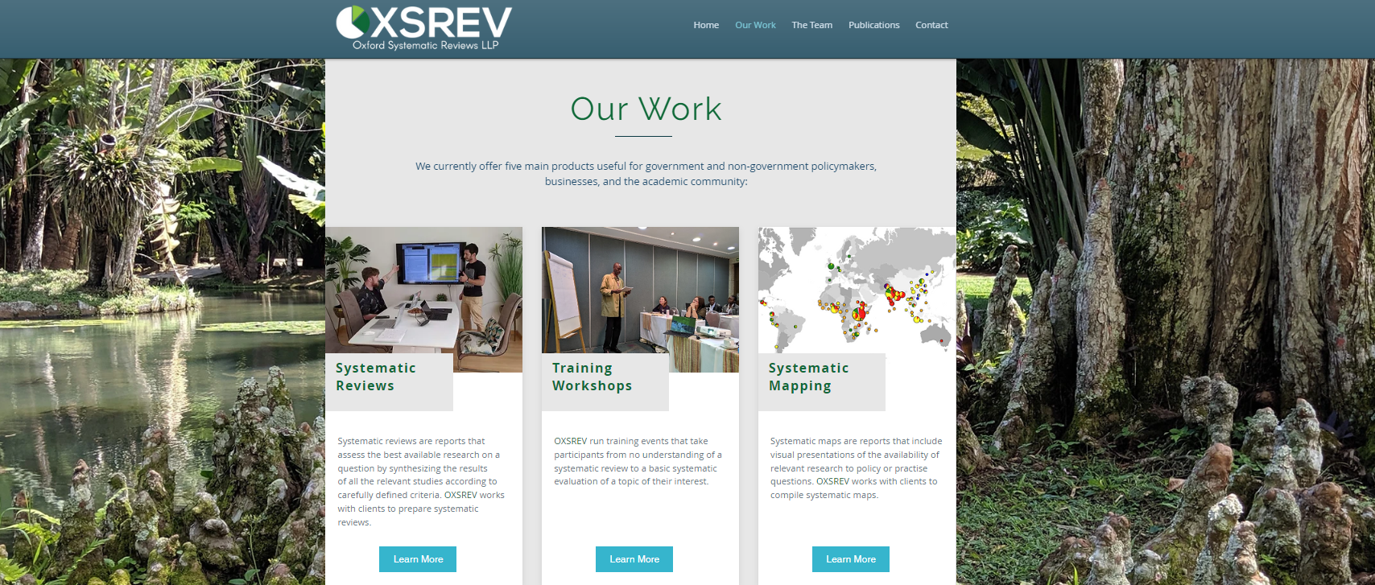
Oxford Systematic Reviews (OXSREV)
Introduction
OXSREV provides services that give organisations a firm basis on which to implement meaningful environmental, social and economic change by using systematic reviews and other systematic evidence evaluations for evidence-informed policy and practice.
https://www.oxsrev.org/
oxlel.web.ox.ac.uk
Notes:
The name “Oxford Systematic Reviews” originated from the founding members’ interest in systematic evidence evaluation methods, and the University of Oxford, where the founding partners first collaborated in the Oxford Long-Term Ecology lab.
OXSREV undertakes systematic reviews (and similar systematic evidence evaluations) and also delivers training in these methods.

Slide 4
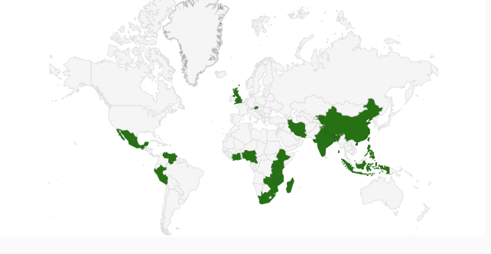
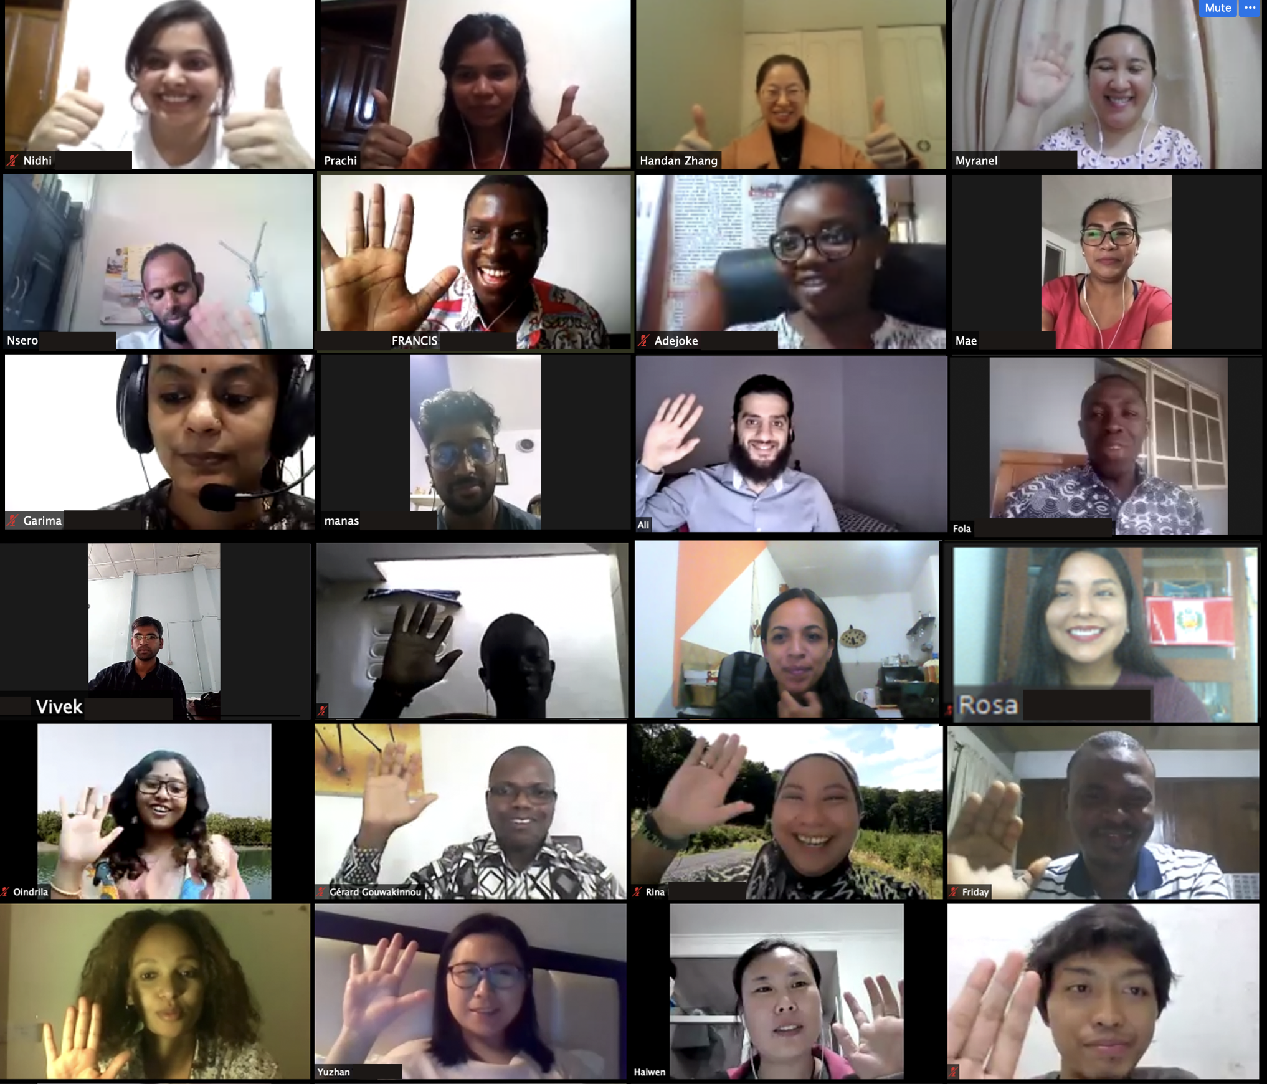
Training
Training
Learning by doing
Notes:
We’ve provided training to individuals from 72 institutes across 31 countries. These were exclusively in-person, mainly through the International Union of Forest Research Organisations (IUFRO), but the global pandemic meant that we had to move online, and we’ve continued to train online, which has been really beneficial from a lot of our students from countries in the global South

Slide 5
What is a Systematic Review?
Definition
Systematic Reviews are reviews of evidence relevant to a clearly formulated question that uses systematic and explicit methods to identify, select, collect and analyse data from all available evidence relevant to the question, while minimising publishing and other biases
Notes:
Here is a definition that is widely used by some of the important Collaborations who do systematic reviews

Slide 6
Why systematic reviews?
Personal history
A tale of two reviews
Drivers of Deforestation
825 articles
140 articles
Notes:
Worked for over 20 years at CABI, becoming Head of the Forestry team responsible for Forestry Abstracts, TreeCD and other information products you will hear about on Thursday. Two reviews came across my desk to abstract - Drivers of deforestation. Eminent researchers. Publ date 1999 and 2000. Very little overlap

Slide 7
Why systematic reviews?
Personal history
A tale of two reviews
A close encounter of the third kind
Fairly detailed method
Very little method
825 articles
140 articles
Notes:
Enter Sir Iain Chalmers - Cochrane Collaboration Systematic reviews in medicine. Well-documented high quality literature reviews driven by a clear method
A few years later when I was looking in more detail about how to bring systematic reviews into forestry, I again spent some of my holiday talking to one of the founders of the Campbell Collaboration who did systematic reviews in topics other than medicine.
Importance of clear transparent method for review - how did they choose the papers thy reviewed? Were some left out . If so why?

Slide 8
An example relevant to SAN
How??
Title: Regenerative Agriculture—A Literature Review on the Practices and Mechanisms Used to Improve Soil Health (2023)
Abstract: …We examined the reported benefits and mechanisms associated with RA against available scientific data. The literature suggests that agricultural practices such as minimum tillage, residue retention, and cover cropping can improve soil carbon, crop yield, and soil health in certain climatic zones and soil types…
Method: none reported
“...the focus of the review shifted to looking at the scientific evidence (local and overseas studies) on RA practices that affect soil carbon build-up and improve soil health.”
Notes:
Highly interesting findings, conclusions. But i wish I knew how they’d arrived at those decisions? We’re asked to take things on trust - not what we’d do in our primary research - but often (mostly) acceptable for literature reviews
Returning to our reviews that sparked my interest…one looked only at journal articles …the other made extensive use of reports,and non-journal articles - ‘grey literature’...but incomplete even for some journal articles. I later found out no CABI database…another story and an important one.

Slide 9
Systematic Review
Bias
Systematic Reviews are reviews of evidence relevant to a clearly formulated question that uses systematic and explicit methods to identify, select, collect and analyse data from all available evidence relevant to the question, while minimising publishing and other biases
“Systematic reviews of relevant evidence must be designed to minimise the likelihood of confusing the effects of interventions with the effects of biases and chance.”
Chalmers (2005)
Notes:
So this looked like a really good fit for forestry and land-use.

Slide 10
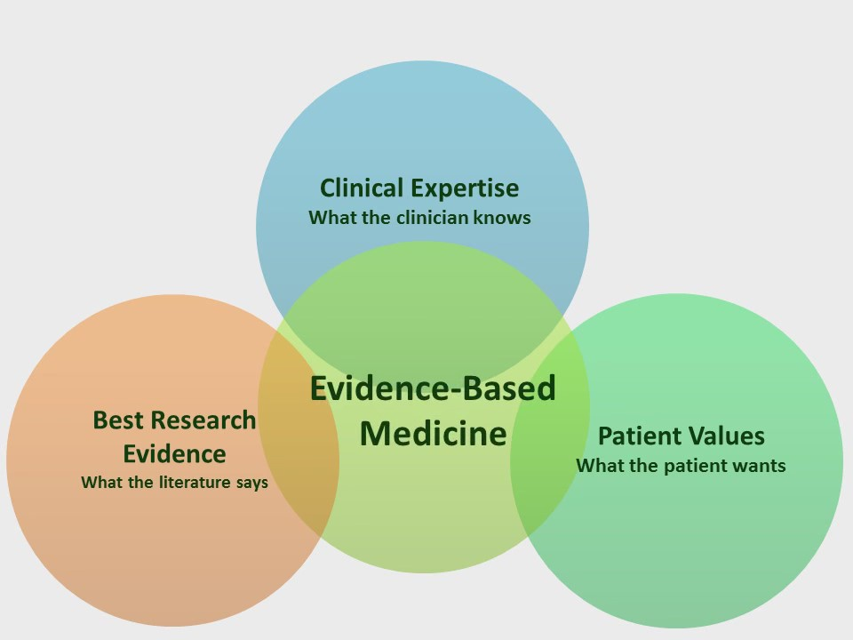
Evidence Based Medicine
EBM
Notes:
The medics developed EBM. Could this be a model for forestry and landuse? I thought we needed something slightly different for the evidence review element.

Slide 11
Stakeholder Engagement
Stakeholders
Major benefits
Wider evidence base to draw on
Greater public acceptance
Wider communication of findings
Increased likelihood of impact on decision-making
Challenges
increased demand on time and resources
potential for marginalising or favouring certain groups of stakeholders
Potential for biased representation of true stakeholder groups
Notes:
In forestry, agriculture and landuse arena, involving stakeholders is important. So we embedded them into the heart of the systematic review process.

Slide 12
Systematic Review for Decision-Making
Process
Actively disseminate results
3. Engage Wider Community with Findings
Practitioners
Policy makers
Academics
Systematic review of the evidence
Collaboration
2. Rigorous Review Methodology
Driven by protocol
Comprehensive
Transparent
Repeatable
Policy-relevant question
Question Framing
Policy and/or practise relevance
Involves stakeholders
Iterative process
Adapted from Petrokofsky et al. (2011)
Notes:
The process looks like this: [click]
Agree a reviewable, policy-relevant question
It needs to have policy and/or practice relevance
Stakeholders have to be involved
The process is iterative [click]
Design the method according to a strict protocol
The methodology is rigorous, robust and ESSENTIAL
The methodology needs to be comprehensive, transparent and repeatable [click]
Make sure the results of the review are actively disseminated and reach all the relevant stakeholders.
This means engaging practitioners, policy makers AND academics
[click]
All of these steps take place through active collaboration. [click]
It is important to remember that a robust and rigorous methodology is ESSENTIAL in a systematic evidence evaluation
Transition:
So why do we need to collaborate? [click]

Slide 13
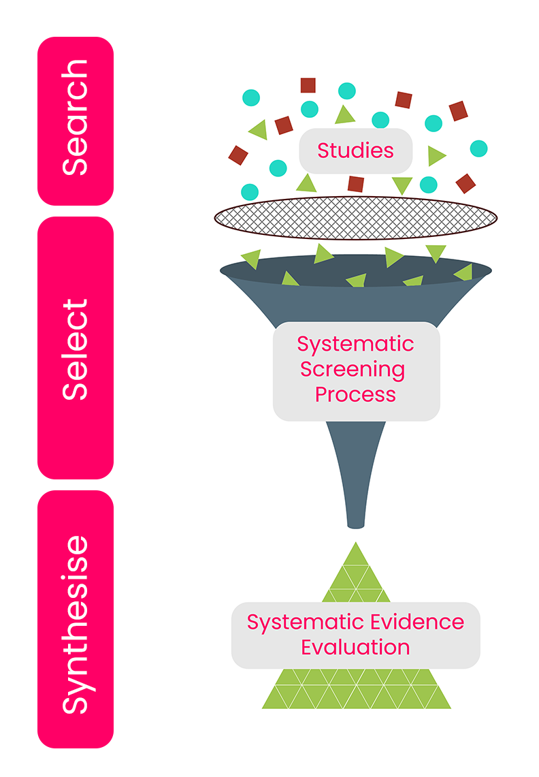
Systematic search, select, synthesise
Review process
Search
10%
Select
40%
Synthesise
50%
Notes:
So how does the concept of systematic evidence evaluation work in practice.
We search for the evidence from a variety of sources,
We select the relevant evidence through a robust and repeatable process of filtering, and
We synthesise the evidence to provide an unbiased account of the evidence base. [click]
In terms of effort (time and cost) these percentages

Slide 14
Steps Involved
Steps
1. Formulate clear & specific question
6.Data synthesis
7.Report writing
2.Develop the Protocol
5.Collect & extract data
8.Interpret the results
3.Conduct comprehensive literature search
4.Screen & select studies
9.Share findings with stakeholders
Notes:
So what are the actual steps involved in a systematic evidence evaluation?
First, we must formulate the problem that our systematic evidence evaluation is going to address. [click]
Then, we need to write the protocol. [click]
Once we have our both problem and our protocol then we need to locate and download the studies that we will be looking at. [click]
When we have the studies we must screen them for eligibility and select the studies that are relevant. [click]
Then we collect and extract data from the studies that were included. [click]
After collecting and extracting data we must analyse what we have got [click]
Next, we want to present the results from our analysed data. [click]
After we have presented our results, we want to interpret them [click]
And finally, we finish our write up, publish and complete our systematic evidence evaluation.

Slide 15
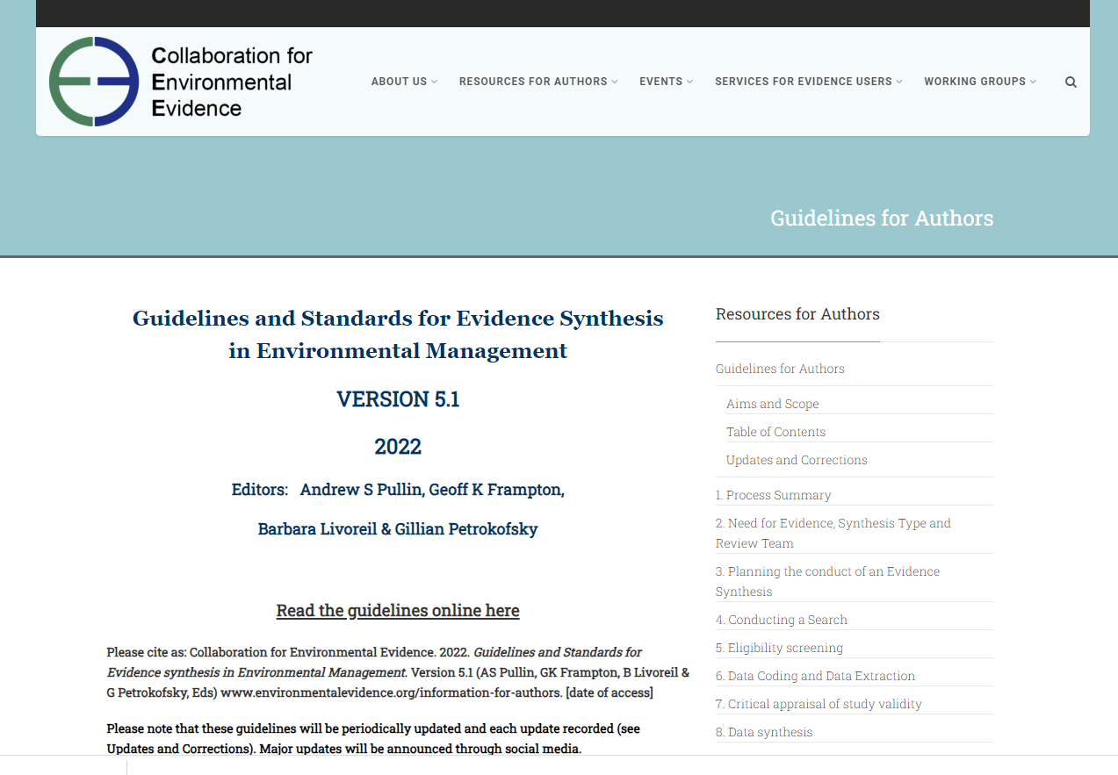
Good Practice Guidelines
Good practice
https://www.environmentalevidence.org/information-for-authors
Notes:
This is freely available online and takes you through each stage of the systematic evidence evaluation process.
[click]

Slide 16
Systematic Collaboration
Collaboration
Collaboration –
asking the most useful questions
Collaboration –
communicating what you discovered
Collaboration is everything
Collaboration – finding the relevant evidence
Collaboration – agreeing how to analyse the evidence
Notes:
Collaboration – widespread feedback and peer-review at all stages [click]
Collaboration –
widespread feedback and peer-review at all stages

Slide 17
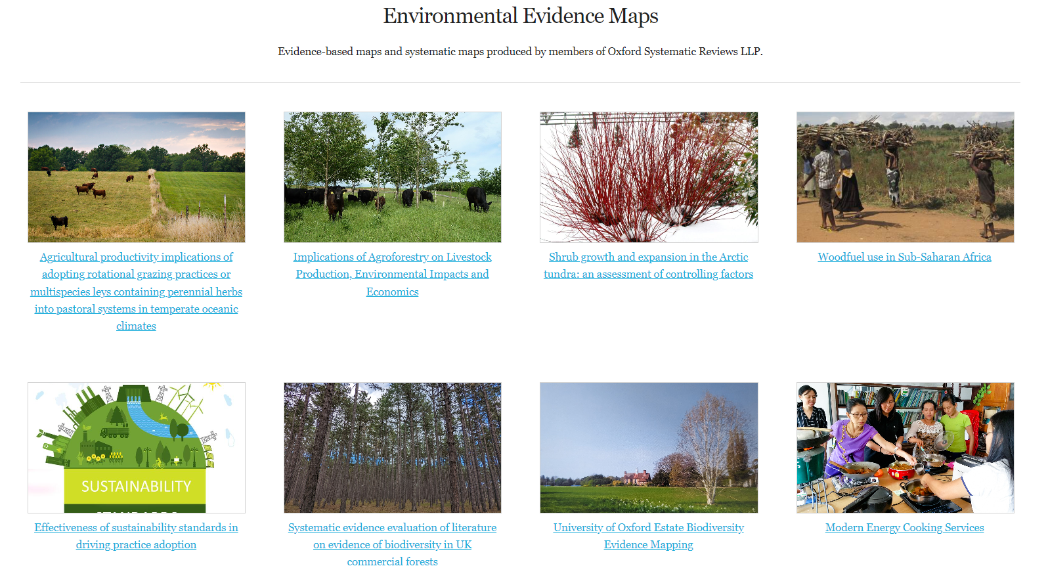
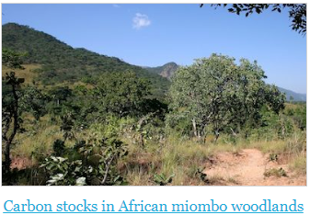
Notes:
These are some of the systematic reviews, maps that we’ve collaborated on in OXSREV

Slide 18
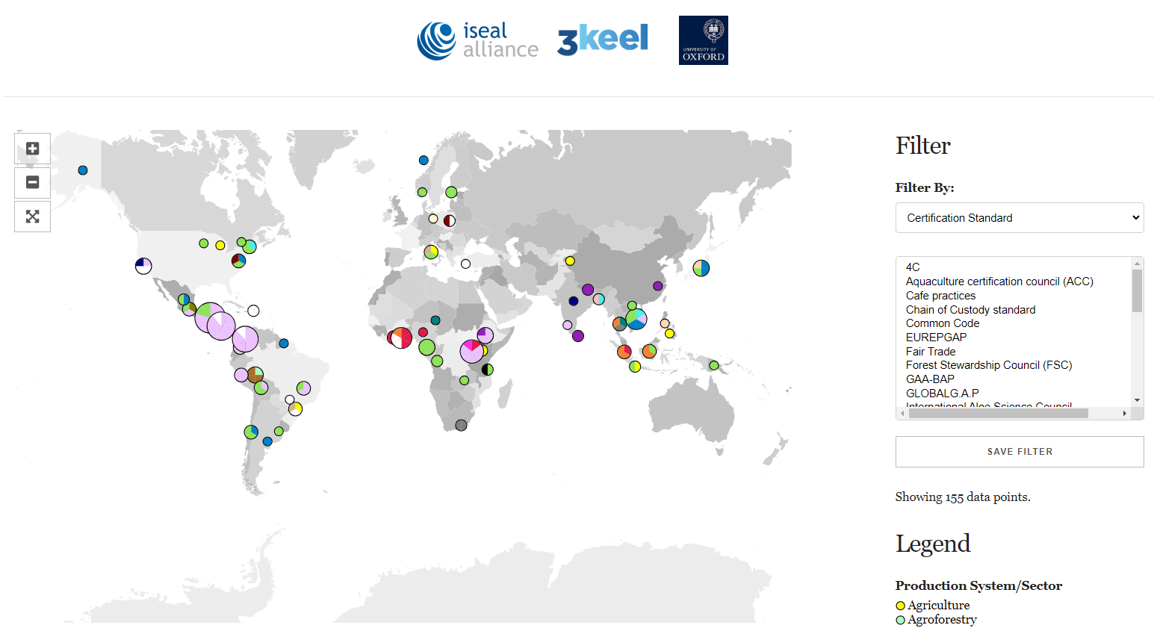
Notes:
Zooming in on the sustainability standards review. Data points from all the studies included.

Slide 19
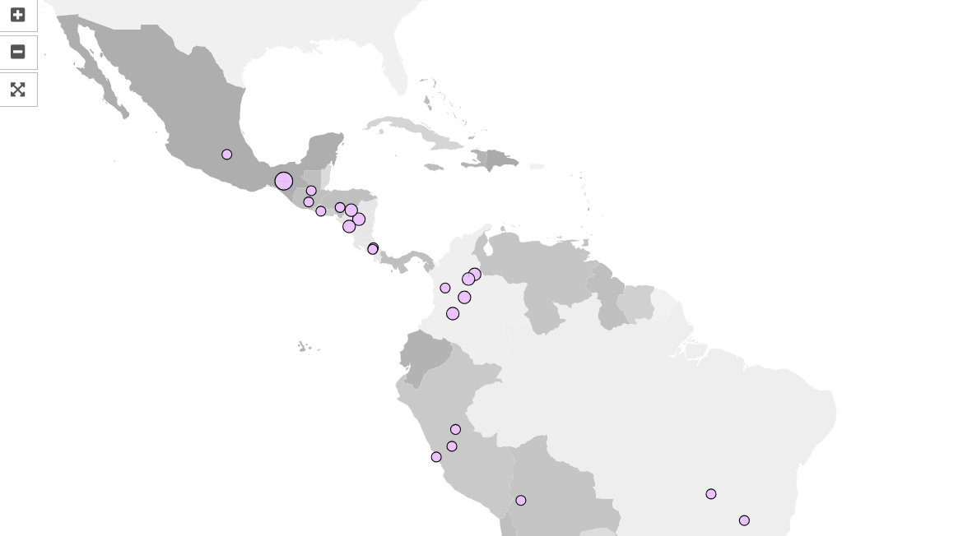
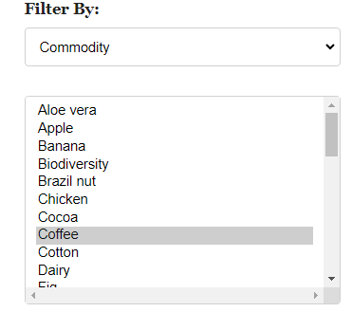
Notes:
Zooming in further to hte central american isthmus and filtering the evidence map for coffee

Slide 20
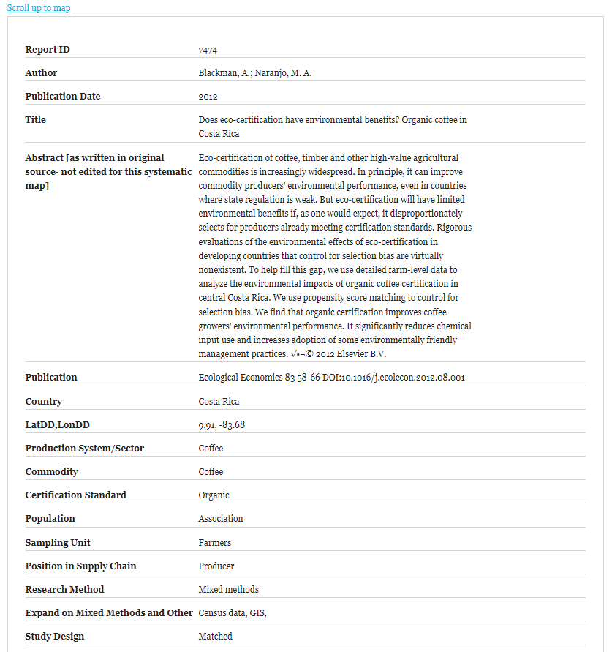
Notes:
Data sheet, made at the synthesis stage where the article was selected then thoroughly coded with all the fields we have decided collaboratively that we want to include…

Slide 21
Access to Information is Challenging!
Collaboration
There are too many publications for an individual to assess
No one institution holds everything
Not all information is in academic journals
No one institution can access everything
Science is not only written in the English language
Not all information is free
Notes:
Access to information is really challenging. Consider these issues:
There are too many publications for an individual to assess
No one institution holds everything
Not all information is in academic journals
No one institution can access everything
Science is not only written in the English language
Not all information is free
The need for collaboration is clear to overcome these challenges. [click]

Slide 22
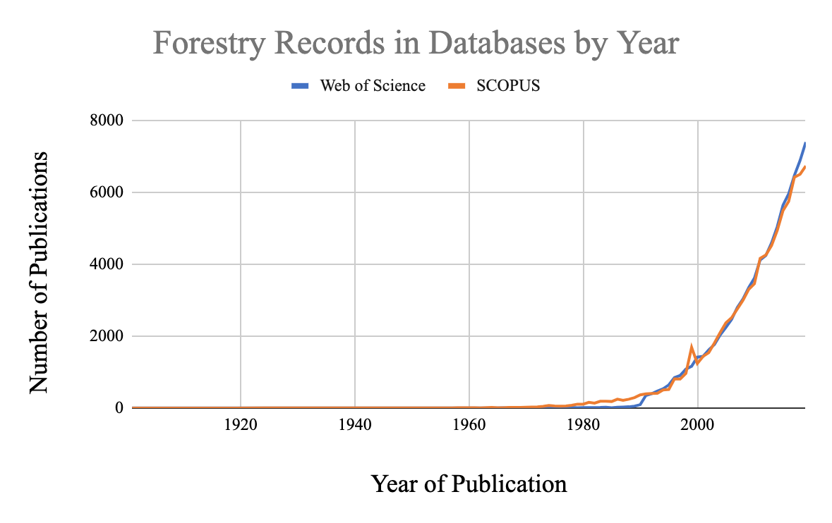
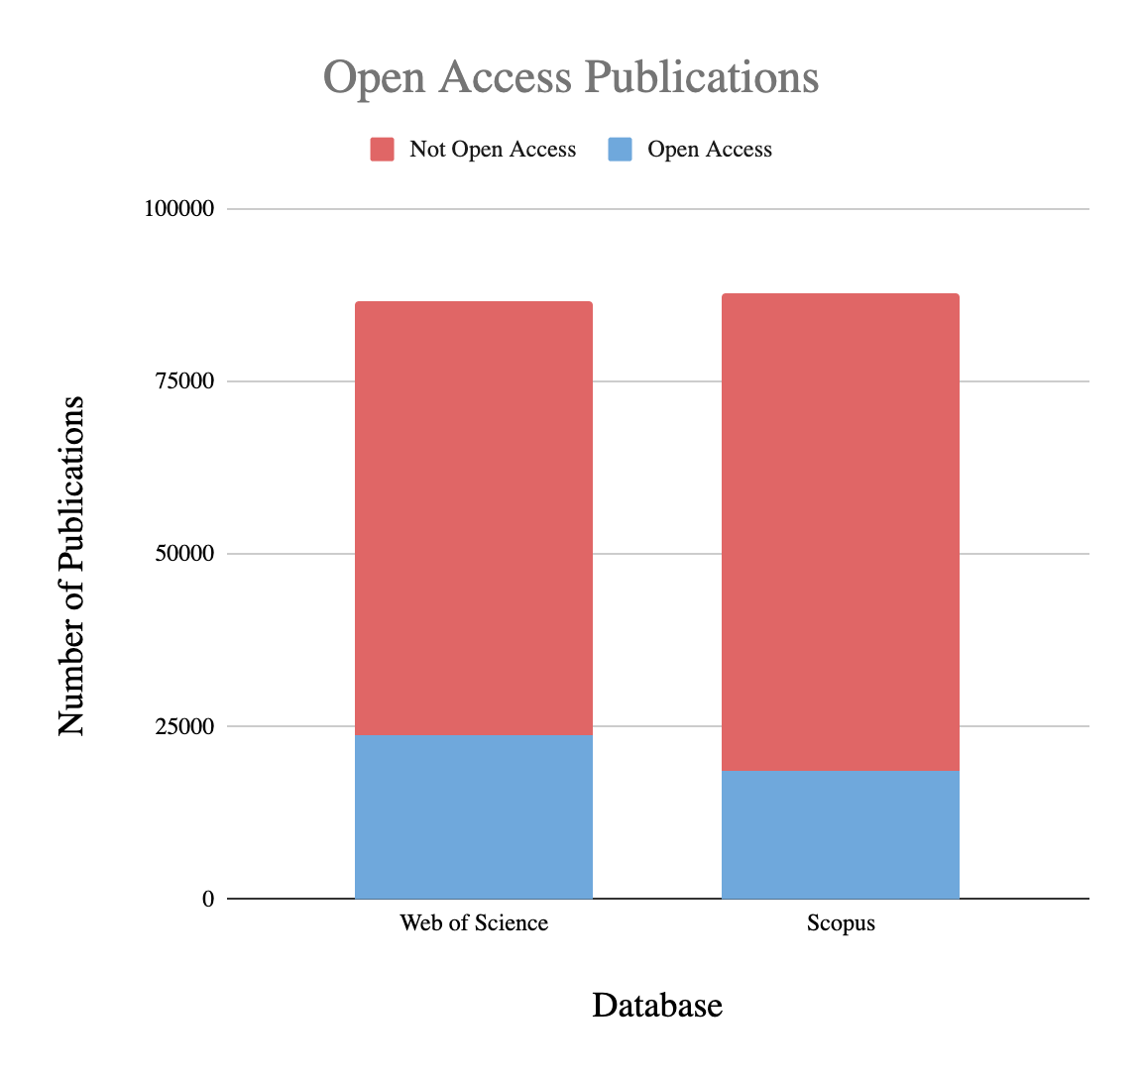
Information Overload!
Collaboration
$$
$$
Notes:
There is a lot of evidence out there!
And the number of scientific articles is increasing exponentially. Here is an example of the corpus of literature related to forest degradation & restoration using a simple search in 2 of the top bibliographic databases: Scopus and Web of Science.
A really important challenge also to note is how little of this information is available for journals which are free (i.e. Open-Access) [click]

Slide 23
Conclusions
Finally
Systematic reviews are essential for synthesizing research in agriculture
They provide comprehensive, evidence-based insights
They identify evidence gaps
They provide tangible outputs from collaboration
Encourage more systematic reviews to improve agricultural practices and policies
Thank you for your kind attention!

