Slide 1
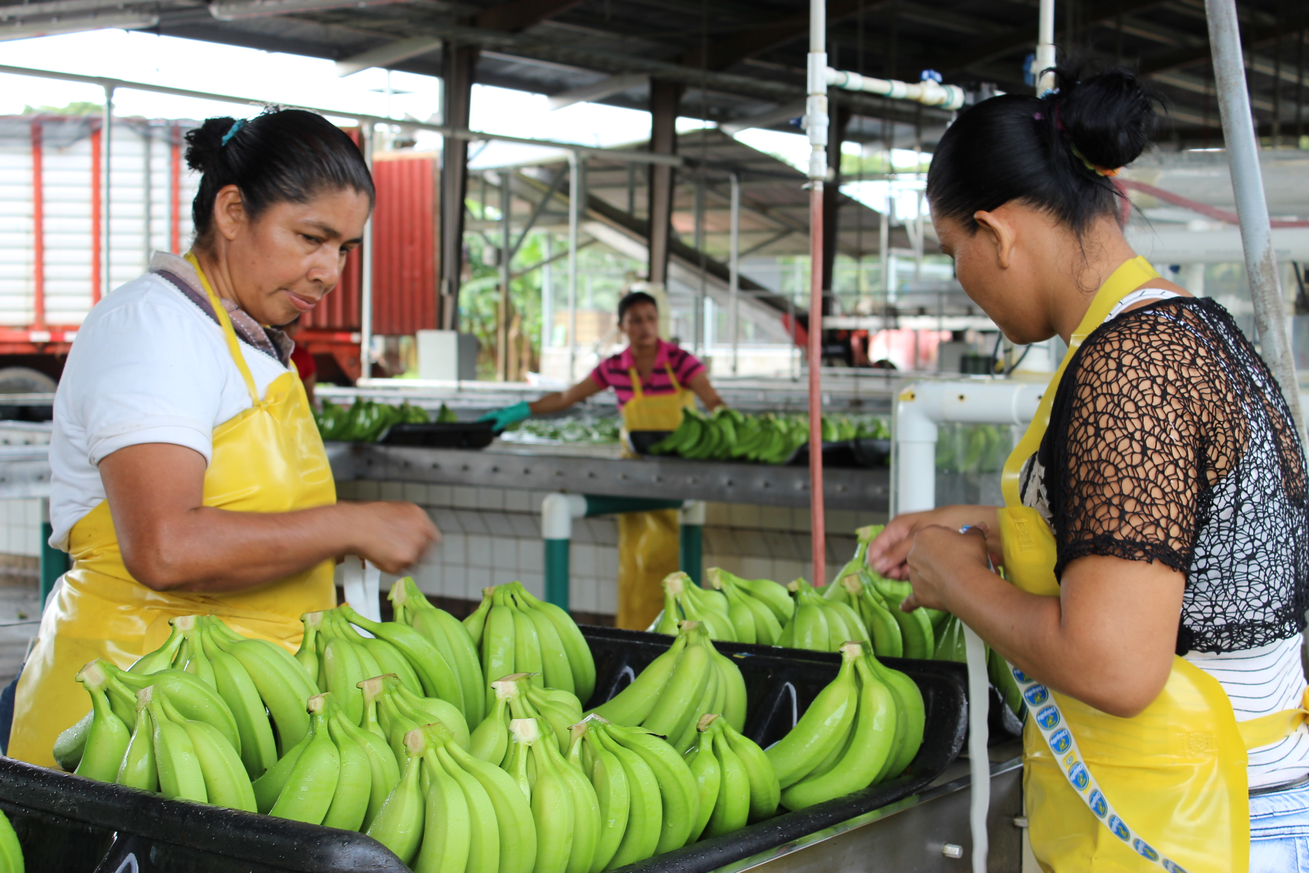
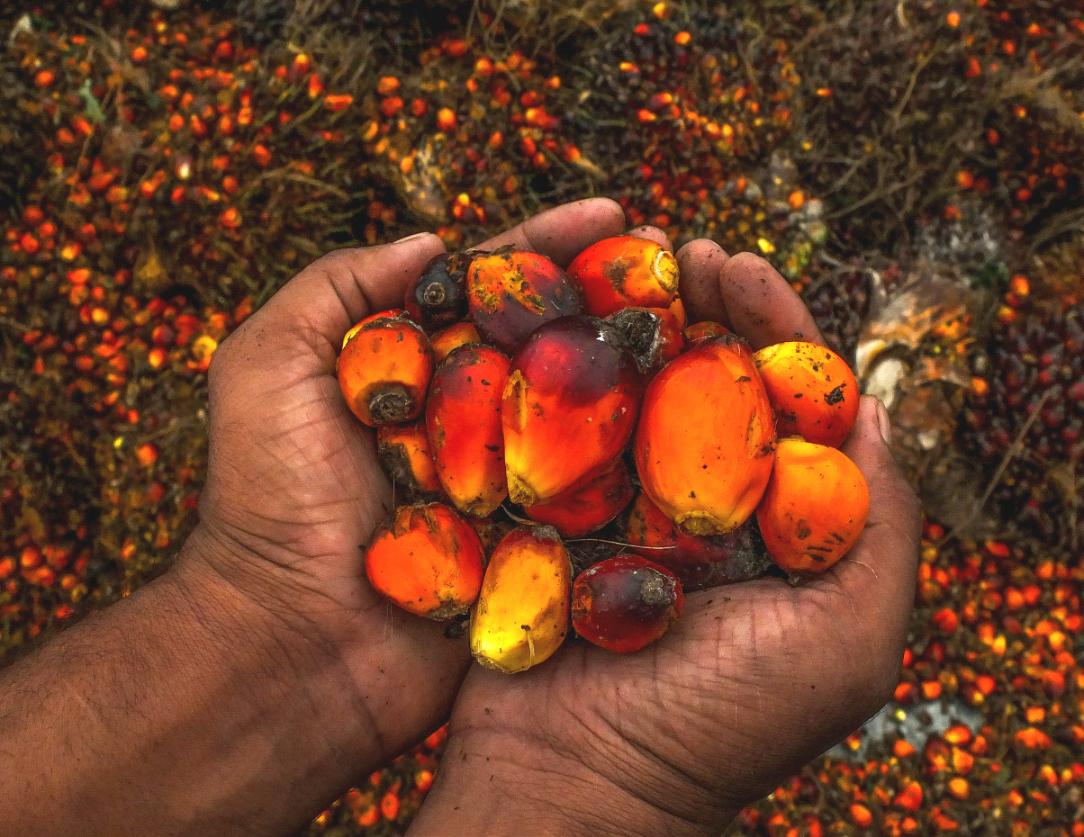
REGENERATIVE AGRICULTURE
Sucess stories and lessons learned

Slide 2
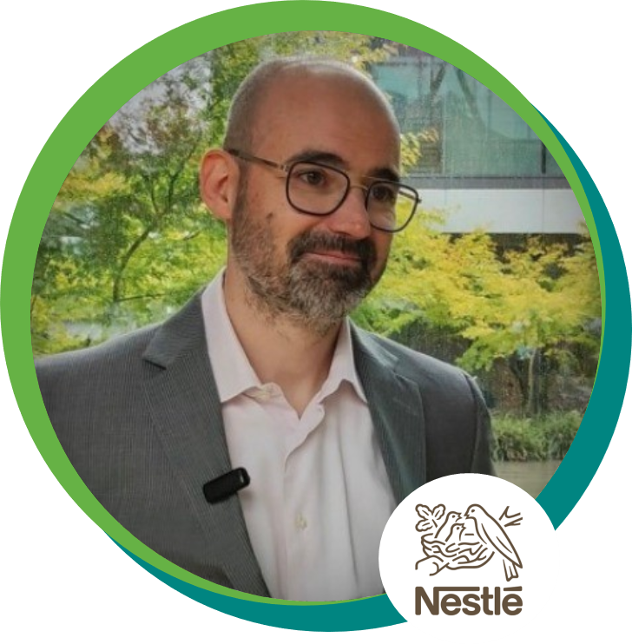
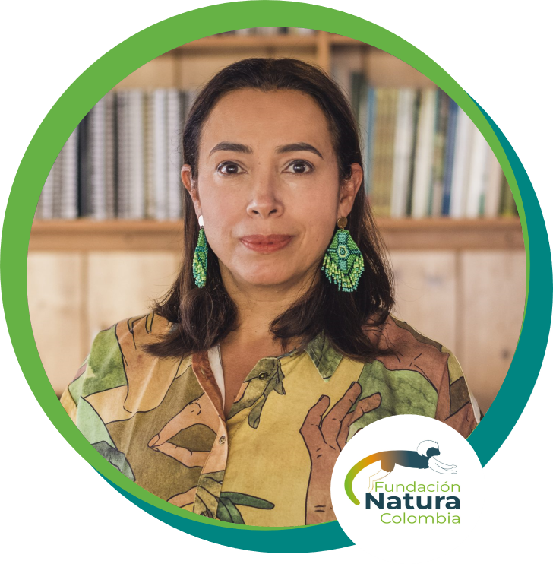
Meet our speakers
Alain Nguyen
Clara Solano
Hardeep Desai

Slide 3
Investors’ interest
Local partners create trust with our company’s suppliers
What has worked?
Action plans flexibility allowed for continuous mindset evolution
2) Climate action
1) Margins
Scope increased rapidly
Climate Roadmap
Companies scope 3
REGEN AG
Supporting farmers through RegenAg allowed us to introduce actions on human rights
Unintended benefit
Few internal resources
Greater visibility on/of suppliers' achievements
Corporate Problems
Your value proposition
Personal vision
Large supply chain
More industry collaboration
No influence on origins
Expertise
Consumers switching for brands invested in this work
Turnkey solutions for corporates
Local ressources
Regional coordination

Slide 4
CLARA SOLANO
Colombia

