Slide 1
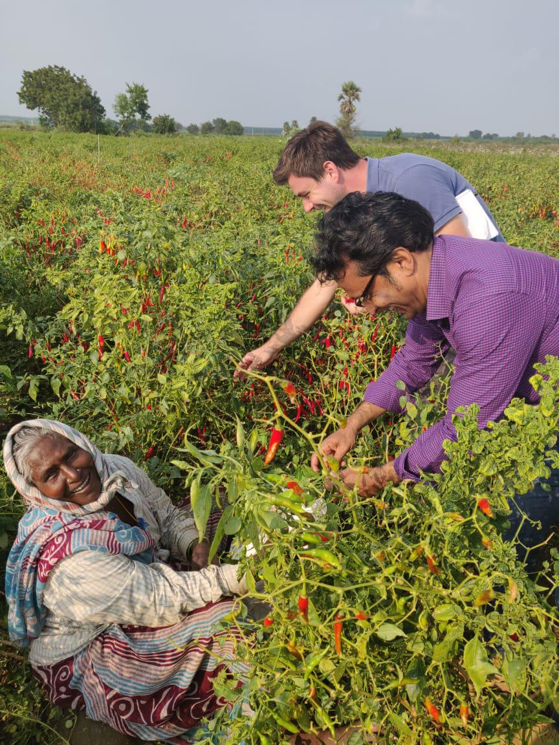
Human rights standards within agri- supply chain
Association for Stimulating Know How (ASK)

Slide 2
Key Information Areas
Prevalent decent working conditions guided by the international codes and standards and local legislations
Recruitment Practices
Hiring Practices: discrimination in hiring on the basis of caste, ethnicity, religion, age, disability, gender, marital status, pregnancy, sexual orientation etc.
Mode of hiring - Role of labour contractors
Nature of labour contracts transparency
Child labour
Children and nature of work undertaken by them in cultivation and harvesting
Vulnerability of Migrant worker children
Involvement in hazardous activities or handling of hazardous substances
Engagement of young workers (14-18yrs) – working hours, nature of work undertaken - employed in hazardous conditions/activities
Forced labour
Nature of work and employment conditions and instances of forced labour, bonded labour
Common money-lending practices or wage advance policies in the community which may be associated with worker vulnerability to bonded labour

Slide 3
Key Information Areas
Prevalent decent working conditions guided by the international codes and standards and local legislations
Access relevant health and safety measures
No Provision of PPE at no cost to workers
No Provision for first aid and occupational medical assistance in case of accident or injury
No Provision of health & safety trainings
No Provision of free potable drinking water and toilet facilities
No Special measures for young workers, pregnant women and persons with disabilities
Work and living conditions of migrant workers
Nature of work/employment conditions
Working hours & conditions
Legal Minimum wages and compensation
Regular payment of wages
Deductions from wages as a disciplinary measure
Disparity in wages
Regularity of work
Additional facilities provided by the employer
Hygiene and Sanitation - Availability, accessibility of free potable drinking water, Availability of toilets and washing facilities
Access to housing, water, food and sanitation for migrant farm workers
Safe work environment for workers, their family (including children)
Social security benefits
Freedom of Association/collective bargaining - Any farm workers’ association – its responsibilities and management.

Slide 4
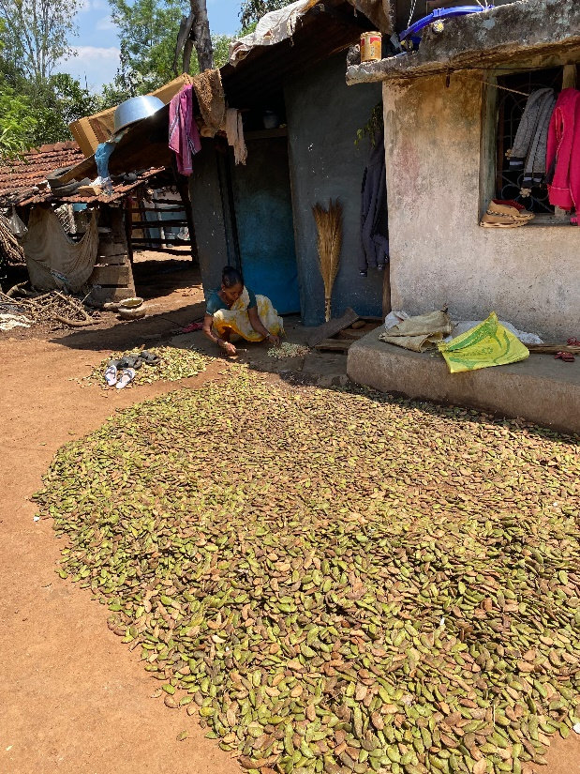
Key Information Areas
Gender Equality
Assessing the challenges faced by WOMEN FARMERS
Access to resources, technology, financial services, markets and related information on extensions and schemes – decision making and authority
Alternative sources of livelihood during the periods of unemployment between harvests.
Health and safety implication on women farmers
Representation and Participation: Representation of women among supervisors (at farm level) and workers organizations (unions and federations) ; Nature participation of women in local producer organizations' and cooperatives
Assessing the challenges faced by WOMEN FARM WORKERS
Role and Tasks undertaken
Working hours & conditions
Regularity of work
Access to legal Minimum wages (as set by law)
Disparity in wages - Wage rates and earning potential for ‘male’ vs. ‘female’ jobs - Access to legal Minimum wage (as set by law) and compensation
Any other Inequality risks and discrimination other than wage disparity
Loss of employment/reduction of income experienced by pregnant or lactating women
Nature of Harassment or abuse by farmer or farm workers - Issues faced in farms and in worker camps and Grievance Mechanism to report and handle harassment
Health and safety and associated risks - Precautions for pregnant workers
Additional facilities provided by the employer, if any - Availability and quality of crèches and allocation of Break time for child care
Access to safe and clean water and access to safe sanitary facilities in the field and in worker camps

Slide 5
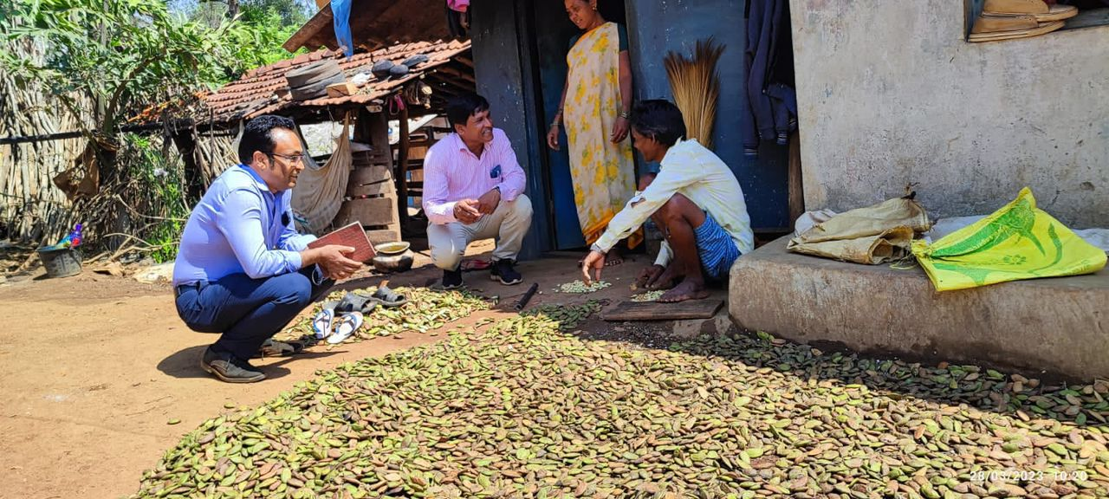
Key Information Areas
Prevalent decent working conditions guided by the international codes and standards and local legislations
Harassment and Abuse faced by male and female workers
Instances of Physical abuse or discipline, threat of physical abuse, sexual or other harassment and verbal abuse or other forms of intimidation
Instances of sexual harassment including threats of such acts, coercion or arbitrary deprivation of liberty etc
Existing grievance redressal systems
Grievance Redressal mechanism and its effectiveness
Freedom of Association and Collective bargaining

Slide 6
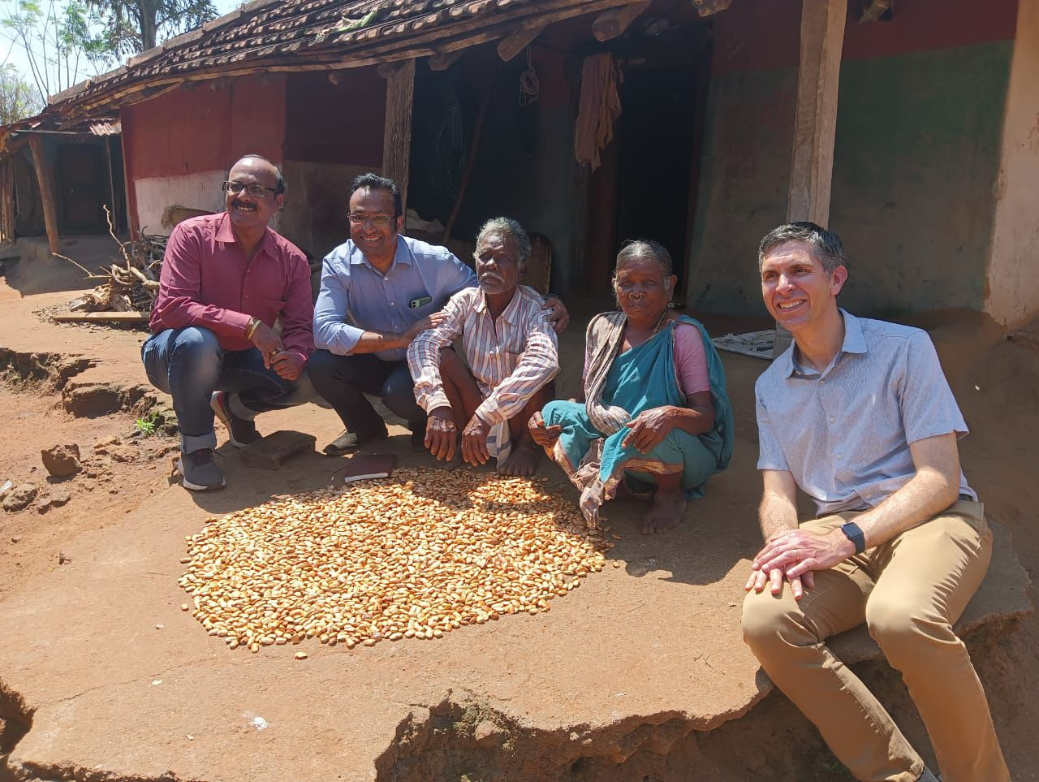
Key Information Areas
Farmer Livelihood
Assess the average net income levels of the participating farmers
Contribution of income from agriculture to the total household income to understand the dependency on cultivation.
Gaps in Living income
Access to various government entitlement : No resource centre or hand holding support
Digital inclusion

Slide 7
Thank you
www.askindia.org/ask/
V-30/3
DLF Phase III, Gurugram, Haryana – 122002, India
ask@askindia.org
+91 124 4060353 / 54

