Slide 1
Why and How to Measure Biodiversity Gain in Food Supply Chains?
Jordi Domingo Calabuig
June 4th 2024, Oxford

Slide 2
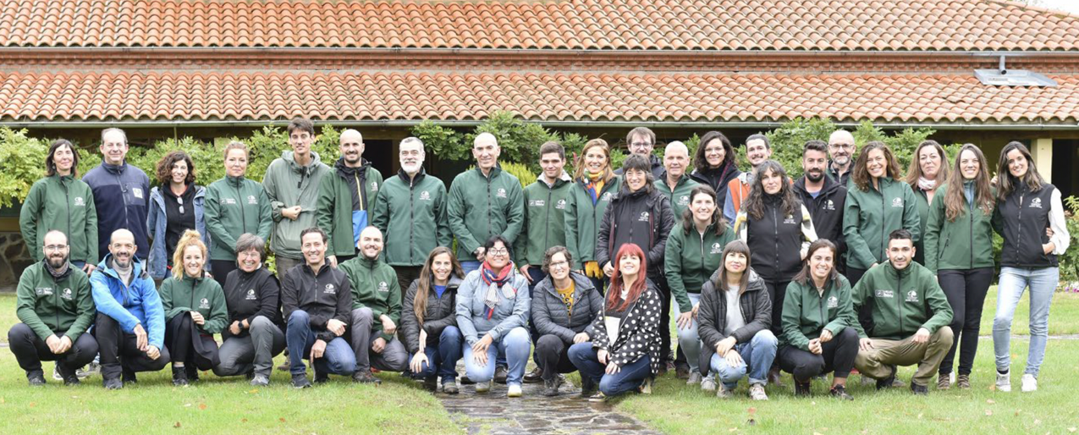
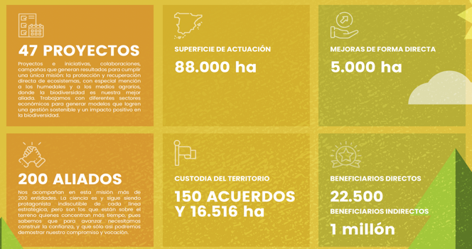
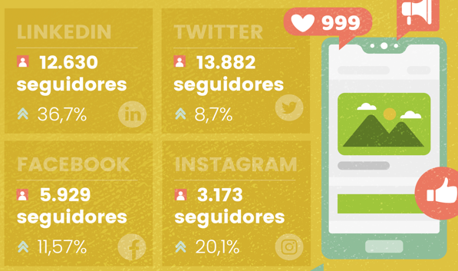
31 years working for biodiversity conservation!
Notes:
… and happy to work everyday in places like these ones…

Slide 3
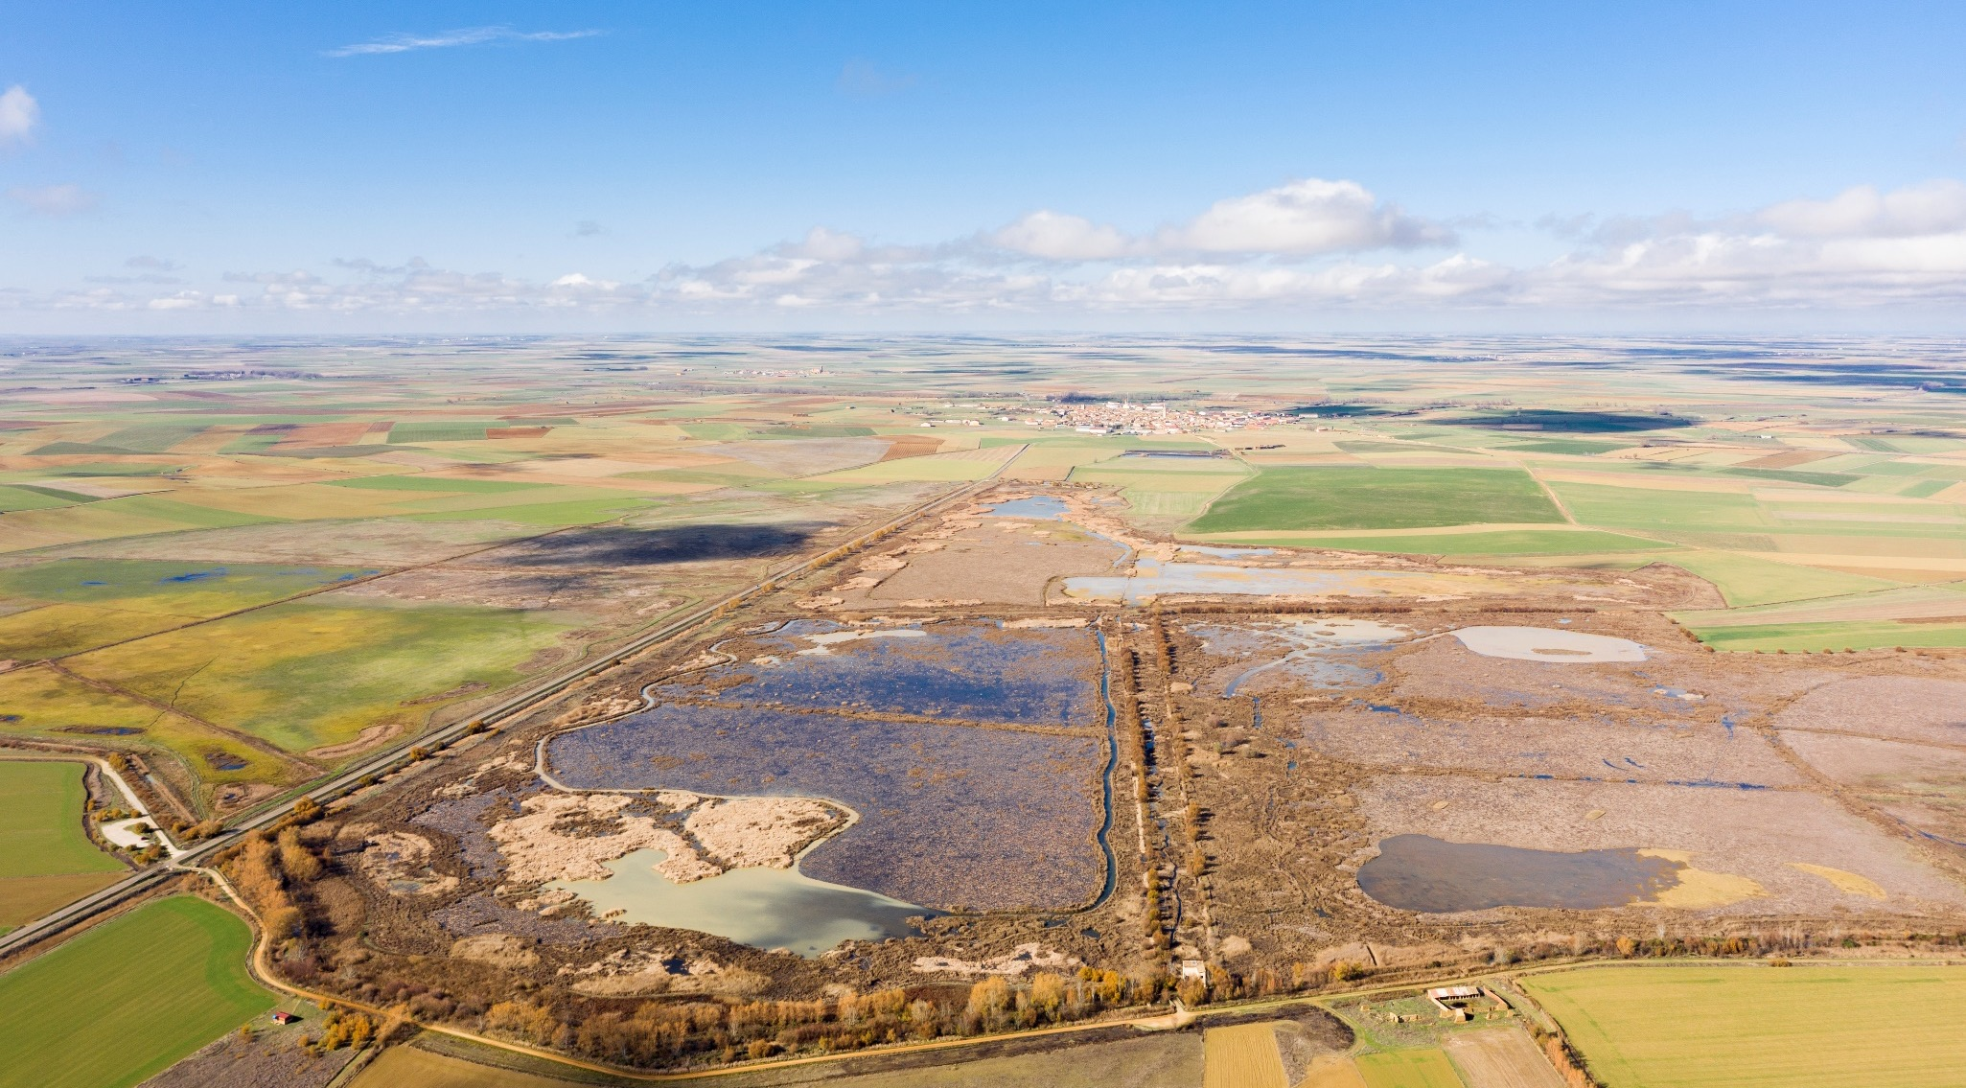

Slide 4
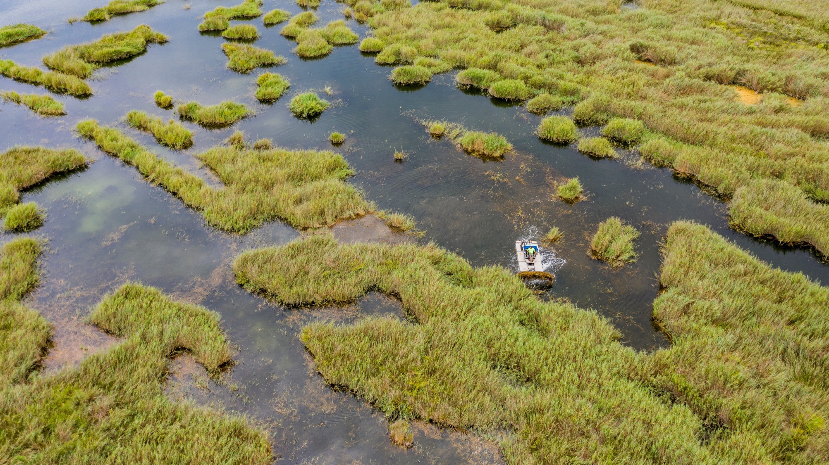

Slide 5
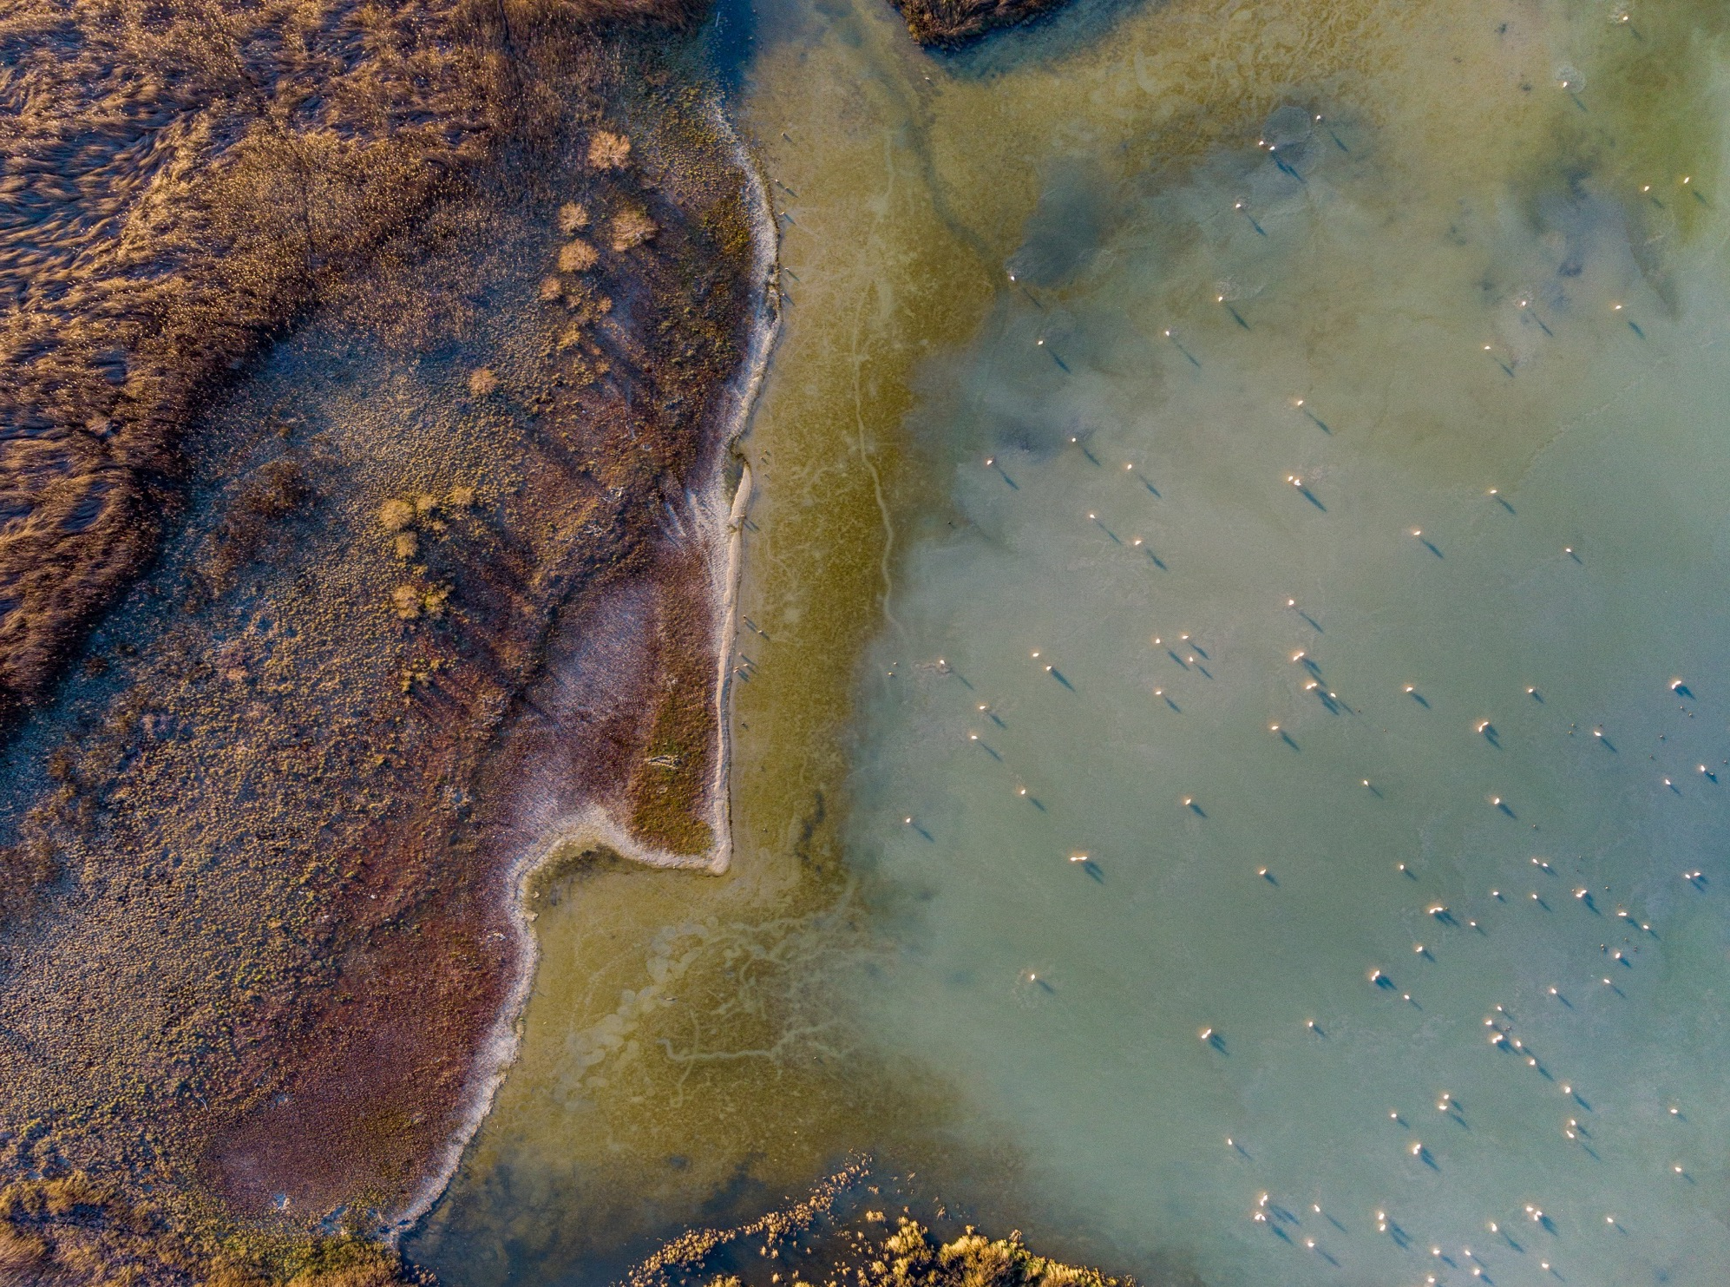

Slide 6
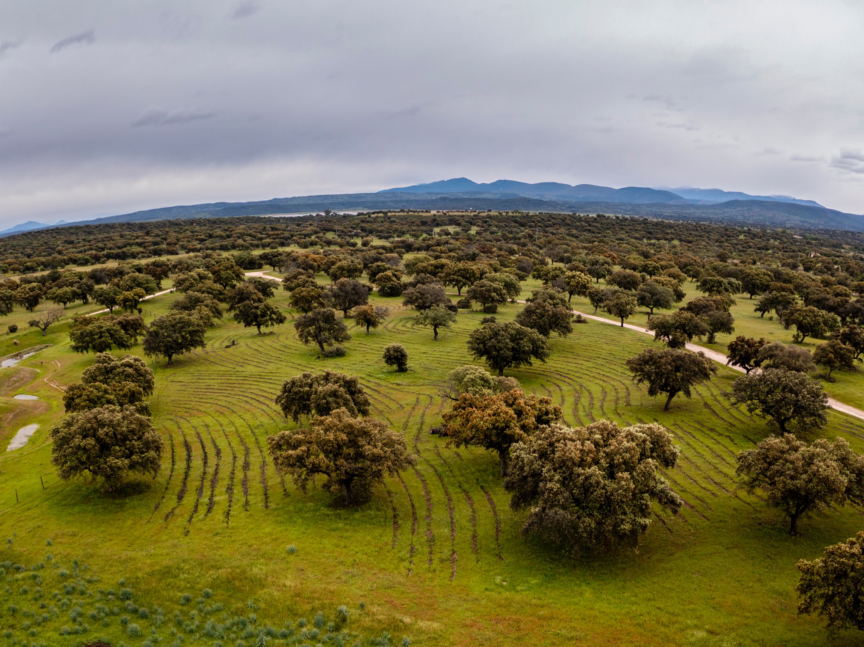

Slide 7
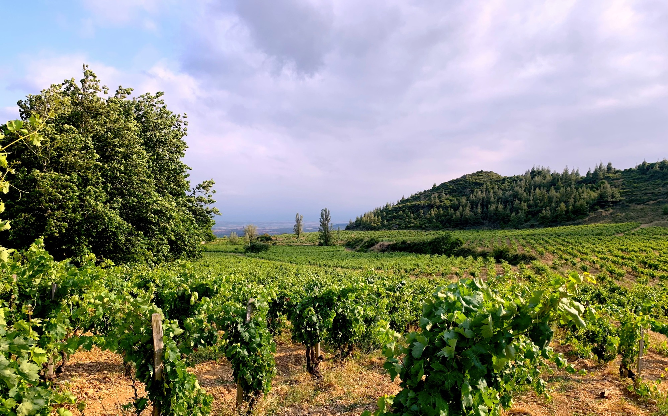

Slide 8
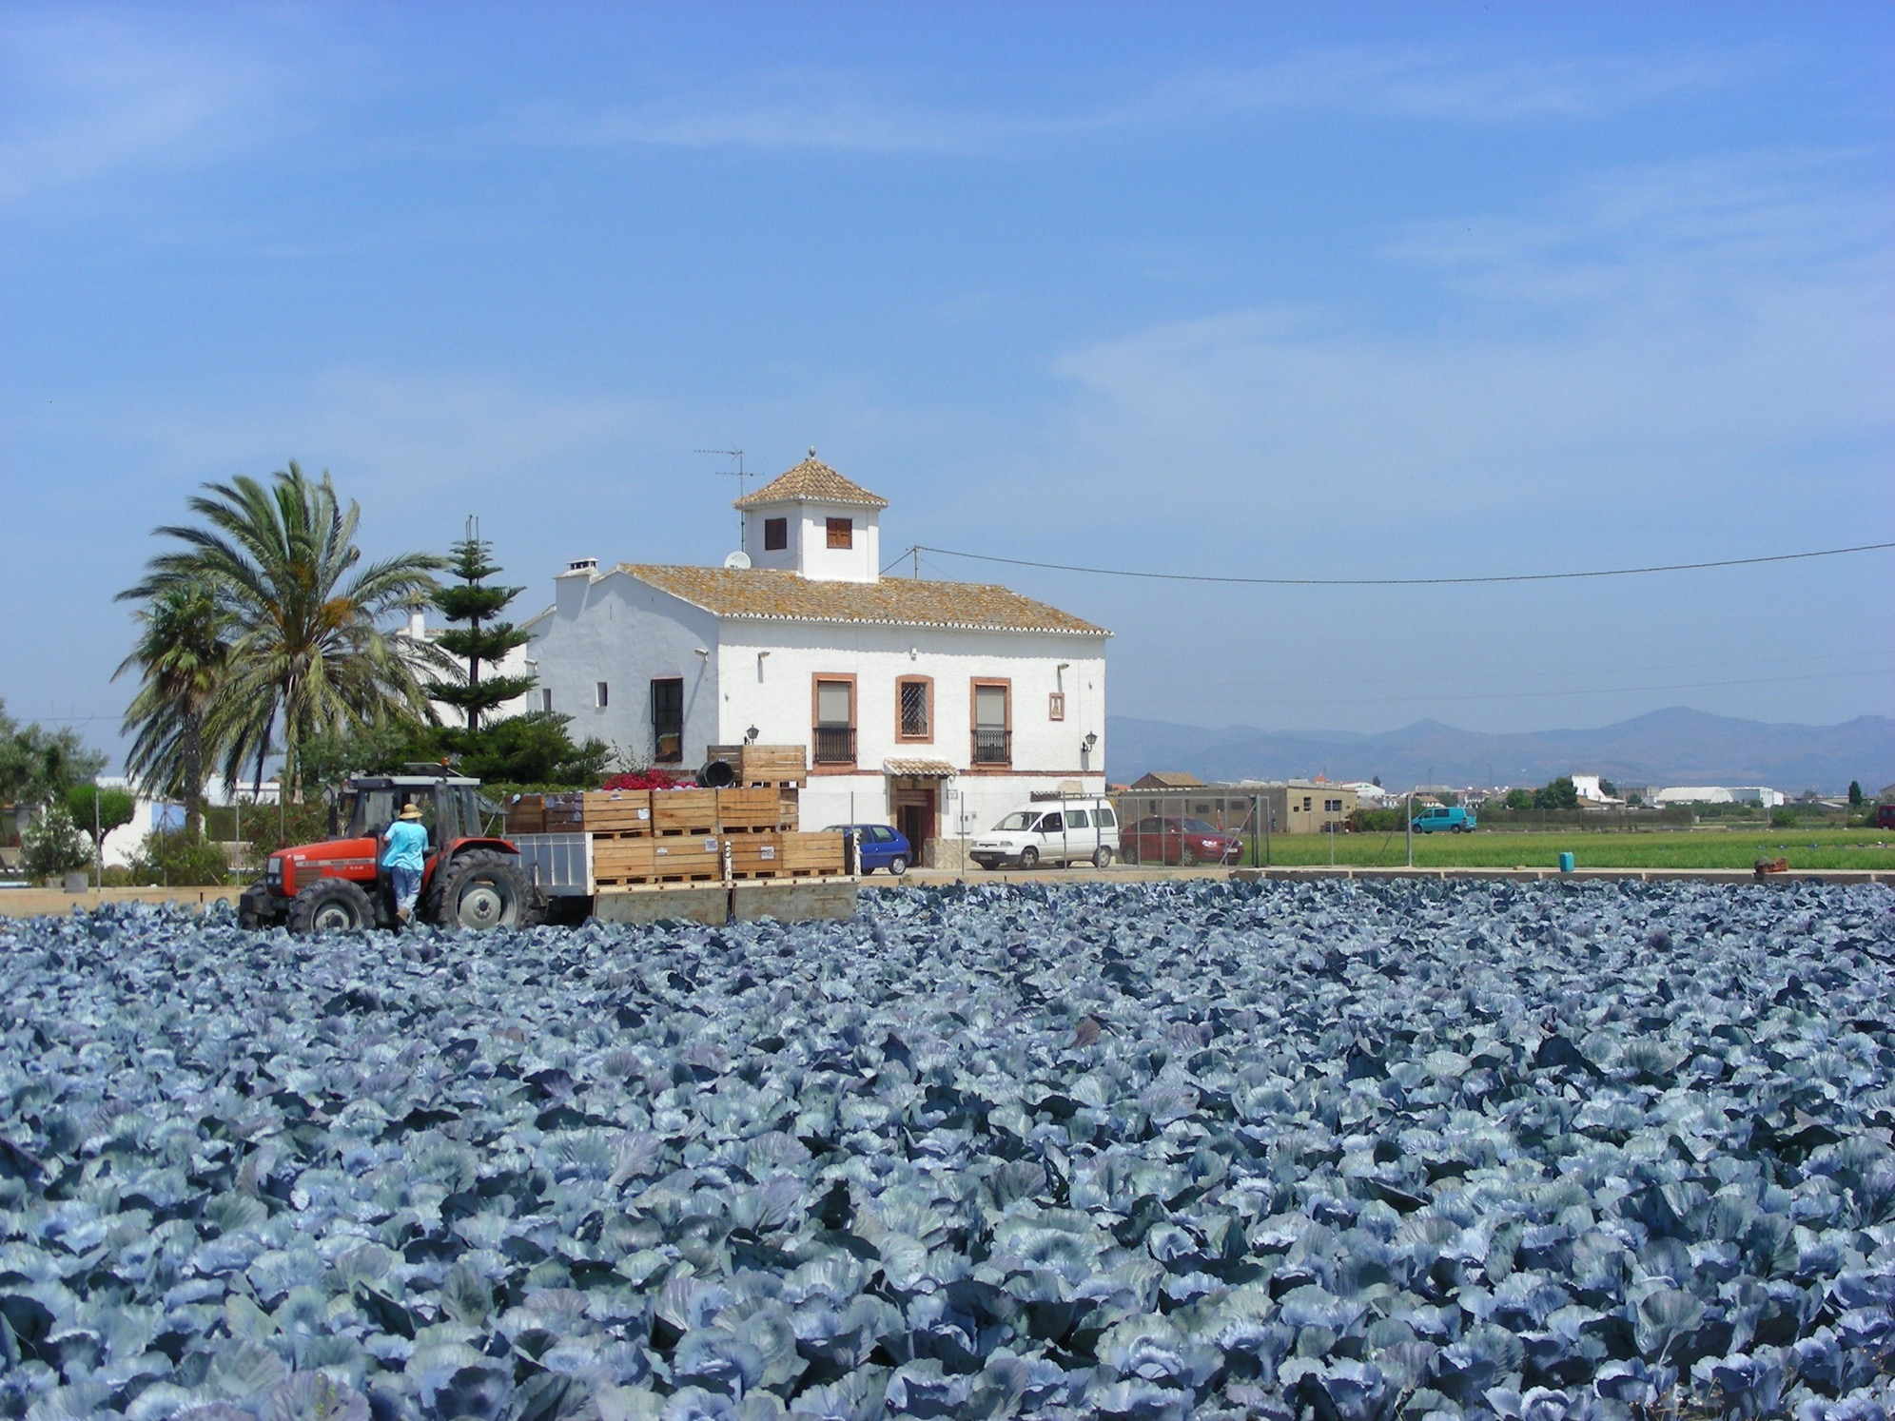
Notes:
Where our goal is improving biodiversity

Slide 9
However, we find ourselves in the endless loop of biodiversity
We prescribe...
to achieve…
Better water retention
Soil covered
Hedgerows
More enzymatic activity
Organic matter
More birds
No tillage
More microbial biomass
No pesticides
More carbon
Balanced nutrition
More pollination
But how much of “this” to achieve ”that”?
Notes:
However, when it comes to biodiversity, we tend to confuse prescriptive actions with impact. Moreover, we jump from one to the other because basically we are not good at measuring what we do. For exmaple, we prescribe more hedgerows because they will increase the number of birds, but as we have difficulties for understanding the real gain of birds related to our intervention, we just assume that hedges are good for them and we prescribe more and more…

Slide 10
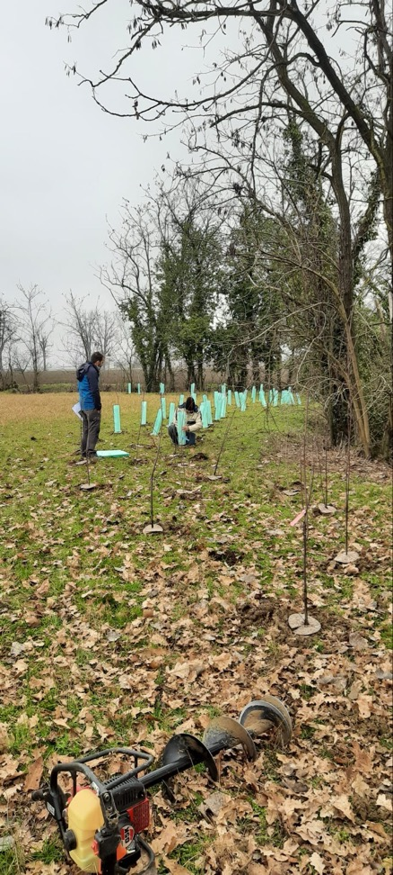
Performance indicators vs impact indicators
 | Performance indicators | Impact indicators
Effort needed | Low | Low to medium
Frequency | Regular – all measures | Regular – some measures
Information obtained | Implementation success | Benefits on biodiversity
Interest | Accumulated results Progress achieved | Trends over time Adjustment measures
Use by food companies | Becoming common | Very rare
e.g. hedgerow | No. of hectares No. of species used No. of specimens per species | Earthworm/macrofauna trends Soil microbiological activity trends Organic matter trends Pollinators and bird trends
We measure action implementation and potential benefits
We measure the real impact on biodiversity
Notes:
Impact monitoring is not new, but companies don’t use impact indicators for several reasons: it is something related to a very mature ESG position, it is more expensive, they don’t feel they are responsible for this… …but the lack of biodiversity units means also uncertainty for investment

Slide 11
Towards a new standardized methodology for measuring biodiversity gain
QUANTIFIABLE
COMPARABLE
VERIFIABLE
CPI-like approach
Units of biodiversity
Landscape
Fungi
Soil bacteria
Arthropods
Flora
Pollinators
Birds
Mammals
Above ground mesofauna
…
Basket of Metrics
Notes:
And money does not like uncertainty

Slide 12
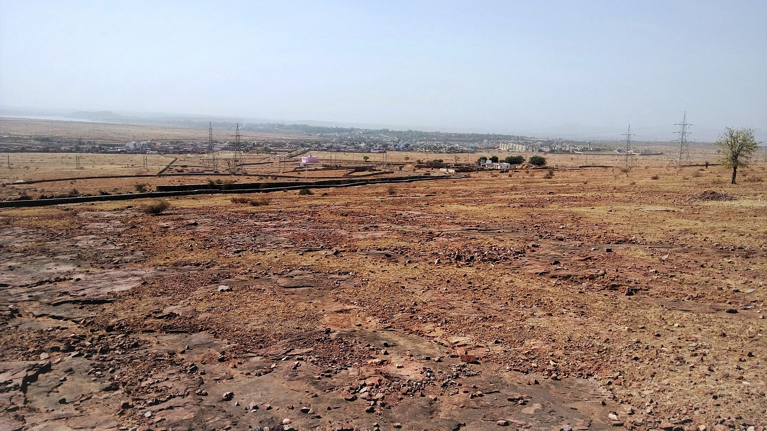
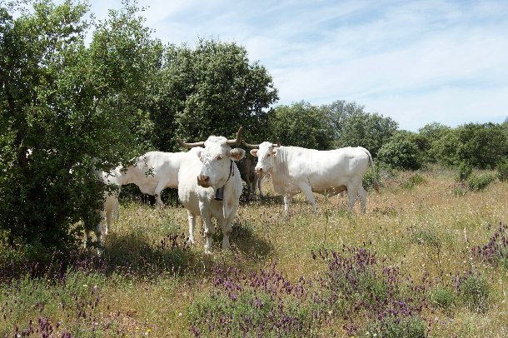
Basket of metrics and Biodiversity unit
BASKET OF METRICS
LANDSCAPE
SOIL QUALITY
FLORA
GENERAL ARTHROPODS
POLLINATORS
control
(%)
(%)
X (%) /Ha
=
X BIODIVERSITY UNITS/ha
(%)
restored
(%)
(%)
µ (%)
The basket of metrics might vary per situation, but needs to remain meaningful and constant for the same situation

Slide 13
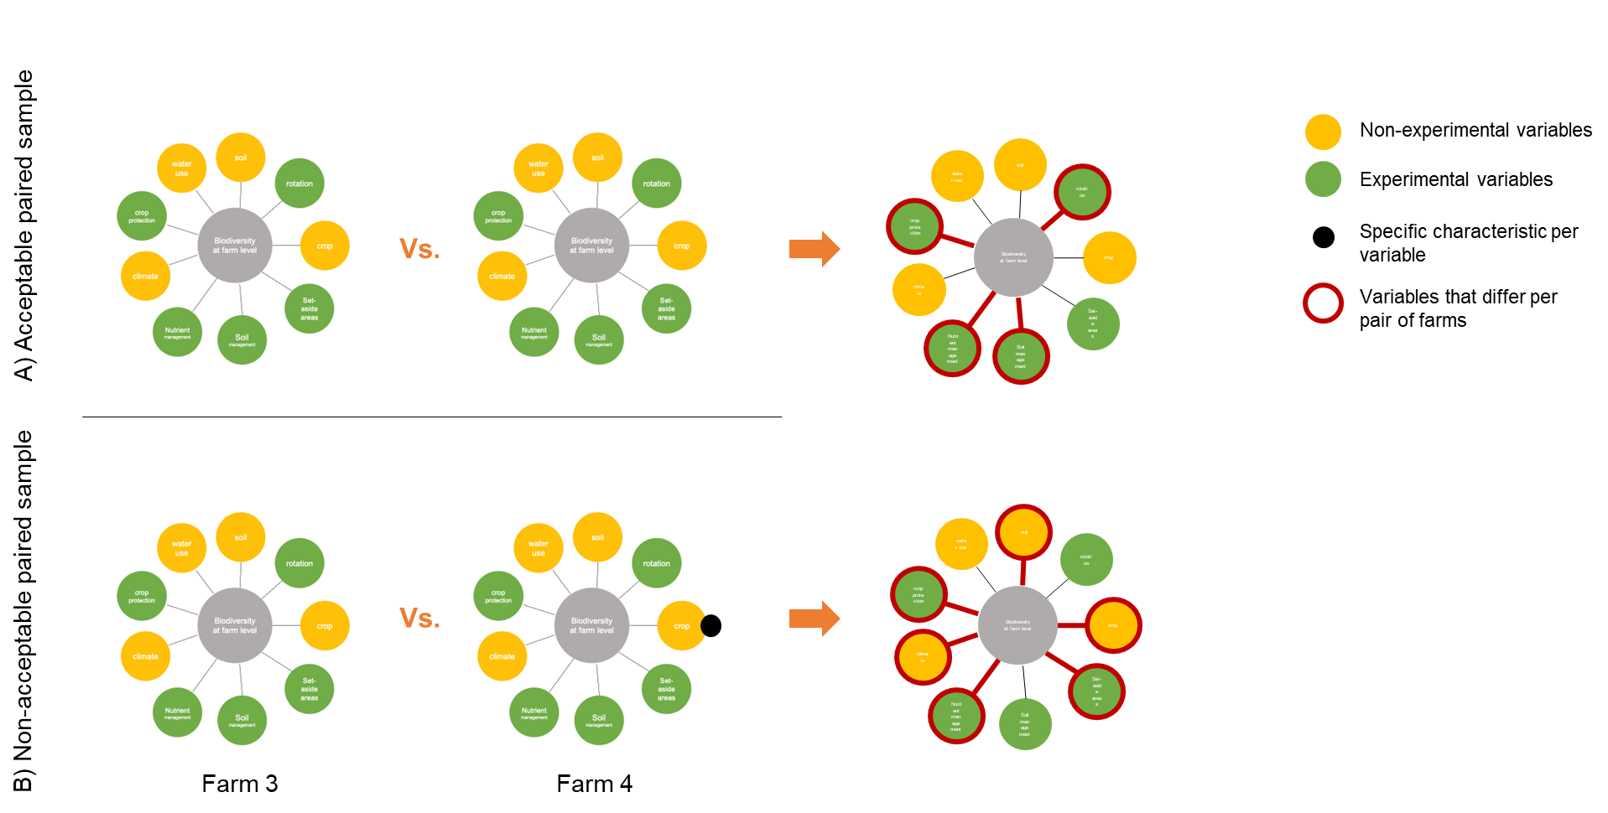
Importance of experimental design
QUANTIFIABLE
COMPARABLE
VERIFIABLE
control
restored

Slide 14
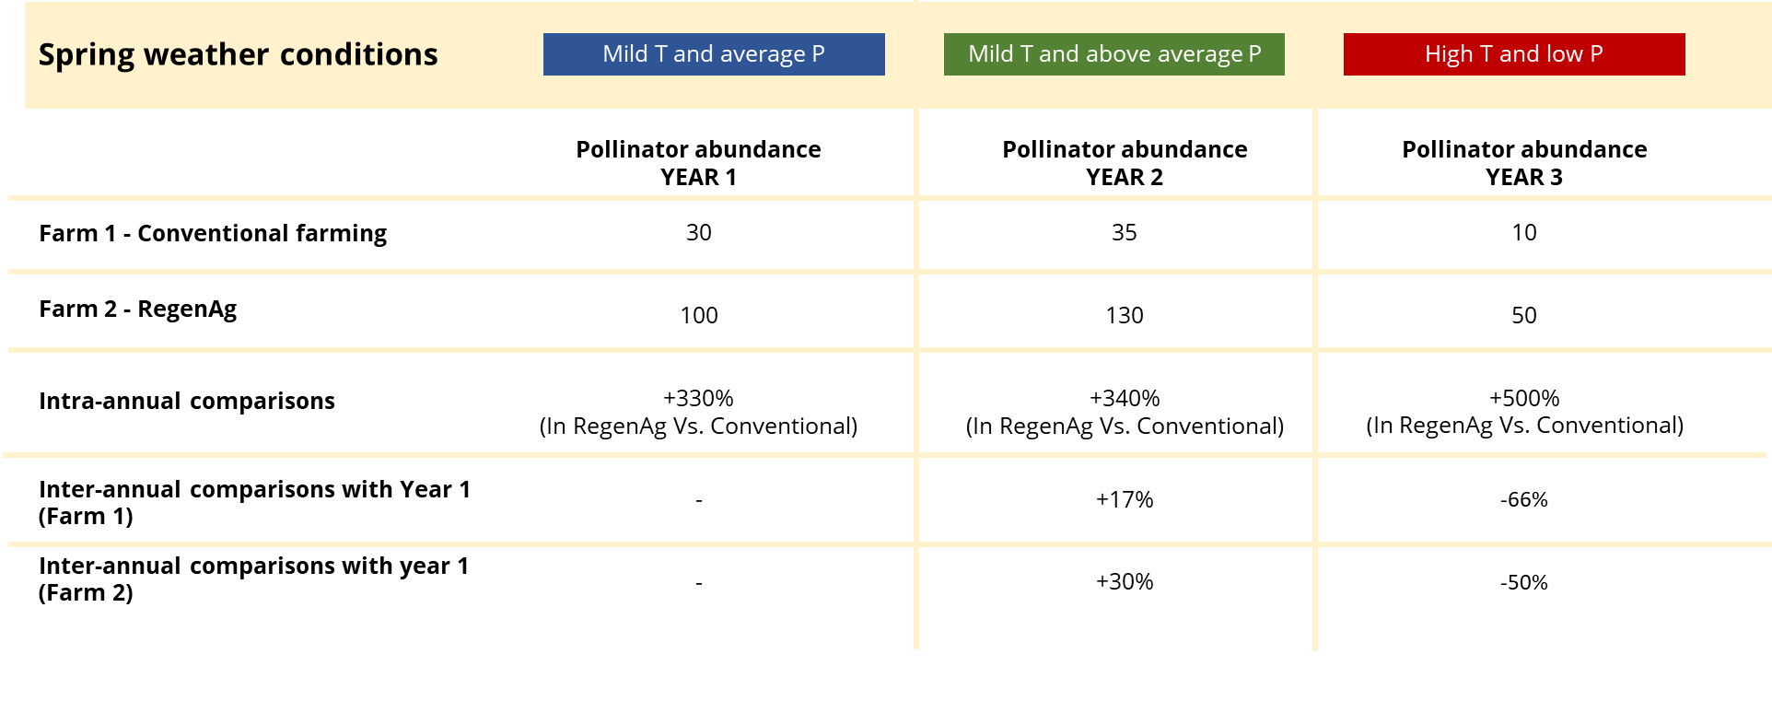
Importance of experimental design
QUANTIFIABLE
COMPARABLE
VERIFIABLE

Slide 15
An example: restoration project in a farm
QUANTIFIABLE
COMPARABLE
VERIFIABLE
Interventions
Soil covered +10 months
30% reduction pesticides
Phase out herbicides
5% farm with ecological infrastructures
Basket of metrics
Soil biodiversity
Pollinators
Flora
Arthropods
Nesting birds
Methodology used
DNA barcoding
Pollinator traps
Flora counting
Arthropods vaccum
Automatic audio recording
Evidence
GIS-referenced data
DNA report
High-res pics
Preserved specimens
Audio records
Metrics
(diversity index)
Richness
Abundance
Interest
Vm = (AIR)^(1/3)
One single unit
experimental design
Measured farm + control plot/farm for 3 years
Intra-annual comparison! (measured in %: 1% = 1 biodiversity unit)
If we come up with a standardized unit of measurement for biodiversity, do we reduce the uncertainty for biodiversity investment?
average biodiversity gain / year
Money does not like uncertainty!
average biodiversity gain for the 3 years

