Slide 1
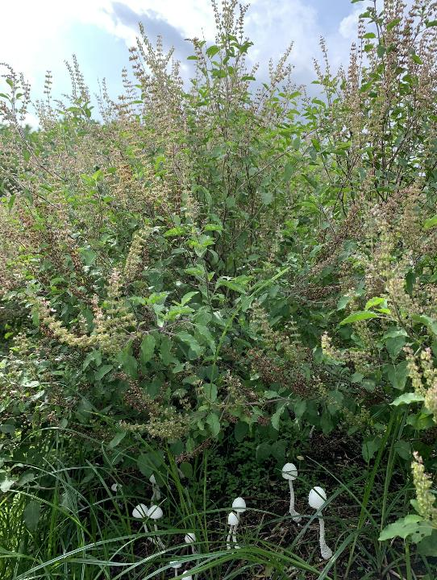
Regenerative Agriculture
Regenerative
Life
Notes:
Introduce the theme of the presentation. Emphasize that healing begins in the soil and ends with human health.

Slide 2
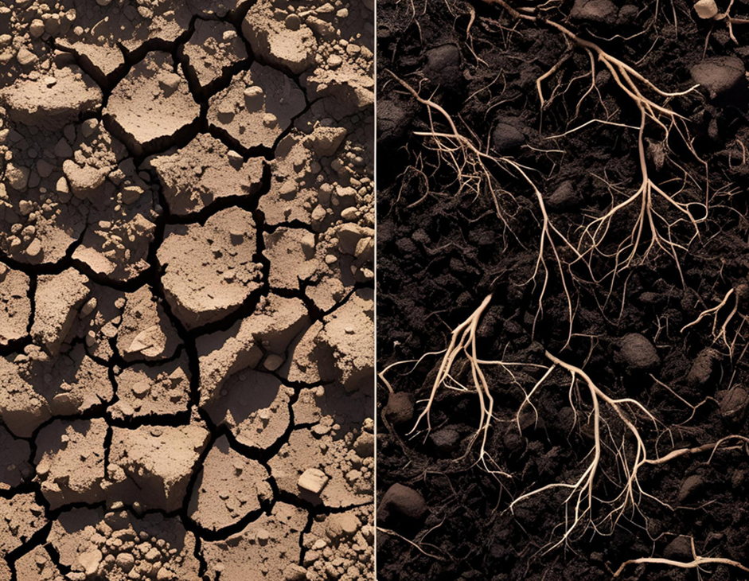
Dirt Minerals Sand, Silt and Clay Boulders and rocks. | Soil Minerals Sand, Silt and Clay Boulders and rocks Organic Matter Microbiology (Specially Aerobic)
Notes:
Connect to practices on your medicinal herb farm. Mention specific actions taken.

Slide 3
What is the Soil Food Web?
Community of soil organisms (Soil Biome)
Includes bacteria, fungi, protozoa, nematodes, microarthropods, earthworms and others.
Drives nutrient cycling and plant health
Notes:
Use a diagram of the soil food web. Emphasize the interactions between soil organisms and their role in ecosystem balance.

Slide 4
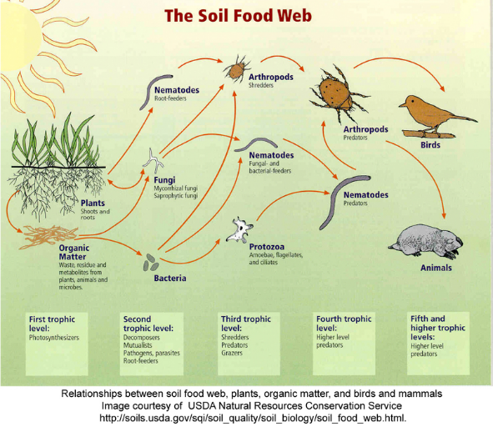
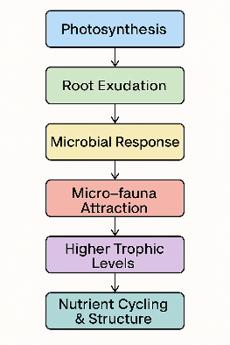
How does the Soil Food Web function?
Notes:
Use a diagram of the soil food web. Emphasize the interactions between soil organisms and their role in ecosystem balance.

Slide 5
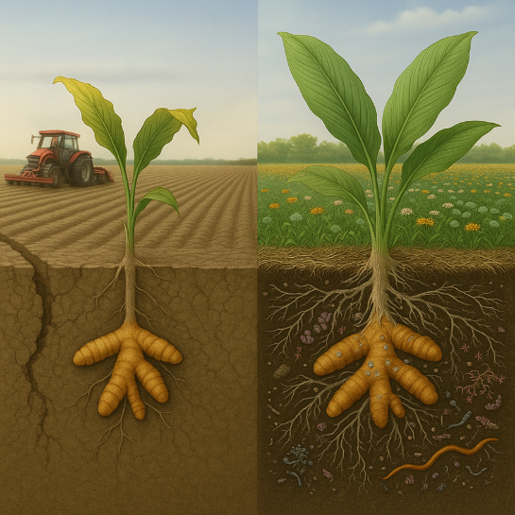
What breaks it down?
Synthetic or excessive use of fertilizers and pesticides
Tillage and soil disturbance
Bare soil
Low organic matter
Lack of diversity
Notes:
Relate to conventional practices. Explain how they disrupt microbial balance and structure.

Slide 6
How Do We Rebuild the Soil Food Web?
ASSESSMENT OF THE SOIL FOOD WEB AND FARM PRACTICES
DEVELOP A BIOLOGICAL REGENERATION PLAN
MONITOR AND MAKE ADJUSTMENTS
Notes:
Connect to practices on your medicinal herb farm. Mention specific actions taken.

Slide 7
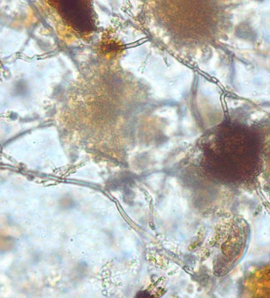
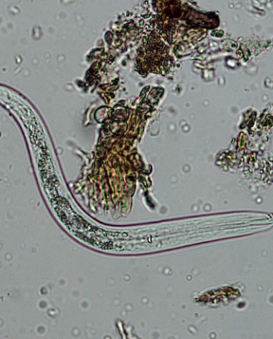
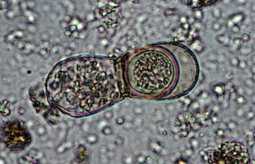
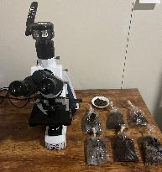
BIOLOGICAL ASSESSMENT Microscopy analysis assessment of the biomass or number of fungi, bacteria, nematodes, and protozoa in the soil and amendments to determine whether they are present in appropriate quantities.
Bacteria Feeding Nematode
Beneficial Fungi
Protozoa (Teste amoeba)

Slide 8
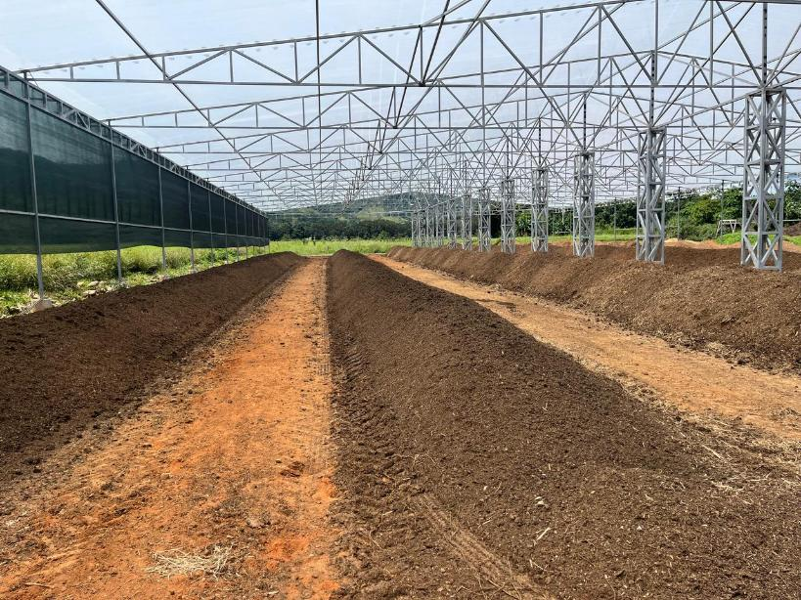
Biocomplete compost at CR Medicinal Farms

Slide 9
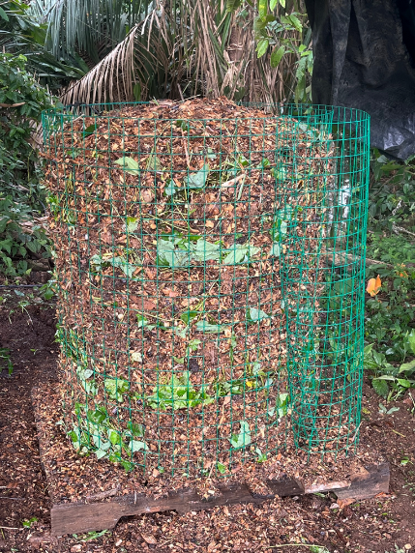
Use biocomplete compost, vermicompost, extracts and compost teas

Slide 10
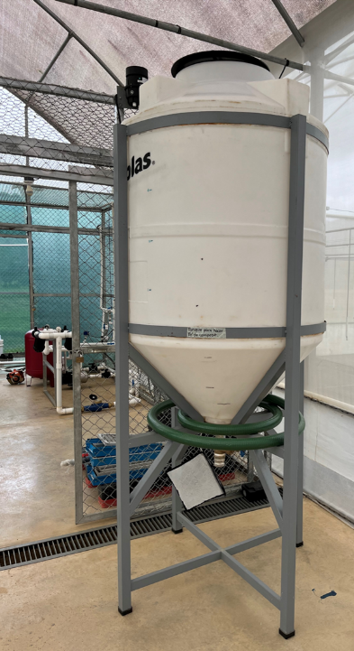
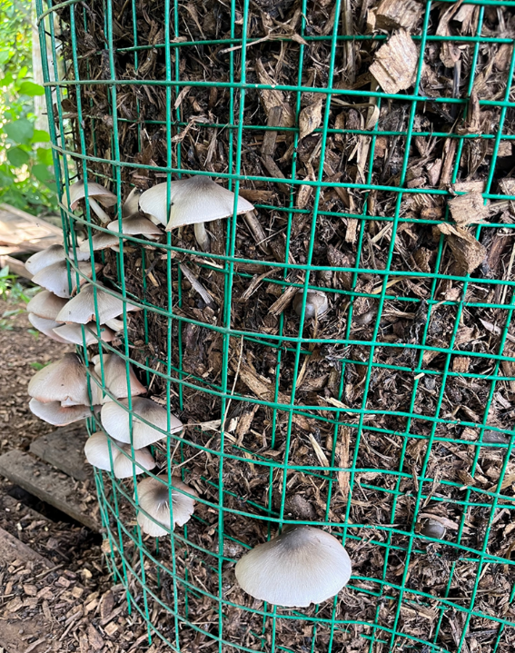
Use biocomplete compost, vermicompost, extracts and compost teas

Slide 11
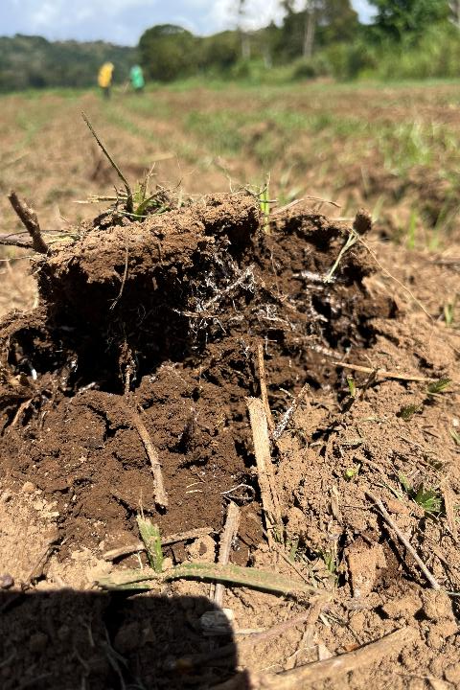
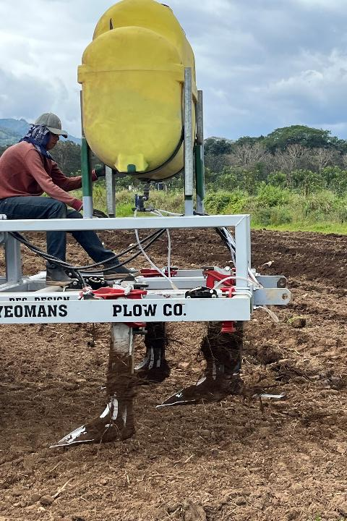

Slide 12
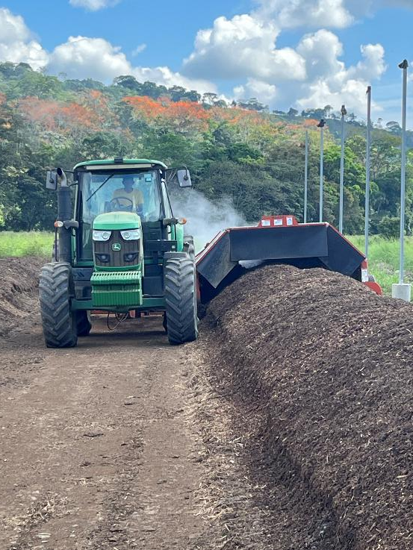
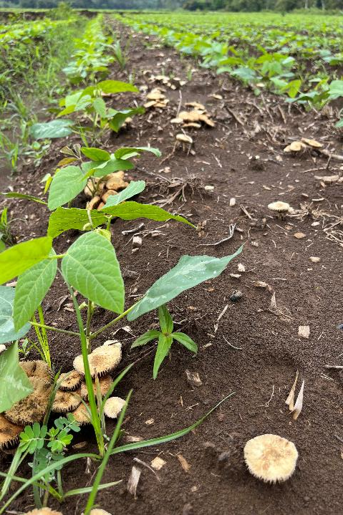

Slide 13
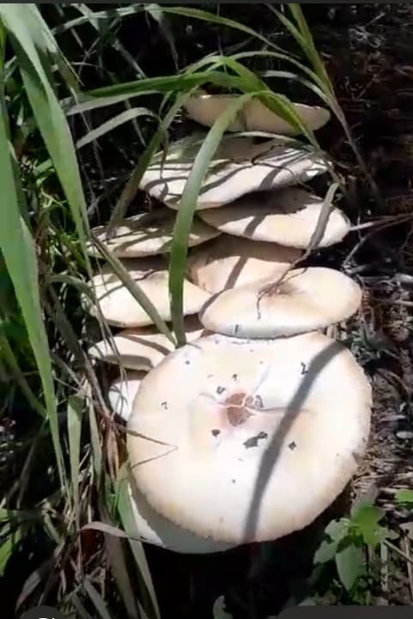
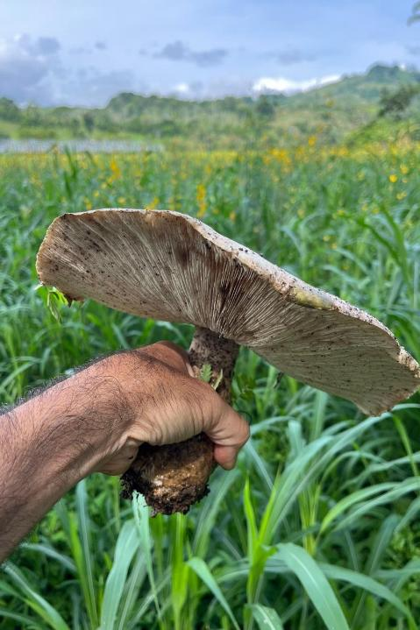
Fungal Biodiversity at CR Medicinal Farms

Slide 14
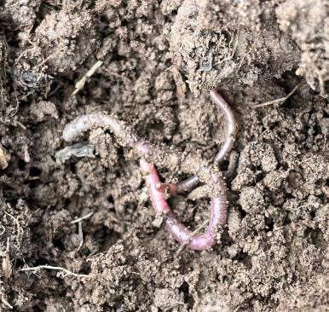

Slide 15
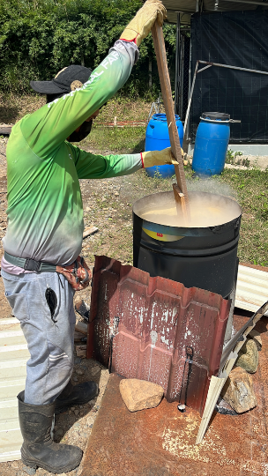
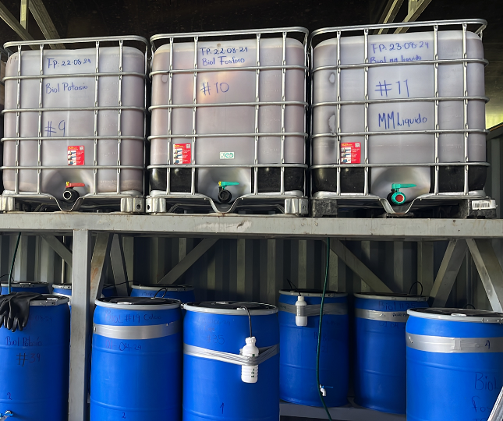
Support the system with balanced quantities of nutrition and bio stimulants and natural phytosanitary methods
Calcium + Sulfur
MM and Bioferments with P, K, S, Ca, B, Zn, Mg

Slide 16
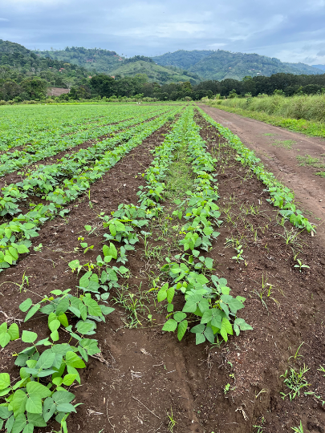
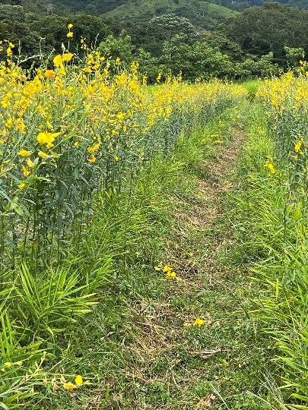
Companion planting at CR Medicinal Farms
Crotalaria juncea and Ginger
Mucuna pruriensand Ginger

Slide 17
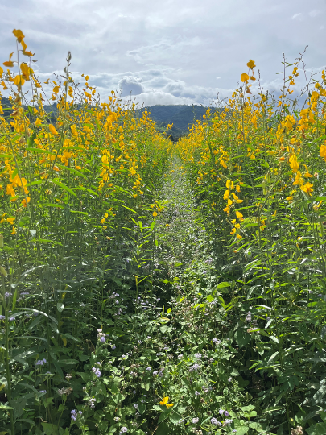
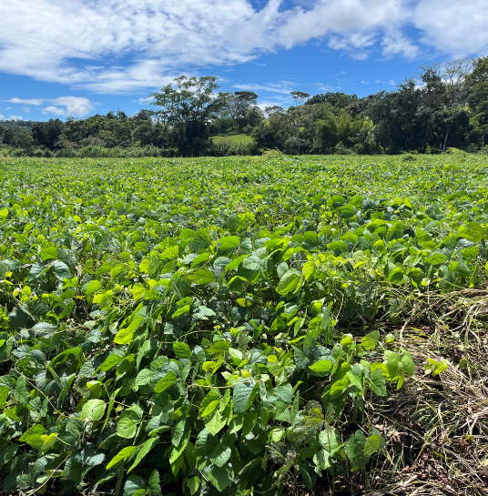
Cover crops and mulching at CR Medicinal Farms
Crotalaria juncea
Mucuna pruriens

Slide 18
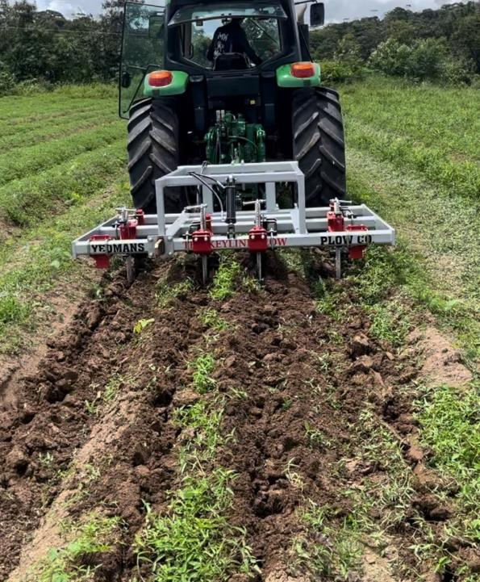
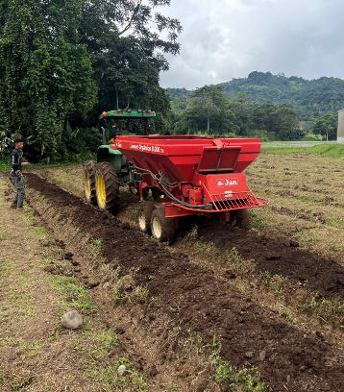
Reduce soil disturbance

Slide 19
Benefits to the Soil
Facilitate Nutrient Cycling
Increases Water Holding Capacity
Improves Soil Structure
Prevents soil erosion
Notes:
Use visuals like sponge analogies or before/after photos. Mention direct observations on the farm.

Slide 20
How Protozoa Feed Plants Through the Soil Food Web
Facilitate Nutrient Cycling
Metric | Value
Bacteria eaten per protozoan/day | 10,000
Nitrogen released per protozoan/day | ~8,000
Protozoa per gram of healthy soil | 50,000
Bacteria consumed per gram/day | 500,000,000
Nitrogen released per gram/day | 400,000,000
1. Bacteria (C:N ratio = 5:1) ↓ 2. Protozoa (C:N ratio = 30:1) - Needs to eat 6 bacteria to meet its carbon requirement - Gains 30 Carbon, but gets 6 Nitrogen (only needs 1) - Releases 5 Nitrogen as ammonium (NH₄⁺) ↓ 3. Plant - Absorbs ammonium for growth
Healthy soils naturally feed plants through microbial interactions—no synthetic fertilizer needed.

Slide 21
Increase Water Holding Capacity, Infiltration and Distribution
Healthy soils rich in organic carbon and microbes, form stable aggregates, improved porosity, infiltration, and water storage.
Change in the capacity of soil to store water (liters/ha) with changes in levels of soil organic Carbon to 30cm soil Depth. Bulk density 1,2 g/cm3
Healthy Soil vrs Dirt
Change in Organic Carbon level in soil | Extra water (liters/ha)
1% | 144.000
2% | 288.000
3% | 432.000
4% | 576.000

Slide 22
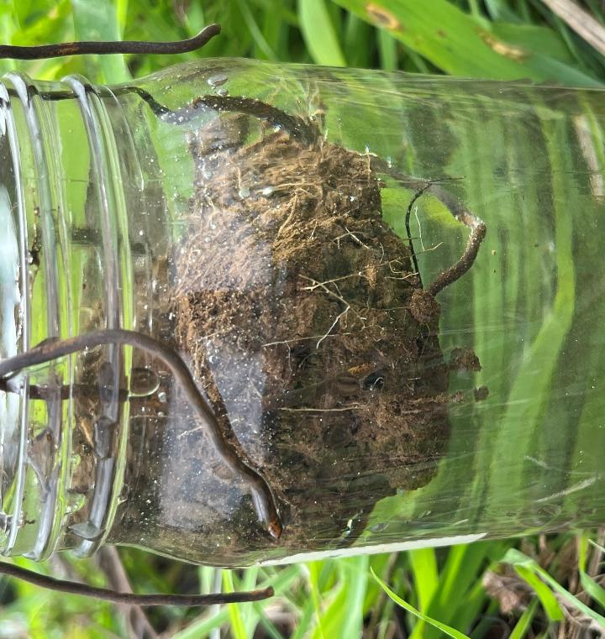
Improves Soil Structure
Fungi (especially mycorrhizal) and bacteria produce glomalin and polysaccharides that bind soil particles into aggregates.
Stable aggregates are more resistant to:
Wind erosion (because particles don’t blow away easily)
Water erosion (because aggregates resist disintegration from raindrop impact)
Notes:
Explain plant benefits using simple terms. Use photos or test results if available.

Slide 23
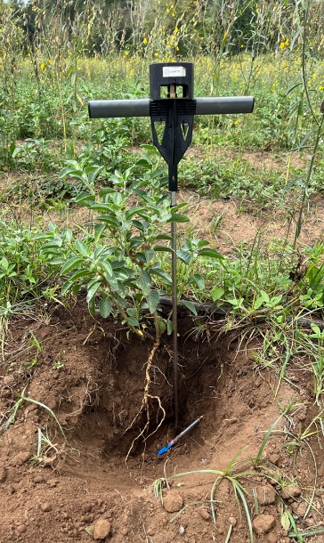
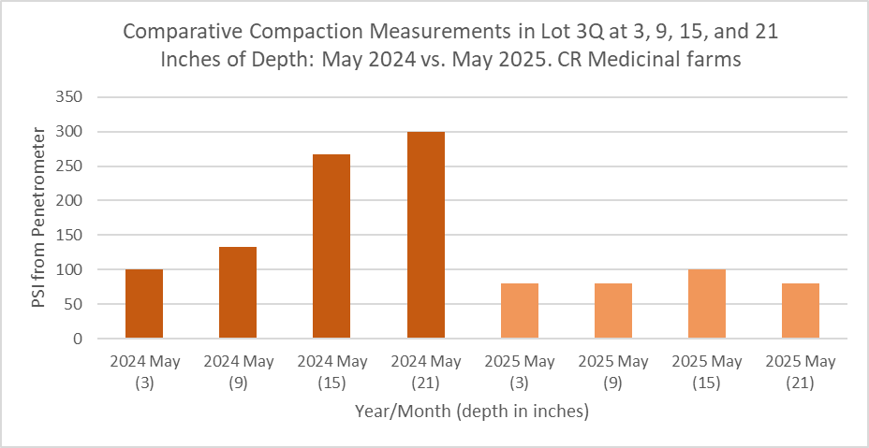
Improves Soil Structure
The soil food web replaces mechanical tillage with biological tillage, keeping the soil loose, porous, and structurally stable without damage.
Notes:
Explain plant benefits using simple terms. Use photos or test results if available.

Slide 24
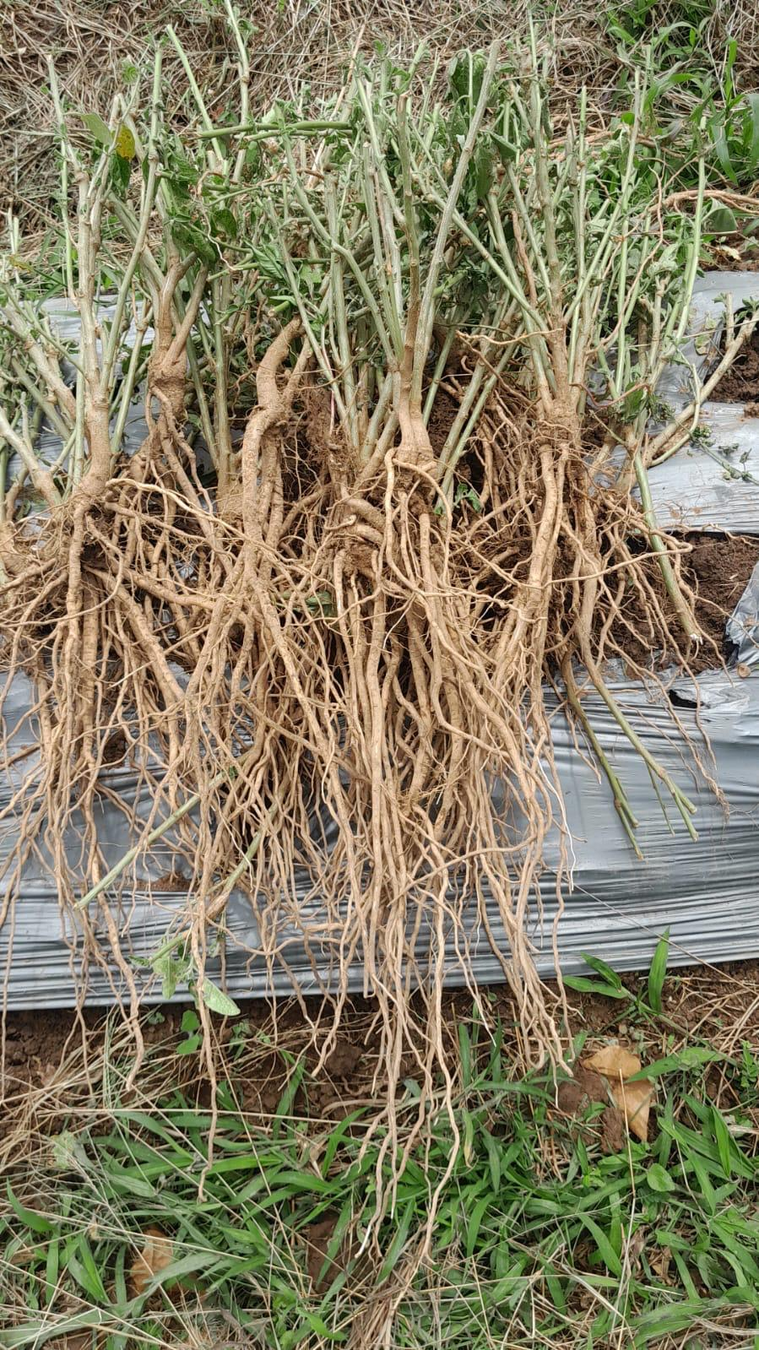
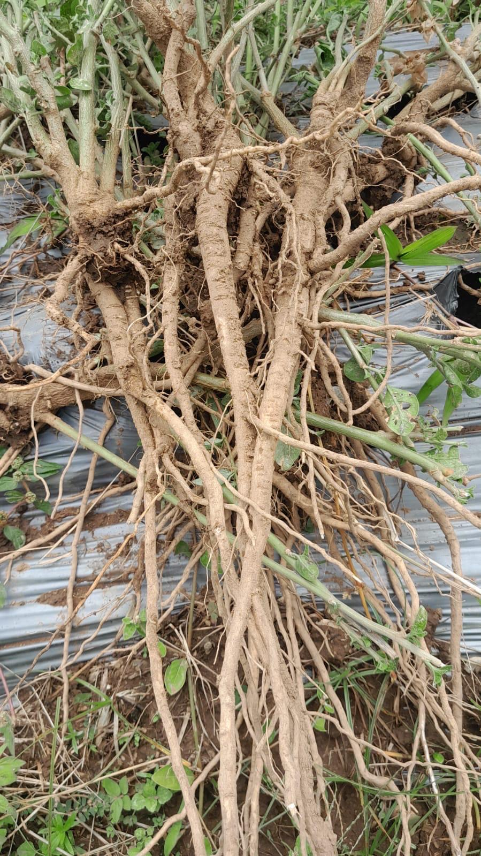

Slide 25
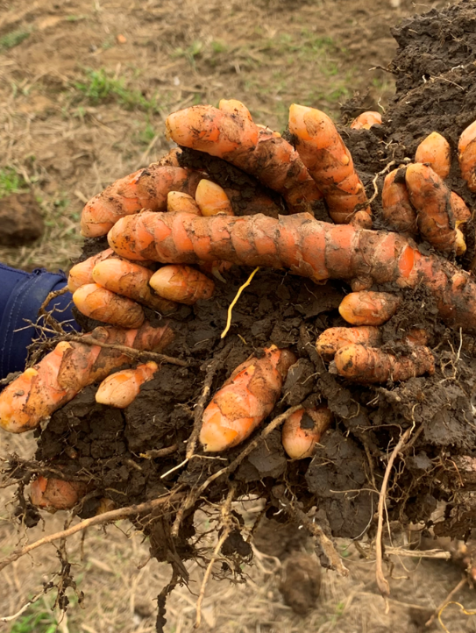
Impact of Soil Food Web on Plants
Increased nutrient density
Increase biomass
Increase Resilience to Pathogens
Notes:
Explain plant benefits using simple terms. Use photos or test results if available.

Slide 26
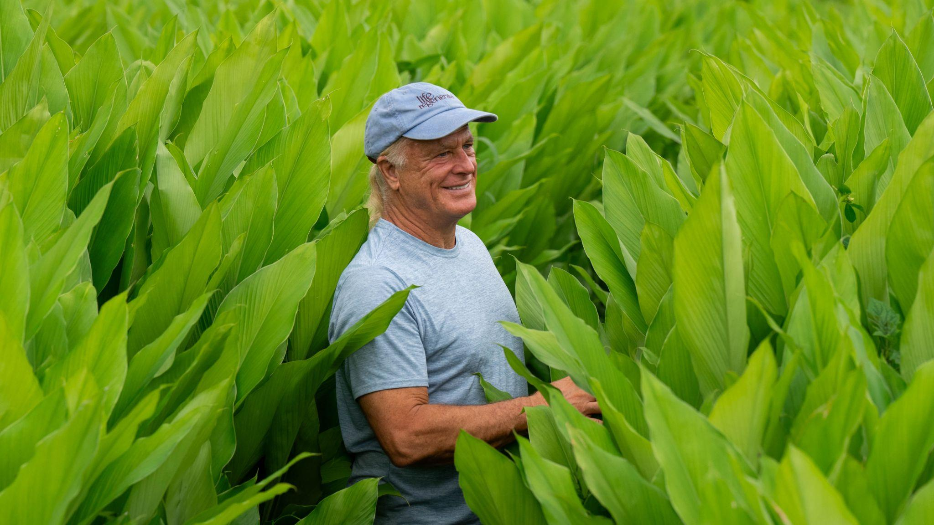

Slide 27
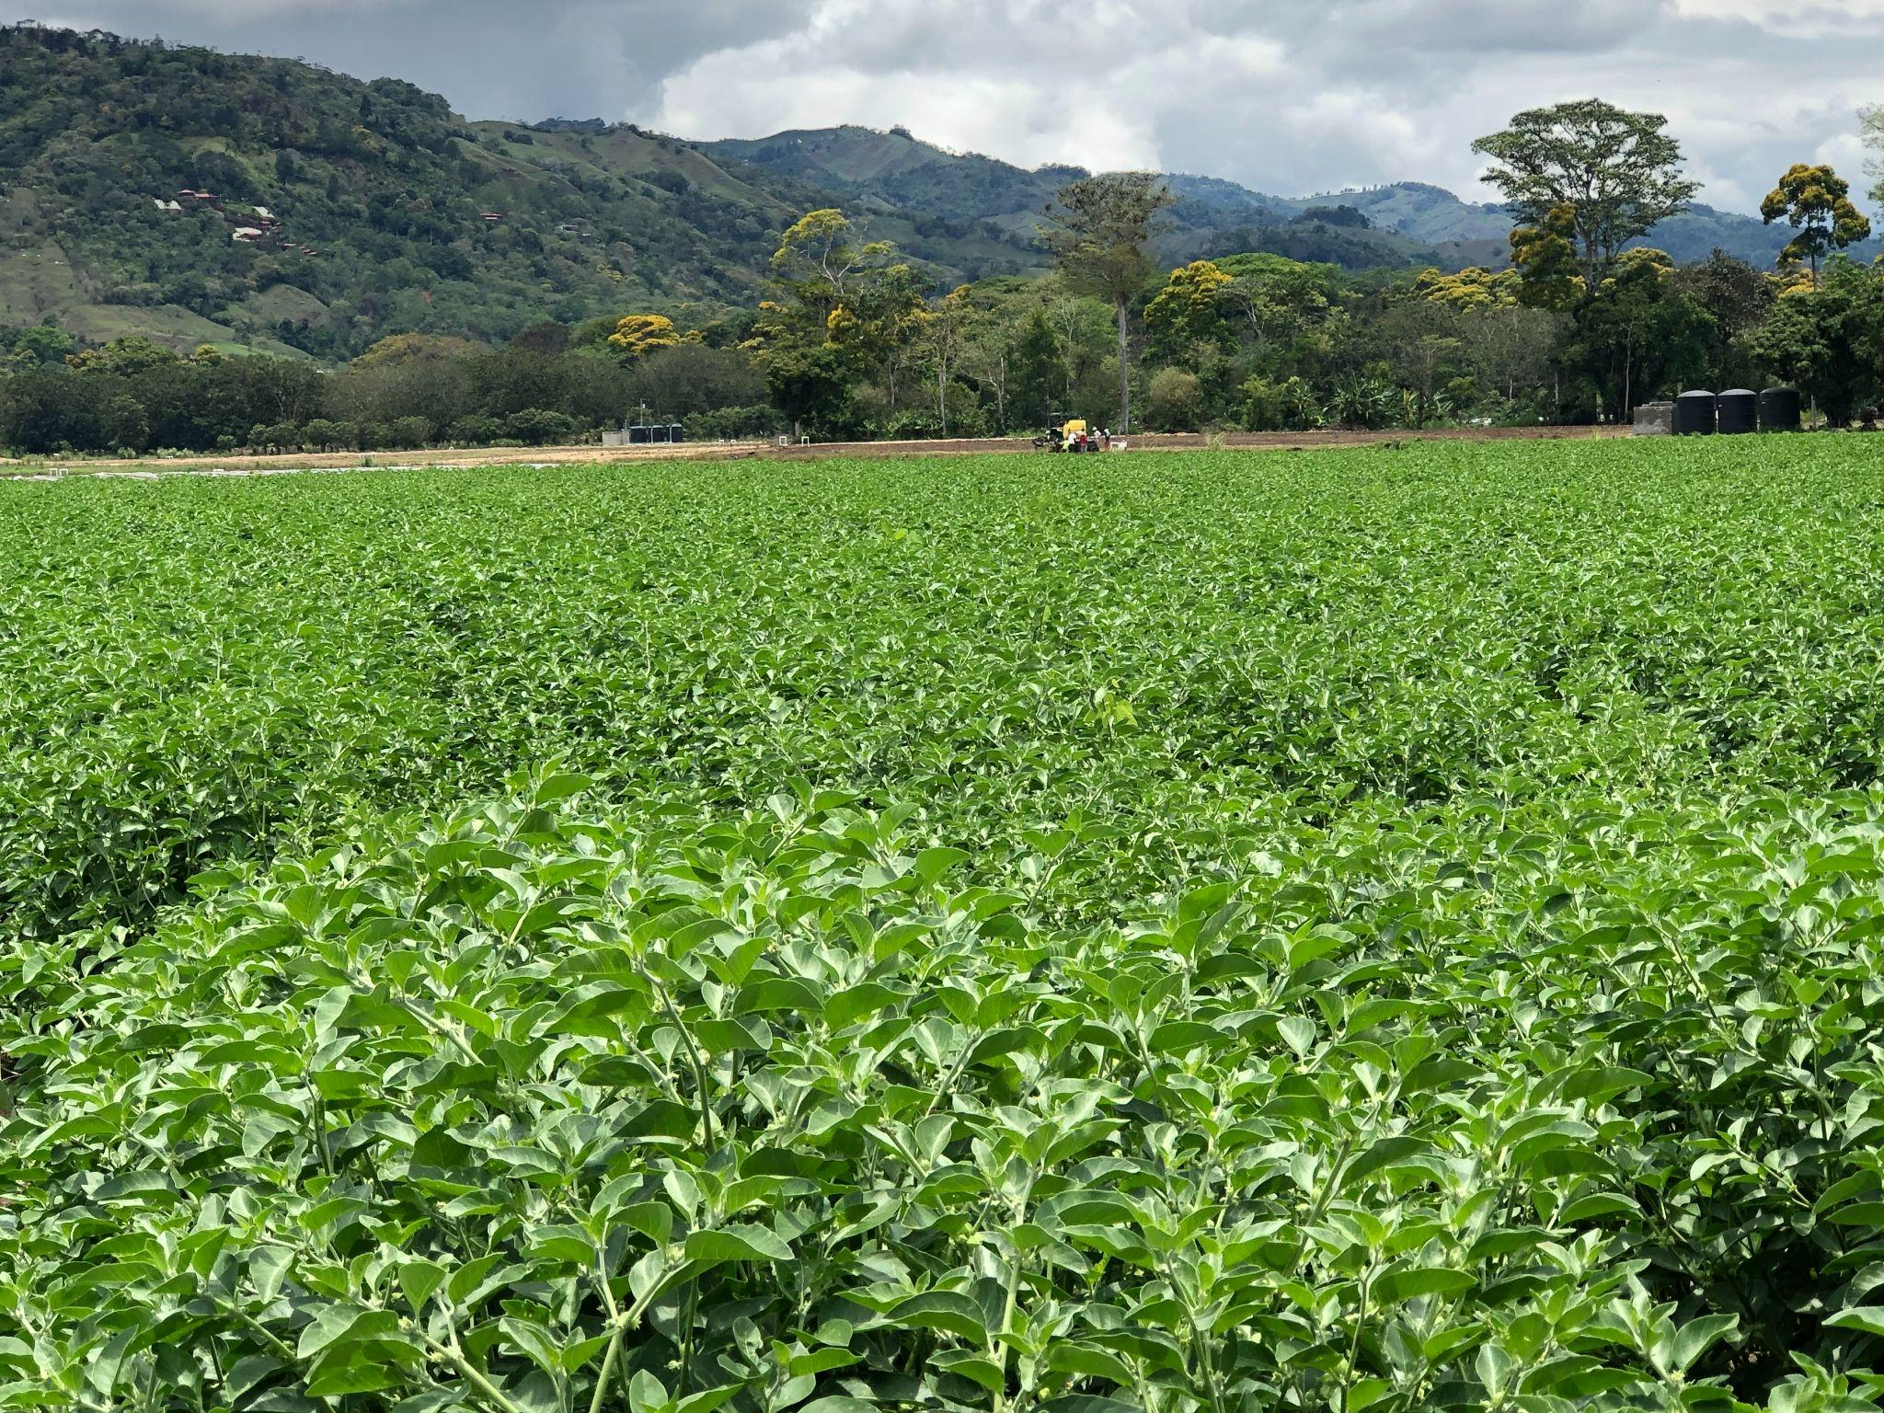

Slide 28
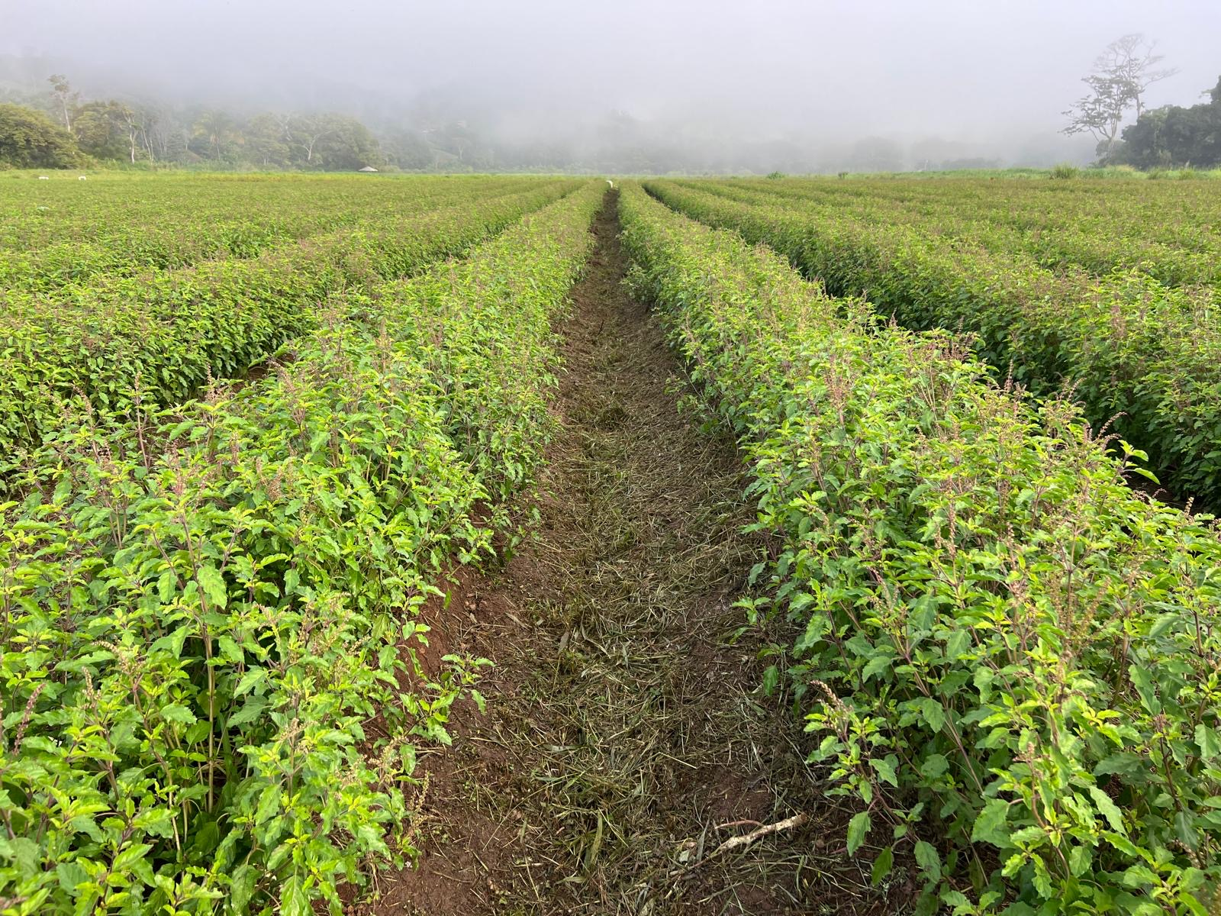

Slide 29
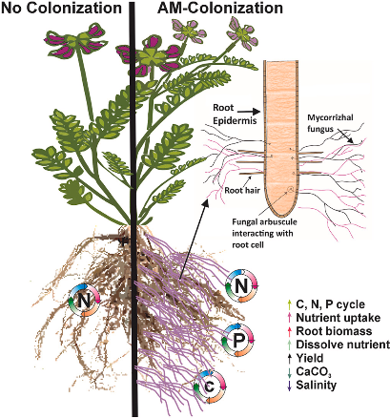
Impact of Soil Food Web on Plants Increased nutrient density
Arbuscula Mycorrhizal (AM) Fungi Root Colonization
A healthy soil food web transforms soil from a static medium into a living, nutrient-cycling engine—leading to crops that are more nutrient-dense, flavorful, and health-promoting.
Microbes unlock nutrients
Mycorrhizal fungi increase nutrient uptake from plants.
Microbes enhance plant chemistry.
Soil life improves structure
Notes:
Explain plant benefits using simple terms. Use photos or test results if available.

Slide 30
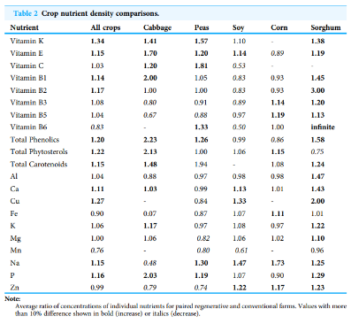
Regenerative Farming Boosts Nutrient Density
Key Findings from Crop Comparisons (2022 Peer J Study)
Regenerative crops had more nutrients overall:
+34% Vitamin K, +15% Vitamin E, +20% Phenolics
+22% Phytosterols, +27% Copper, +11% Calcium
Cabbage grown regeneratively had:
70% more Vitamin E
Over 2× more phenolics and phytosterols
Corn, Soy, and Sorghum:
Had 17–23% more Zinc with regenerative practices
Healthier soils support microbial life that improves how plants absorb and make vitamins, minerals, and antioxidants.

Slide 31
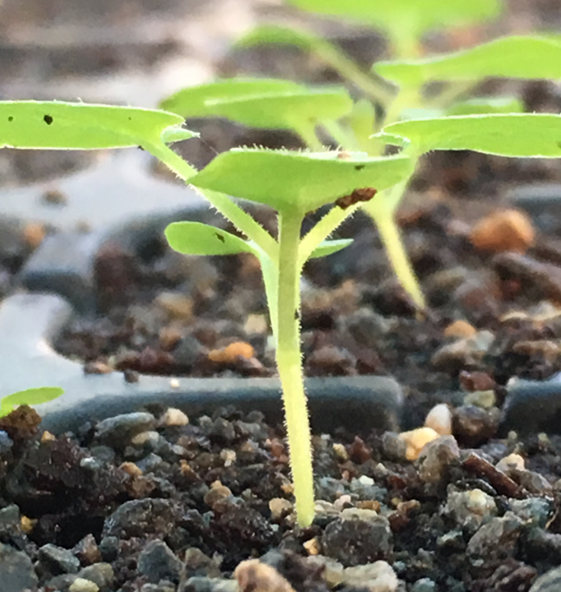
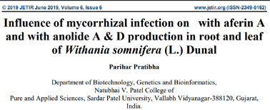
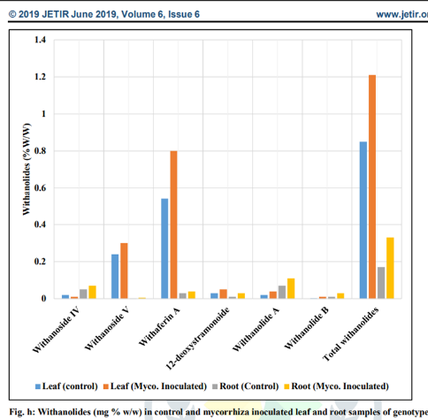
Notes:
Explain plant benefits using simple terms. Use photos or test results if available.

Slide 32
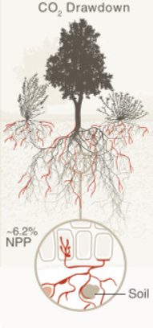
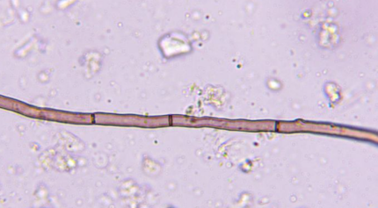
Carbon sequestration with Soil Life
Plants send sugars to roots → feed Mycorrhizal Fungi.
Mycorrhizal fungi store carbon in the cell walls of their hypha network.
Fungi create soil aggregates (glomalin) → protecting carbon from decomposition.
Their death forms stable microbial necromass → long-term soil carbon.
Estimates said a flux of ∼13 Gt of CO₂e moves through plants into carbon that is allocated to mycorrhizal mycelium every year.
Notes:
Link microbial activity to larger environmental goals. Mention compost and vetiver strategies.

Slide 33
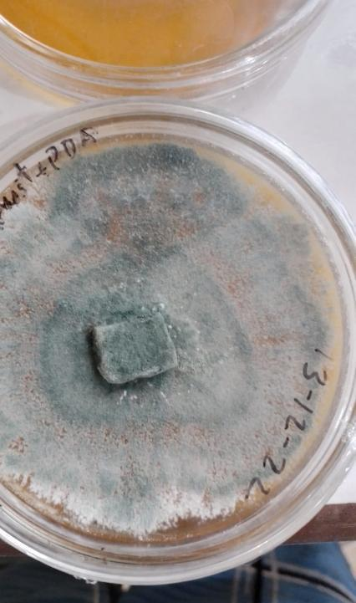
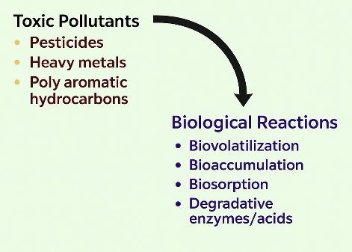
Fighting Pollution with Soil Life
Notes:
Link microbial activity to larger environmental goals. Mention compost and vetiver strategies.

Slide 34
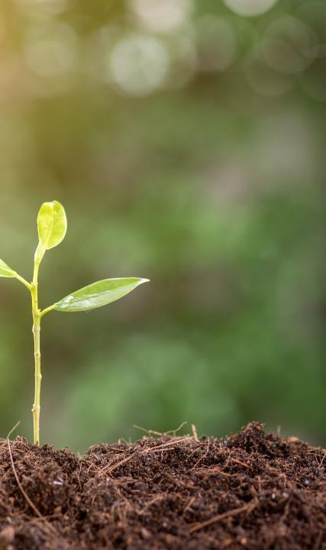
Impact on Human Health and Longevity
Soil Biome to Gut Biome
Greater Gut Biodiversity
Stronger Spleen, Kidney and Immune System
Increased resistance to disease
Notes:
Bridge soil to human health. Emphasize herbs grown in living soil contribute to wellness.

Slide 35
The Soil-Gut Health Axis: A Microbial Connection
Soil Microbiome
Immune System & Health Outcomes
Human Gut Microbiome
Plant Microbiome & Nutrient Density
Food Ingestion & Environmental Exposure
References: Rook GA (2013) PNAS | Wopereis et al. (2022) Frontiers in Immunology | Jansson & Hofmockel (2020) Curr Opin Syst Biol

Slide 36
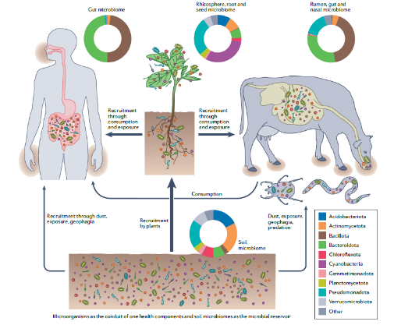
Soil hosts the richest microbiome on Earth. These microbes colonize plants and enter our bodies through food—shaping our gut, our health, and our resilience. The health of the soil is directly connected to our own
Soil Biome to Gut Biome
"Soil microbiomes and one health" Authors: Samiran Banerjee and Marcel G. A. van der Heijden Published in Nature Reviews Microbiology, August 2022 DOI: 10.1038/s41579-022-00779-w

Slide 37
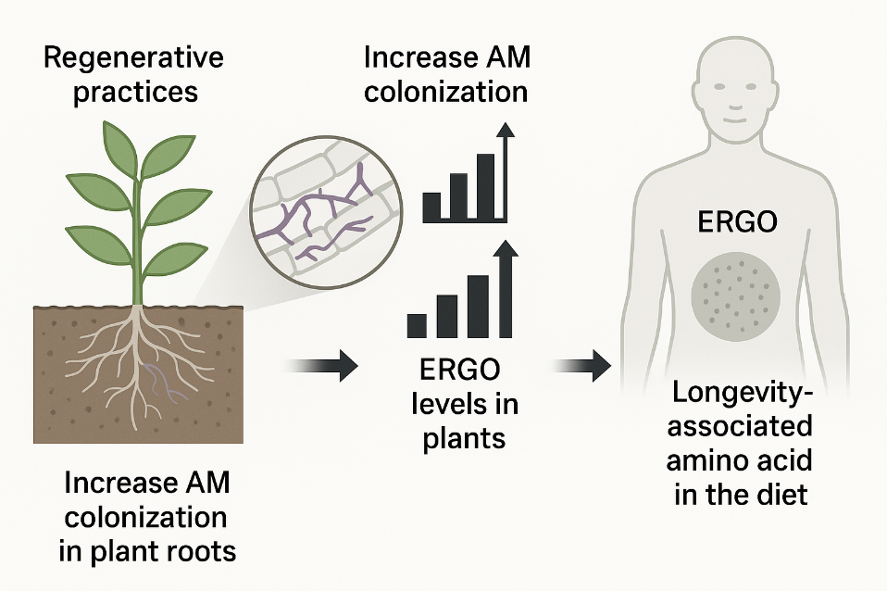
Ergothioneine in Plants and People
(AM) Arbuscular Mycorrhizal Fungi

Slide 38
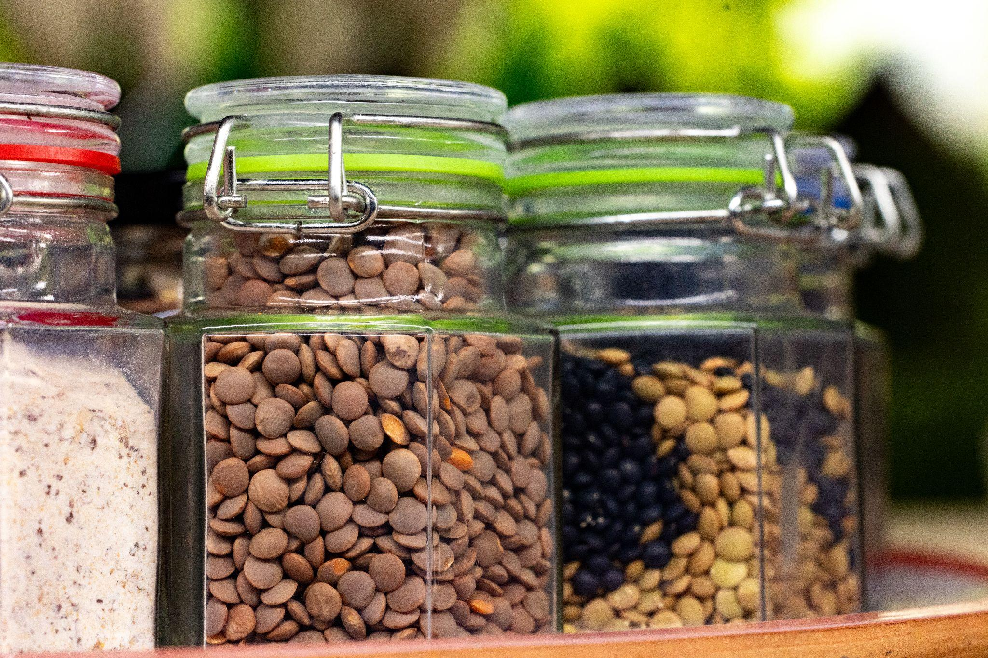
Ergothioneine Rich in Regeneratively Grown Legumes and Yellow Oyster Mushrooms

Slide 39
“The health of soil, plant, animal and man is one and indivisible”
Lady Eve Balfour
The Living Soil (1943)

