Slide 1
SAN Regional Hubs
Collaboration at global and regional level

Slide 2
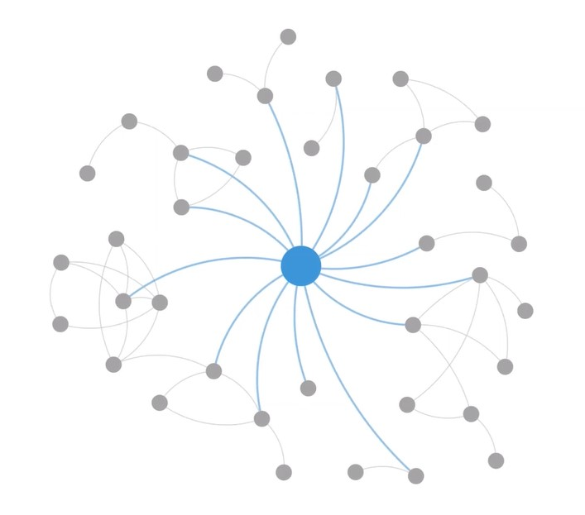
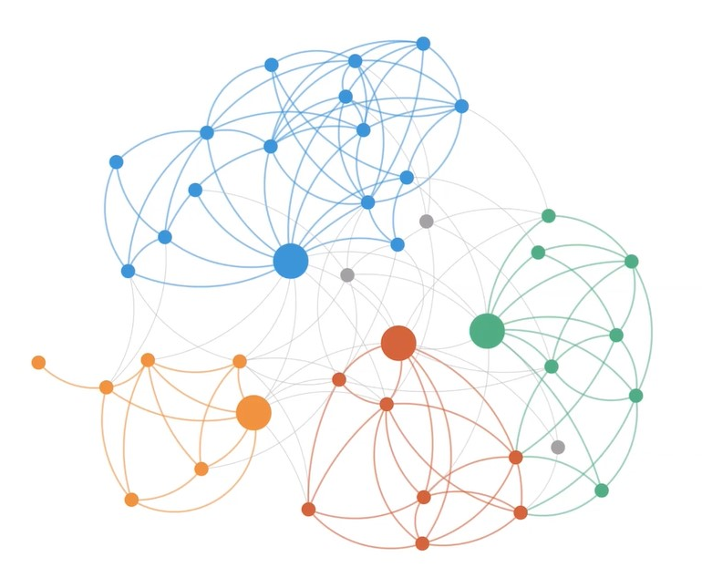
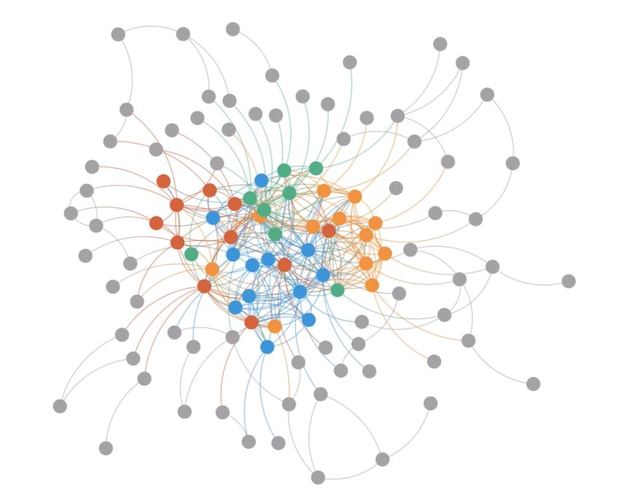
SAN as an Impact Network
Our long-term goal is to become THE global impact network for agriculture.

Slide 3
Network Ecosystem
Network strategy → design a network ecosystem that facilities knowledge exchange and collaborative project design and implementation.
The ecosystem aims to create new connections that lead to collective action.
Regional hubs are central in the structure of SAN’s network ecosystem as a generator and booster of collective impact.

Slide 4
Network Ecosystem
Regional hubs
Commodity platforms
Action labs
Knowledge Management System (KMS)

Slide 5
Network Ecosystem
By creating regional hubs, SAN aims to develop an enabling regional environment for members, creating a space to generate learnings and address common challenges and opportunities.
Commonalities inherent to certain regions, which may share agroecological conditions affecting the type of agriculture, political arrangements and policies, cultural elements such as language, and potentially a track-record of existing cross-border cooperation, e.g. Kaleka and Setara Jambi.

Slide 6
Network Ecosystem
The SAN Secretariat works with hub members to advance business development prospects in the region, identify opportunities for co-creation and implementation via multistakeholder partnerships.
Regional hub members are expected to be proactive in deciding the focus of their respective hubs. The SAN Secretariat plays a supporting role in the areas of knowledge exchange, M&E and prospecting of opportunities for project implementation.

Slide 7
Network Ecosystem
Regional hubs aim to create measurable impact and lessons that can be applied to other regional contexts.
Therefore, besides supporting regional activities, SAN hubs also serve as an incubator of global initiatives. Hubs have the potential to seed scalable initiatives that might be replicable in other regions, e.g. palm oil commodity platform.
Although hubs are governed by local members, international members can play a role in creating cross-regional initiatives.

Slide 8
Network Ecosystem
Concept introduced in the 2025-2030 Strategic Plan
OKR 2024: 5-year plan for regional hubs - how do we imagine SAN growing regionally?
Cover geographies where our membership currently operates: Mesoamerica, Amazon, West Africa, East Africa, South Asia, Southeast Asia, and Europe.
Designing regional hubs as a co-creation process.
Oxford as an opportunity to further develop the idea and get involved.

Slide 9
Network Ecosystem
Regional hub > Concept note
Concept note for Southeast Asia
Five members in SEA: Wild Asia, Kaleka, Setara Jambi, ADC and Earth Net
Focus on regenerative oil palm: commodity platform
Proof of concept of the regional hub model
Feedback from members in Southeast Asia

Slide 10
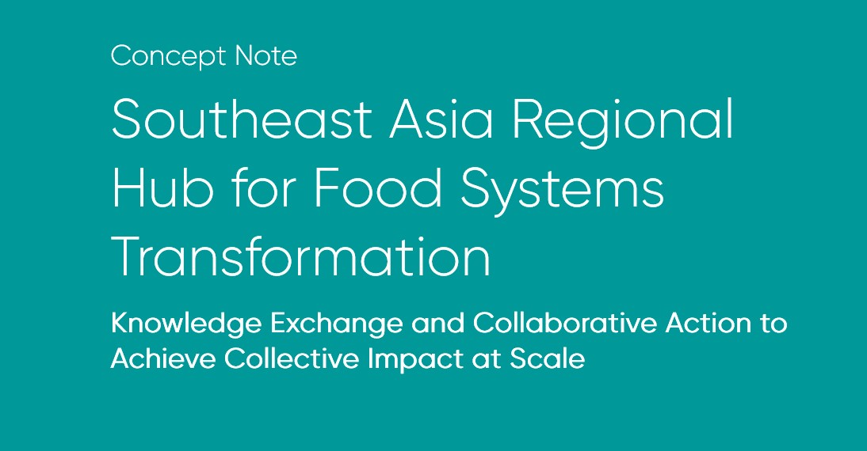
Network Ecosystem

Slide 11
Network Ecosystem
Summary
Local civil society organizations play a critical role in supporting farmers on the transition to regenerative agriculture, but impact is limited to a local scale due to resource constraints and barriers to collaboration.
To address this, we are seeking grant funding to establish the inaugural Regional Hub for Food Systems Transformation in Southeast Asia. This hub will serve as a dynamic multi-stakeholder platform for facilitating knowledge sharing and catalyzing new projects to accelerate adoption of regenerative agriculture practices in the Southeast Asia region.
The Hub will address the transition from oil palm monoculture plantations to resilient and biodiverse farming landscapes, support for smallholders on the transition to regenerative agriculture more broadly, and support policy compliance such as European Union Deforestation Regulations (EUDR), and policy promotion for sustainable agriculture in the SE Asia region.

Slide 12
Network Ecosystem
Activities
Participatory Scoping and Engagement with local CSOs
Local Case Studies
White Paper on Regenerative Palm Oil
SE Asia Regional Hub Summit
Thematic Virtual Events
Action Labs
Monitoring, Evaluation, and Learning Resources

Slide 13
EXERCISE
Design your own regional hub:
How do you envision your regional hub?
Mesoamerica: Alcides, Lucía, Jose, Eliane
Amazon: Eduardo, Priscila, Rodrigue, Ariel
West + East Africa: Melanie, Paul, Dennis, Richard
Southeast Asia: Son, Reza, Catalina, Jasson
South Asia: Shahid, Hardeep, Alex, Carlos
Europe: Jordi, Rocío, Neil, Suzanne, Kylie
Guests: Louisa, Chris, Alain, Karin.

Slide 14
EXERCISE
What do you define as your region? Is the current definition accurate?
Do you think your region could benefit from having a SAN regional hub?
What is currently missing that a regional hub could solve or provide?
What roles and responsibilities should we establish within the hub?
How should the relationship between the hub and the SAN Secretariat be?
What other stakeholders should take part in regional hubs’ activities?
What activities should we prioritize within the hub?
What resources would we need to develop these activities?
What strategy could we follow to get these resources?

Slide 15
EXERCISE
Write, draw, discuss and present to the rest of members how you envision your regional hub.

