Slide 1
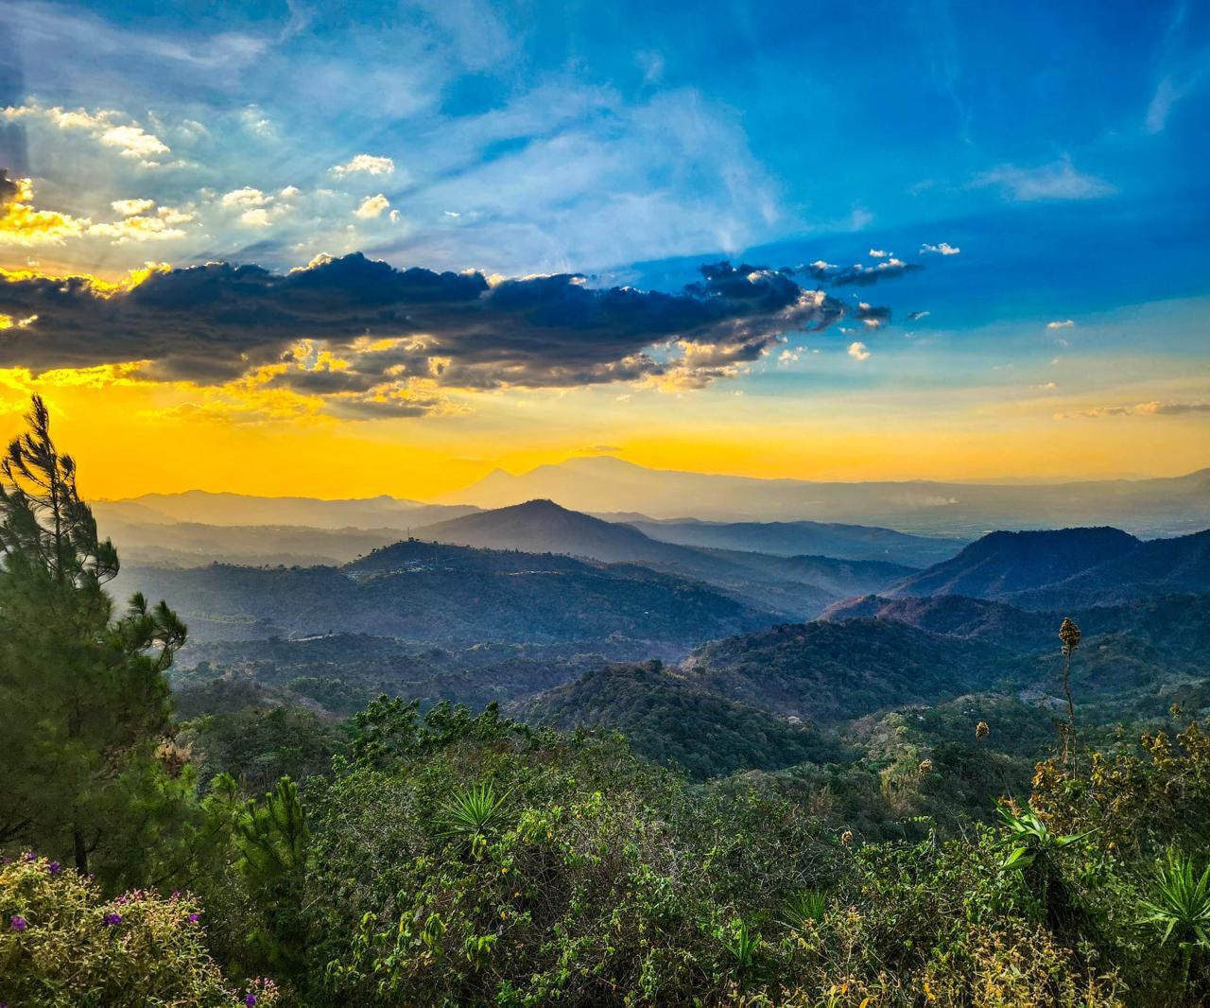
REGENERA™ a door to regenerative products and services and more

Slide 3
regenera
Notes:
RE Viene del latín y significa de nuevo o de nuevo continuamente o de regreso o
GEN Generación consciente que quiere hacer el cambio y también usar un material forma diferente
RE-GEN abreviacion de de regenerando. Todo tipo de acciones verdes reutilizar,reciclar, reorientar a otro uso. También significa una nueva generación.

Slide 4
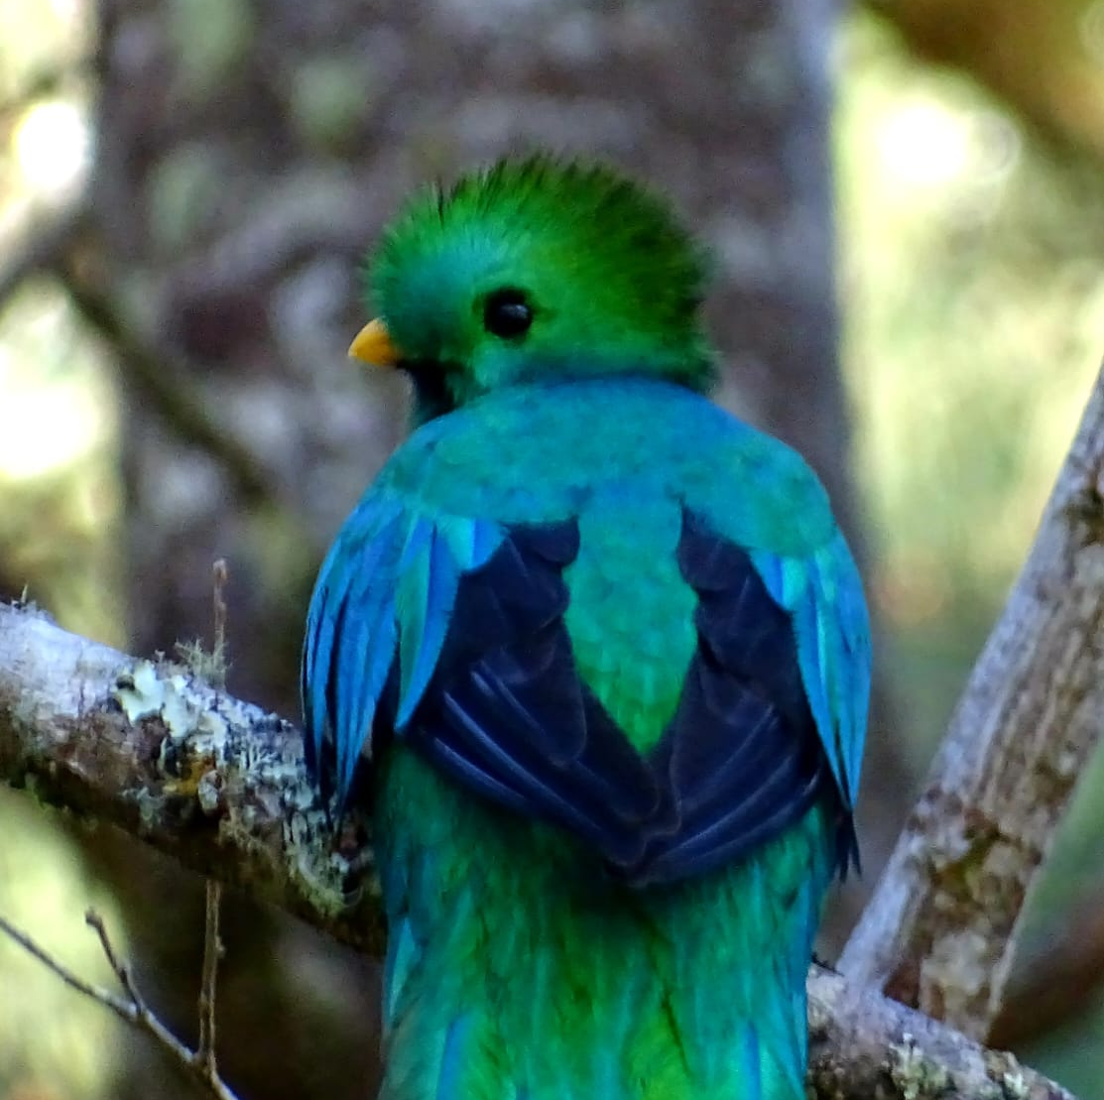
Notes:
Silvia Figueroa and the Freund Family, Salvadoran Nature Heroes, have regenerated 4,060 Hectares nearby the Montecristo National Park, thus the quetzales now breed there!

Slide 5
Regenerated Forest at La Encantada, work done by Silvia Figueroa

Slide 6
Pairs of yellow-naped parrots (Amazona auropalliata) , which is globally in danger of extinction, protect their eggs and their young in the tallest trees of the El Espino Coffee Cooperative, where they nest each year.

Slide 7
Notes:
Design of one of the 40 water infiltration wells which were built at the El Espino Coffee Farm and feed the San Salvador acuifer.

Slide 8
depredation

Slide 9
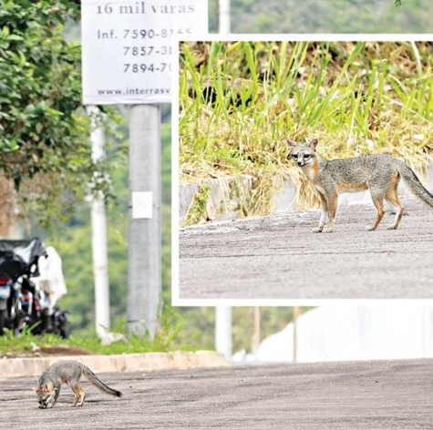
The displaced!
Notes:
A Grey Fox and a Racoon are rumbling now as refugees through the streets of Nuevo Cuscatlan, as their habitat has been destroyed, because of a sudden change of zoning.

Slide 10
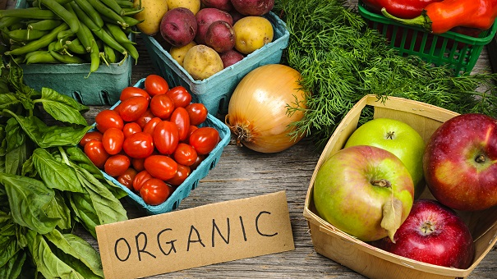

Slide 11
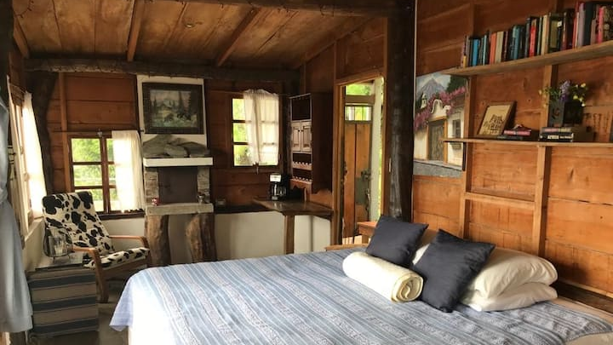
Agritourism
Notes:
Agritourism Market Size was valued at $4,800.67 millions in 2023 and it is expected to almost double by 2030 is expected to reach USD9459.75 Million by the end of 2030 (97% higher) during the Forecast Period 2023-2030. Source: Verified Market Reports.

Slide 12
Birdwatching and Ecotourism

Slide 13
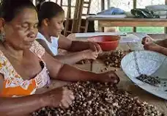
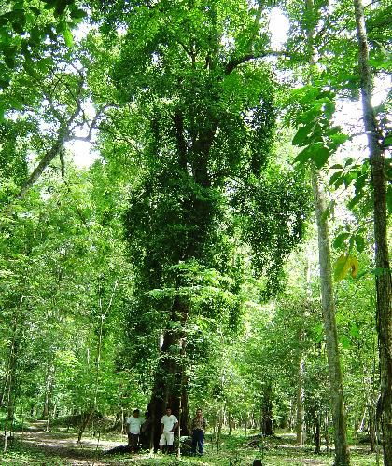
The Opportunities
Brosimum alicastrum Maya Nut and similar high nutrition and health foods

Slide 14
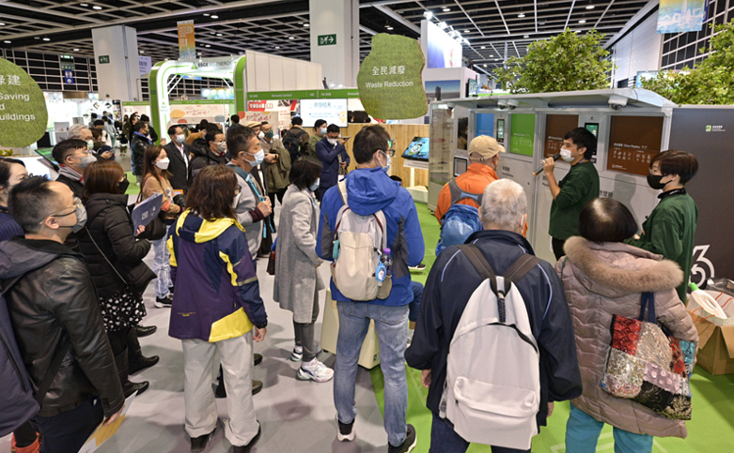
What is REGENERA™ ? Is an International Conference and Fair, physical and virtual, which will be organized in different subregions, to share the latest technological and policy advances, as well as quality cost-effective goods and services, which satisfy new or already existing demand, are friendly with Nature, climate. Health and Economic well-being. REGENERA™ will takes us out of the current four-pronged global crisis (Climate, Biodiversity/Ecosystem, Health and Poverty).

Slide 15
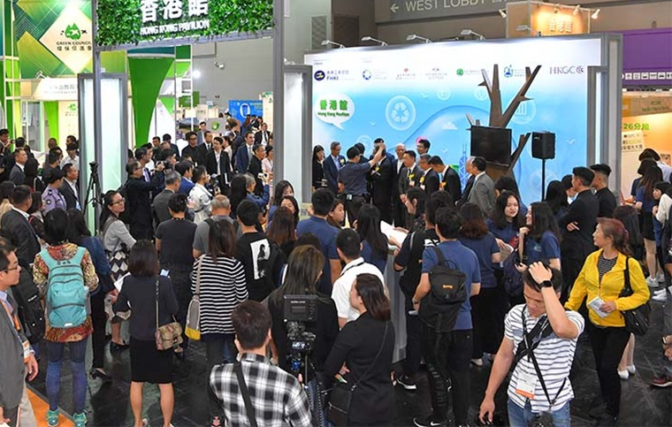
As REGENERA™ needs to be carried out in different subregions with SAN’s support, as well as with support from other partners. If SAN General Assembly adopts SalvaNATURA’s initiative, REGENERA™ will set an Executive Committee with SAN and other agreed upon additional partners, so that before 2029 its 7 subregions have an annual REGENERA™ event. After each REGENERA™ fair, a subregional virtual market will either be launched or updated. SalvaNATURA is aiming to organize the 1st REGENERA™ event on November 6, 2025, in San Salvador, El Salvador, for Mesoamerica and the Caribbean.

Slide 16
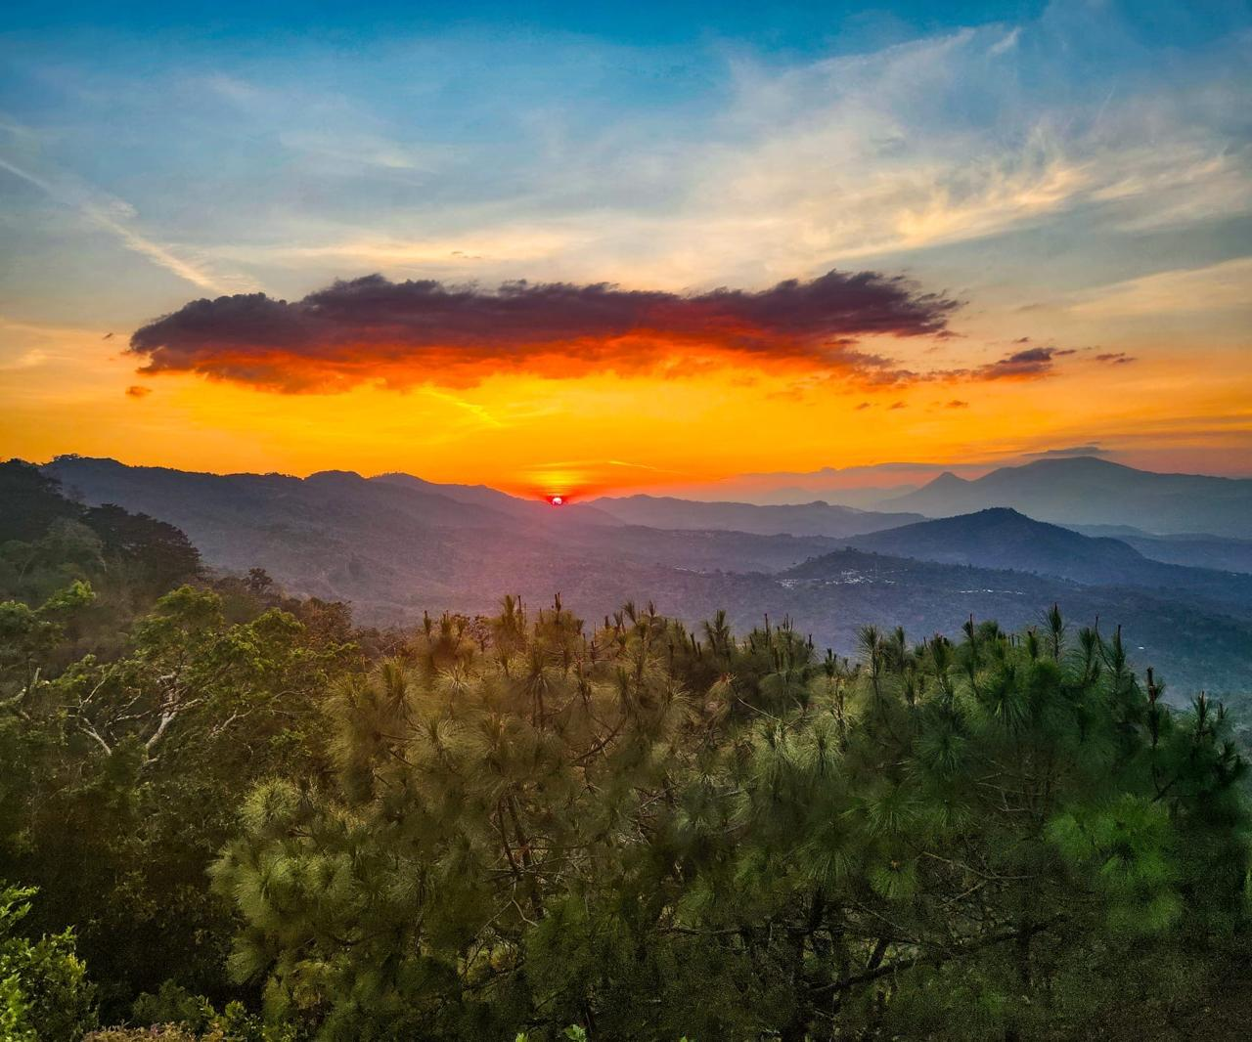
Thank you very much for your attention!
Miguel.Araujo@salvanatura.org.sv +503 7841 9305
I will be very happy to answer your questions and receive your comments.

