Slide 1
Sustainable Agriculture Network (SAN)
Ordinary General Assembly
05 June 2024
Dr Emmanuel NJUKWE, Director of Research and Innovation
CORAF Presentation

Slide 2
Presentation outline
CORAF in WCA
CORAF Organogram
Strategic Plan (2018 – 2027) & Operational Plan (2023 – 2027)
No. of Technologies & Innovations developed
Framework of operation & Scheme for technology dissemination
Potential areas of synergy and collaboration

Slide 3
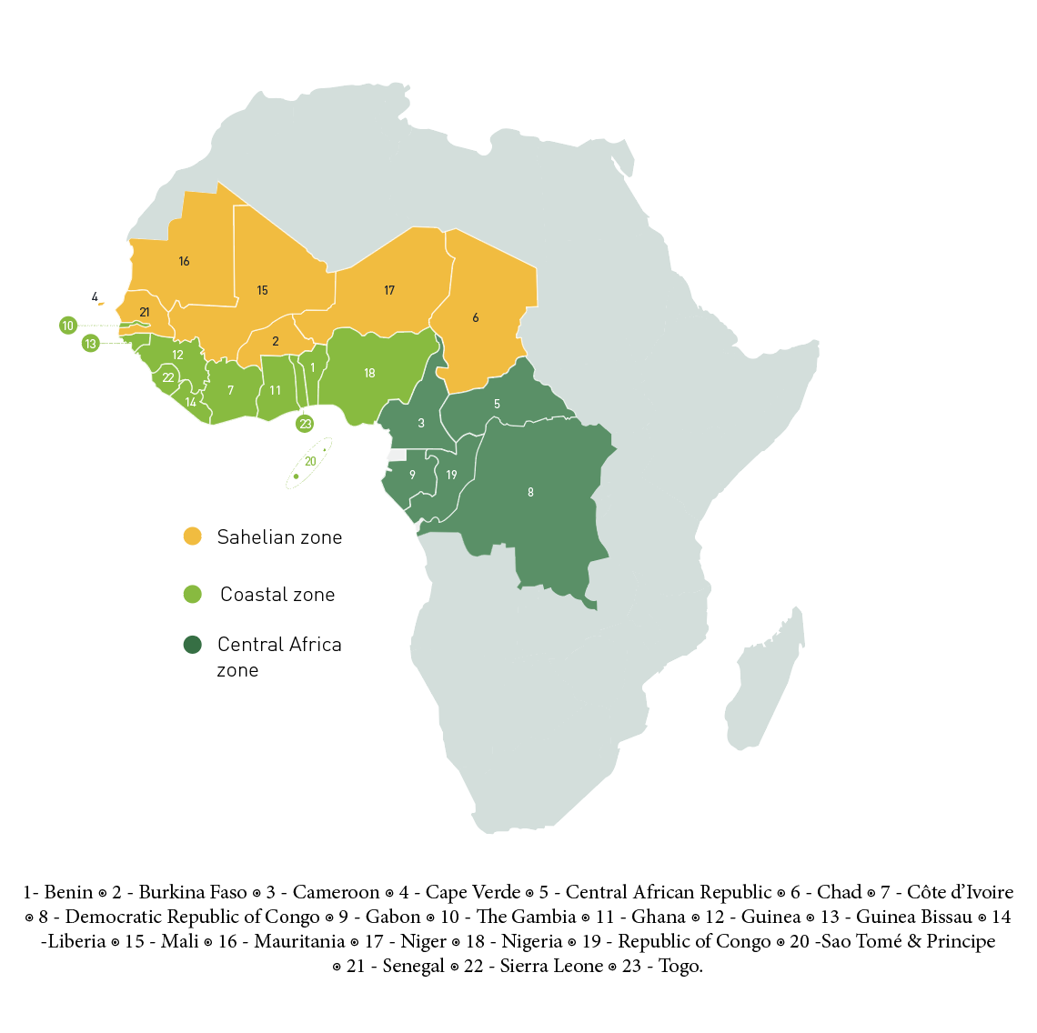
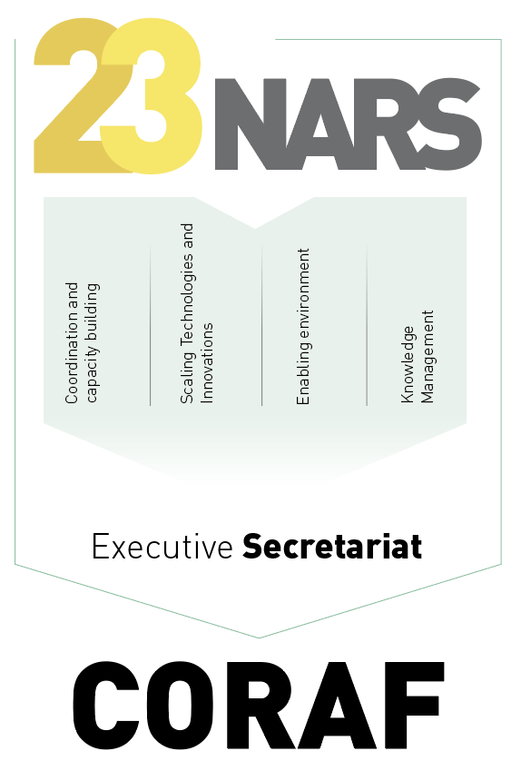
CORAF in West and Central Africa
Harnessing Partnerships in the Discovery to Delivery Ecosystem in West and Central Africa
FARA/AFAAS
NASRO
ASARECA
CCARDESA
CORAF-1987

Slide 4
CORAF Organogram
Conseil d’administration
Audit Interne
Communication interne et externe
Direction Exécutive
Contrôle Interne
Partenariats stratégique et mobilisation des ressources
Pôle stratégie
Direction Recherche et innovation
Direction Services de Gestion
DP1: Agriculture & Sécurité Alimentaire et Nutritionnelle
DP2: Politiques-Institutions-Marchés-Commerce
DP3: Genre-Jeunes-Equité Sociale
Knowledge Management
Passation des marchés
Ressources Humaines
Système d’information et Technologies
Administration et finance
Pôle projets
Pôle Services de Gestion

Slide 5

CORAF Strategic Plan 2018-2027

Slide 6
Operational Plan 2023 to 2027
High broad-based agricultural growth sustainably established in WCA
General objective
Agricultural productivity, competitiveness and markets sustainably improved for target groups in WCA
Specific objective
Result areas
Increased use of appropriate technologies and innovations
Increased uptake of strategic decision-making options for policy, institutions and markets
Enhanced institutional and human capacity in AR4D
Demand for agricultural knowledge from target client facilitated and met
Priority intervention Domains
Agriculture, food and nutrition security
Policy, institution, markets and Trade
Gender, youth and social security
Activity
Pillars
Scaling technologies and innovations for impact
Regional integrated capacity strengthened and coordinated
M&E, Knowledge management, foresighting and anticipation

Slide 7
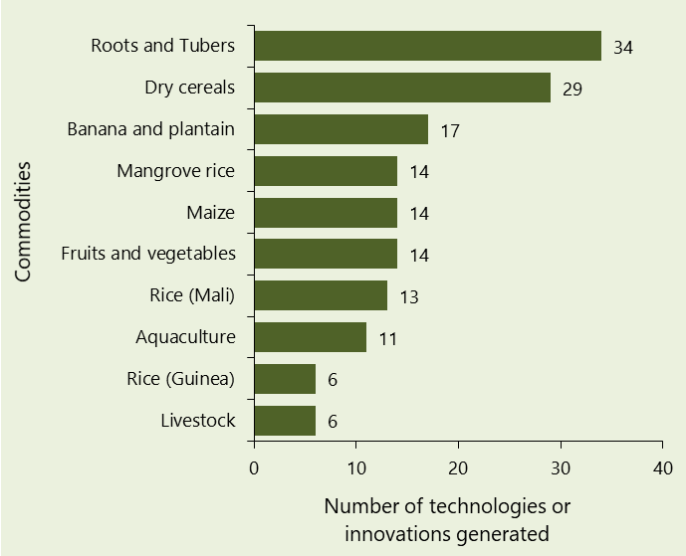
Number of technologies or innovations developed through the WAAPP programme

Slide 8
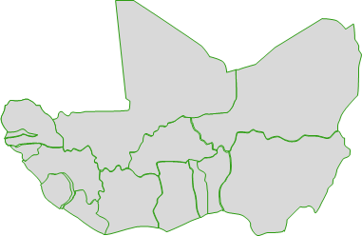
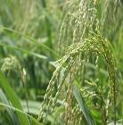
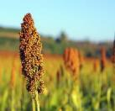
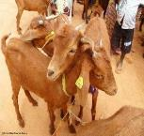
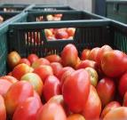
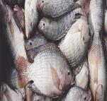
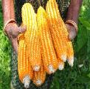
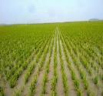
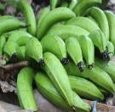
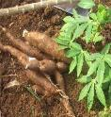
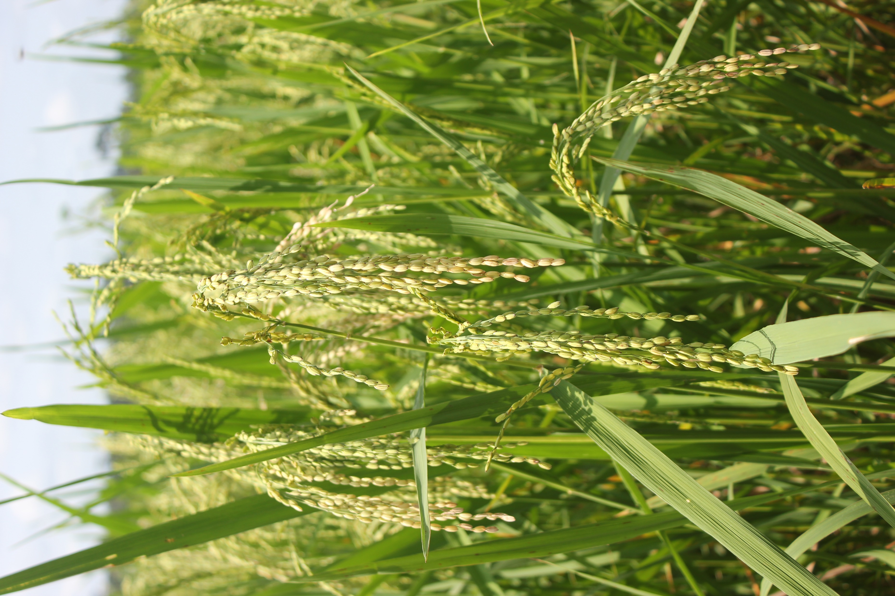
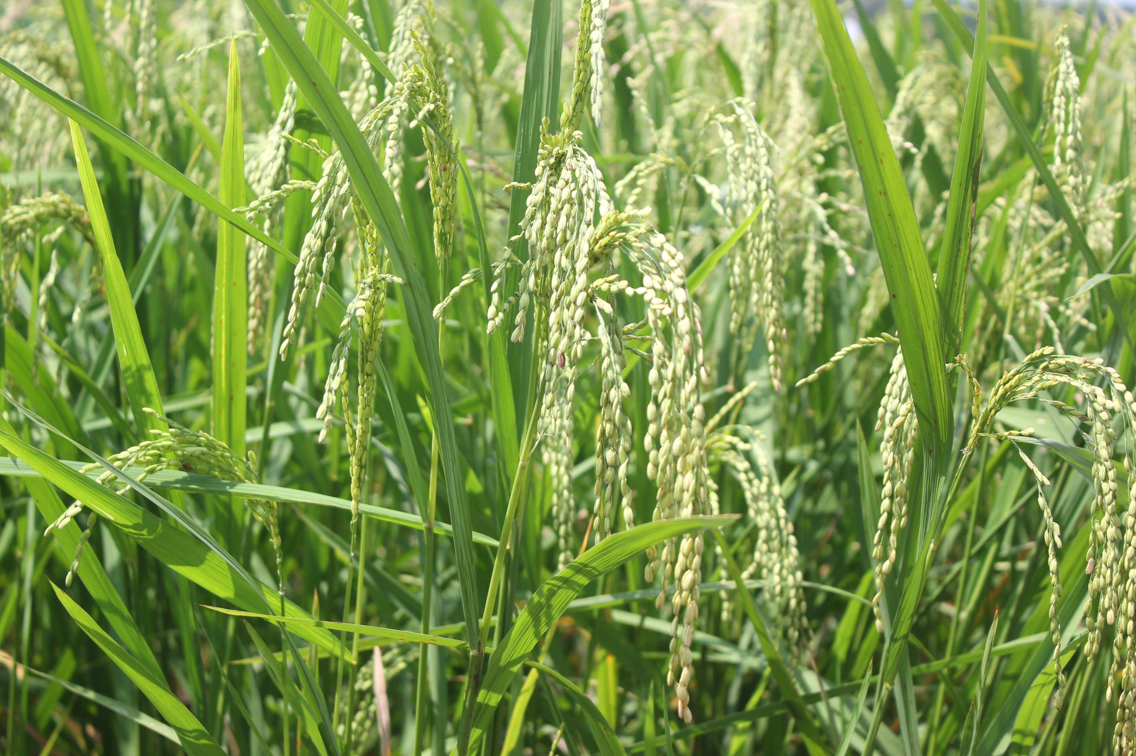
Framework of operation- NCoS and RCoE
Network of 9 commodity-based centers of specialization
Regional Integration
1
Pooling Resources (Human and financial) for economy of scale
Centers of convergence of international expertise, mobility, capacity building
Harmonized Processes (Peer Review)
Adapted Solutions (Tech Market)

Slide 9
Scheme for Technology Dissemination
NARS Agriculture Technology Park
HUB
RLF
MITA
Partnership with Critera for Partner and Site Selection
IPs with advisory services: Climate, Soil, Market
Technology Guide to Include Cost, Return on Investment and Business Plan
Requirement
Monitoring and Evaluation
Satellite Center
Satellite Center
Adoption studies (quantitative and qualitative traits - Attributes & Perception)
Use of communication tools, materials and approaches
Impact Studies
Reporting
CBO & CBES
Field Site
Field Site

Slide 10
Potential areas of collaboration
Agricultural (crop, livestock, aquaculture) production and Seed systems
Access to improved crop varieties and livestock breed
Climate Smart Agriculture (CSA) and Climate Information Services (CIS)
Land restoration, Soil and Water management
Circular economy, Regenerating, Integrated and Conservation agriculture
Transboundary plant pests and disease management
Mechanization and Irrigation
Capacity development (technical and institutional)
Gender mainstreaming and Youth engagement /empowerment
Private sector engagement, Policy, Market, Trade and Institutions
Post-harvest processing and Value addition (products development)
Monitoring and Evaluation, Knowledge management and Foresight

Slide 11
THANK YOU FOR YOUR ATTENTION

