Slide 1
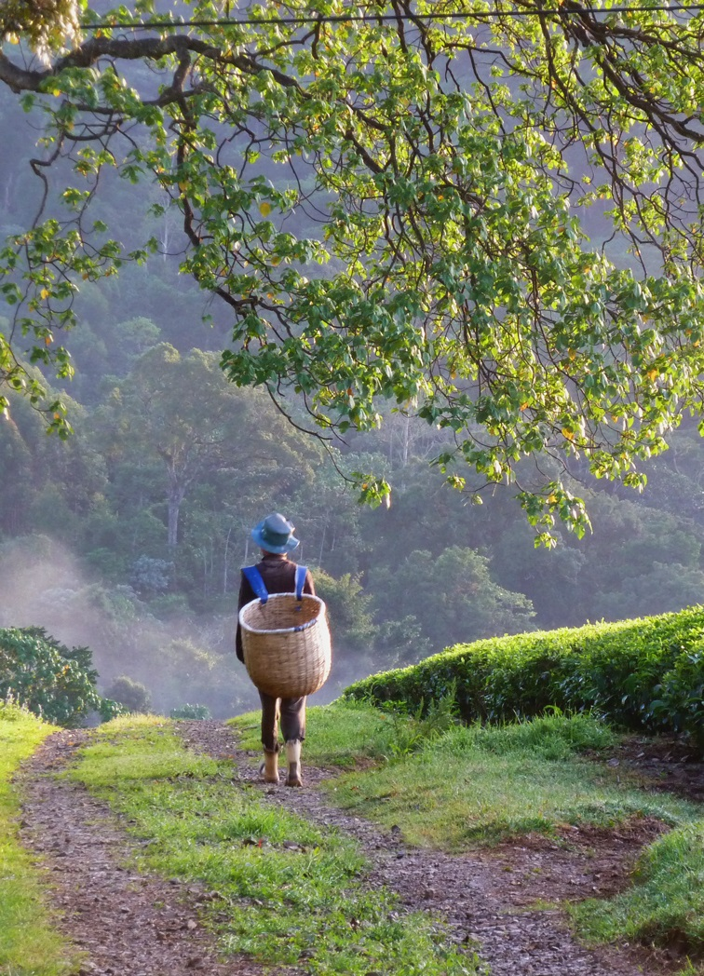
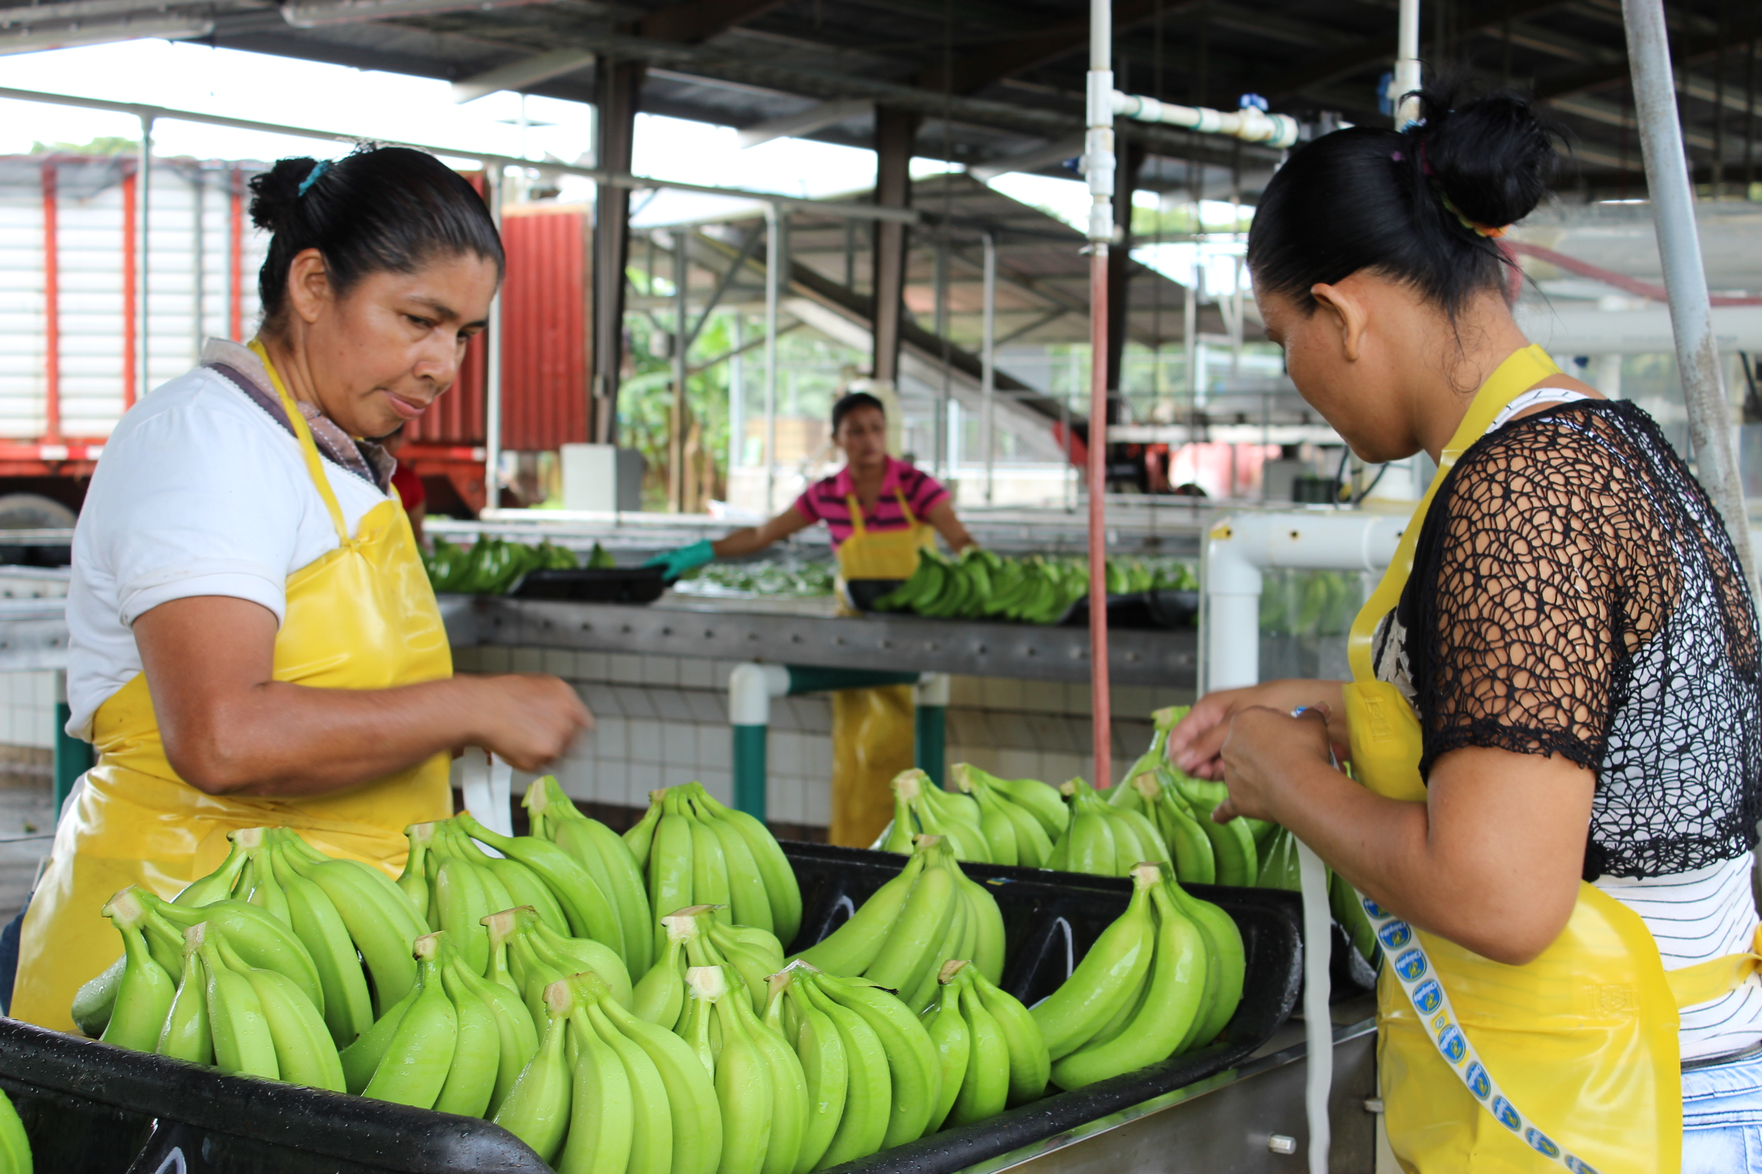
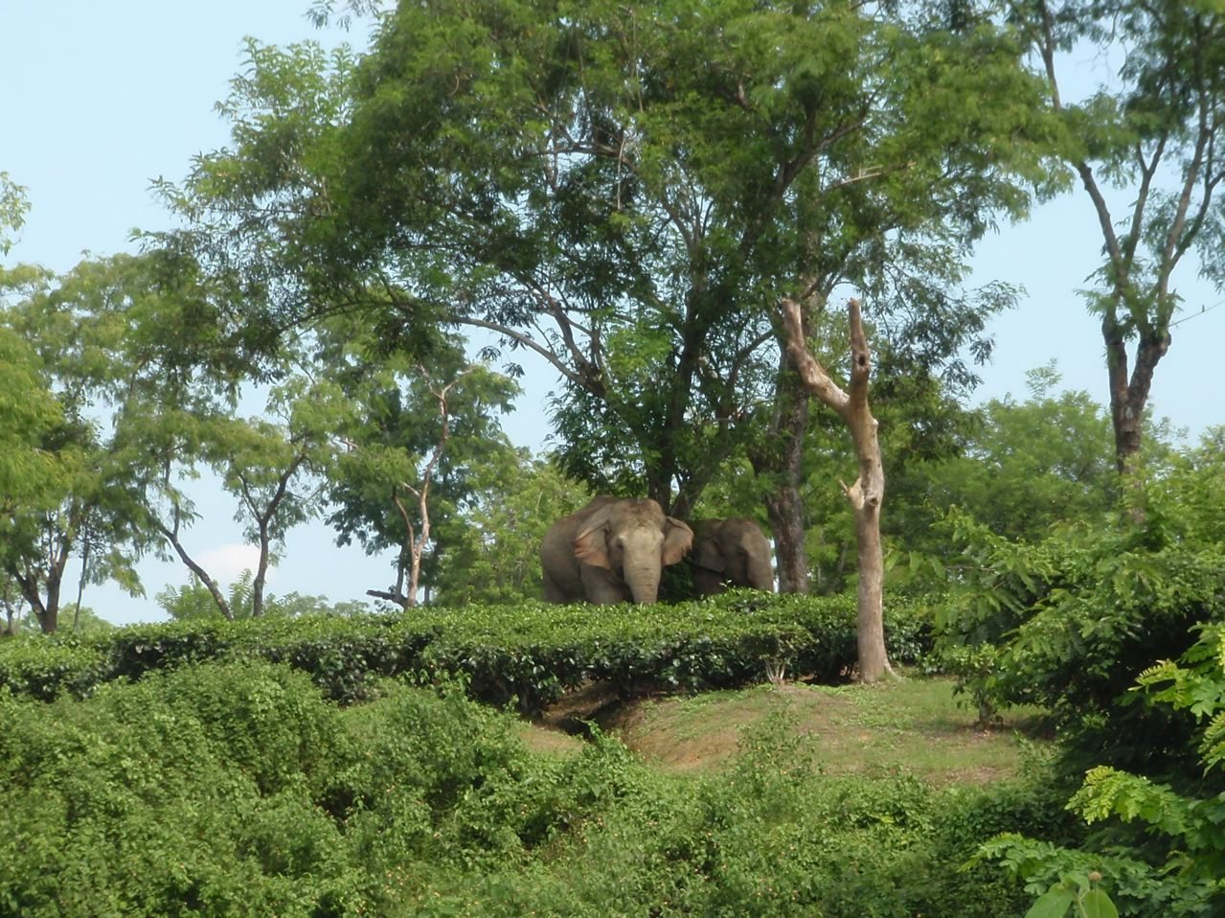
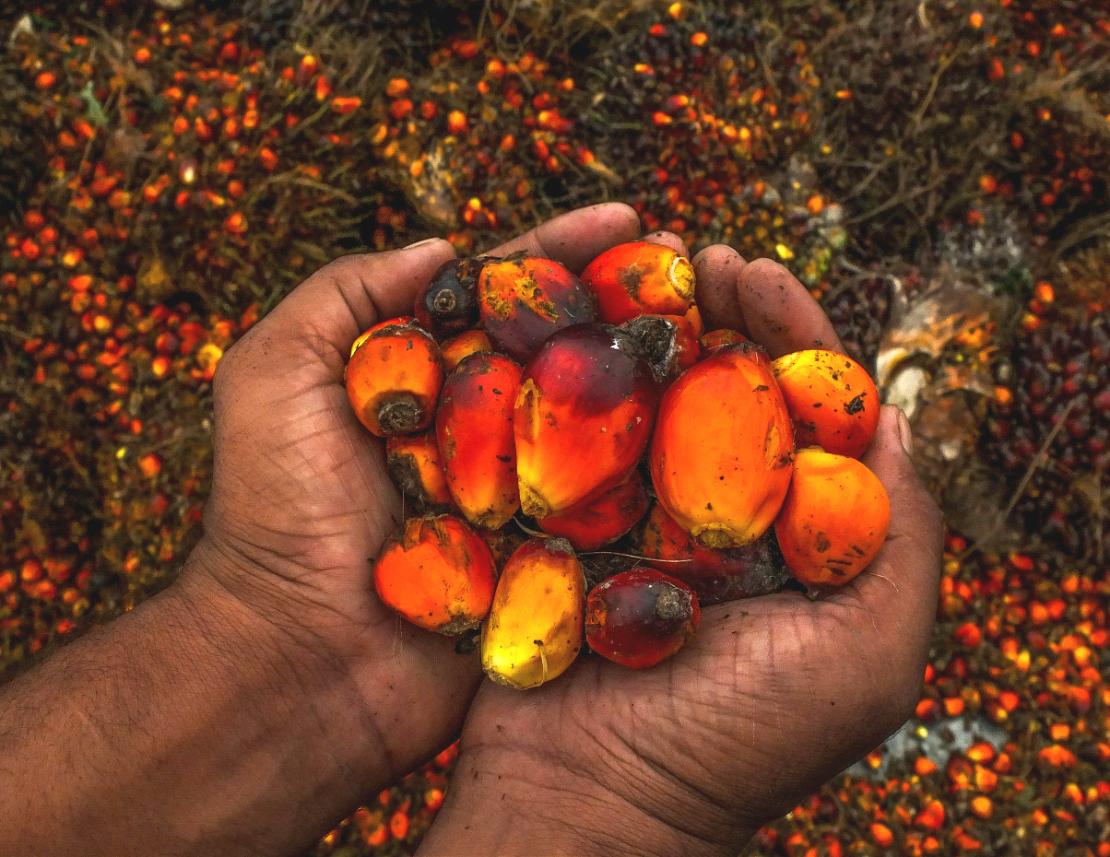
REGENERATIVE AGRICULTURE
A common definition?

Slide 2
The many meanings of the concept
A movement?
A commitment?
An ideal?
A practical approach?

Slide 3
Several global initiatives on-going
OP2B’s Regenerative Agriculture Framework
Rodale’s Institute Regenerative Organic Certification

Slide 4
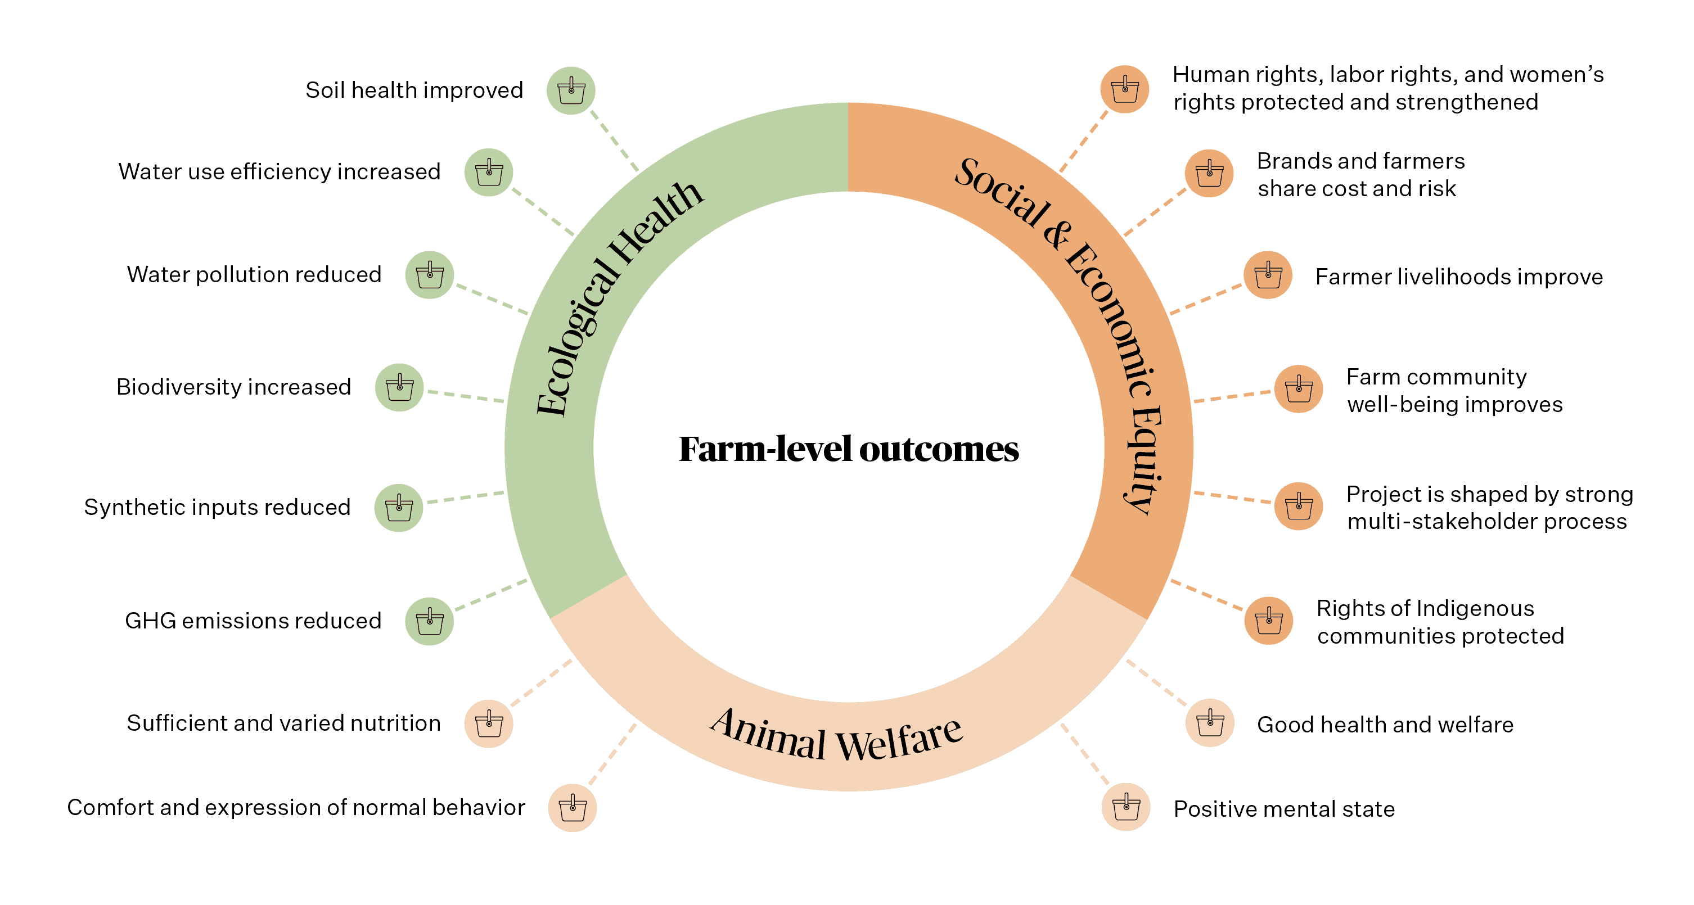
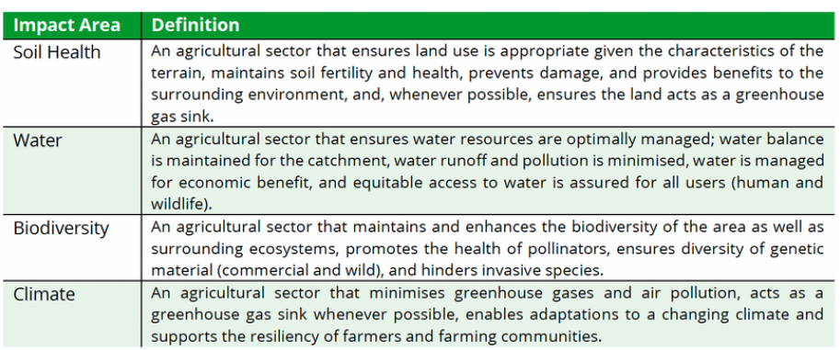
Several global initiatives on-going
Textile Exchange’s Regenerative Agriculture Outcome Framework
SAI Platform’s Global Framework for RegenAg – Regenerating Together Program

Slide 5
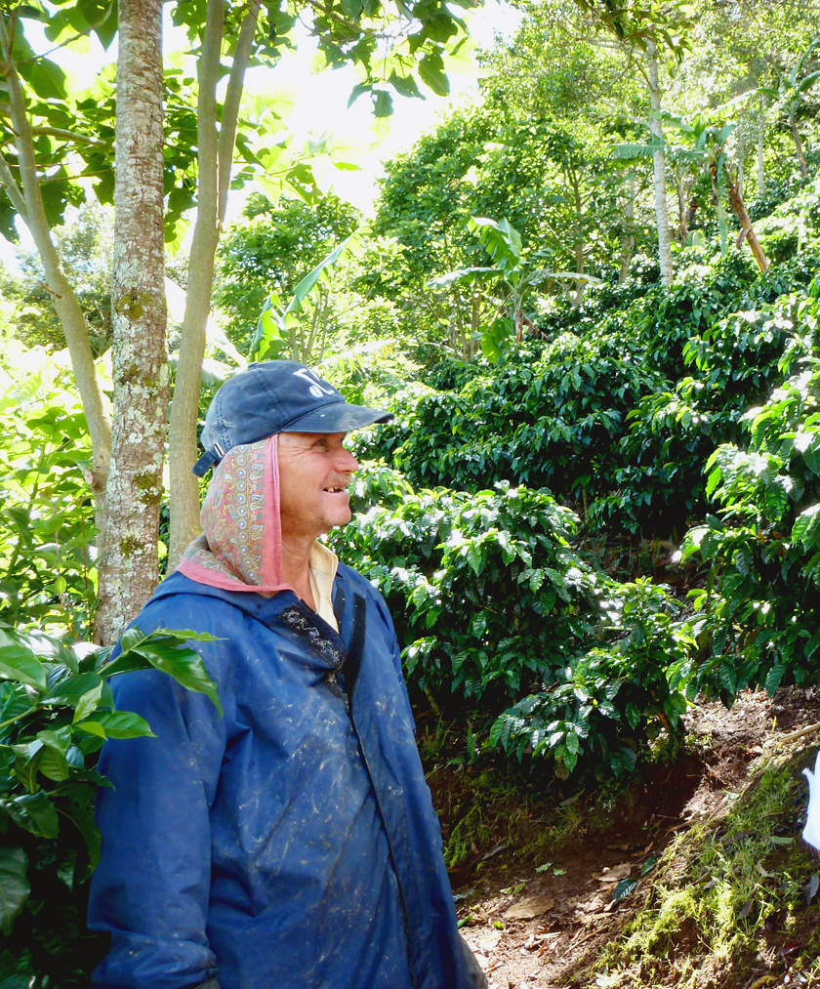
The risk of the “multiple definitions”
One size does not fill all – how to assess efficacy?
Tracking progress - how to implement MRV?
Collective reporting - how to communicate to markets and consumers?
Harmonization – trivialized concept and contradictory approaches

Slide 6
Opportunities and role of our Network
How can SAN contribute to the discussion?
Which principles/key elements need to be considered in global initiatives?
How can we leverage ongoing initiatives and existing commitments?
Can all member organizations commit to a common definition & impact indicators?

