Slide 1
Circular Bioeconomy Alliance
June 7, 2024

Slide 2
Agenda
1
Vision and background
2
Approach and activities
3
Governance

Slide 3
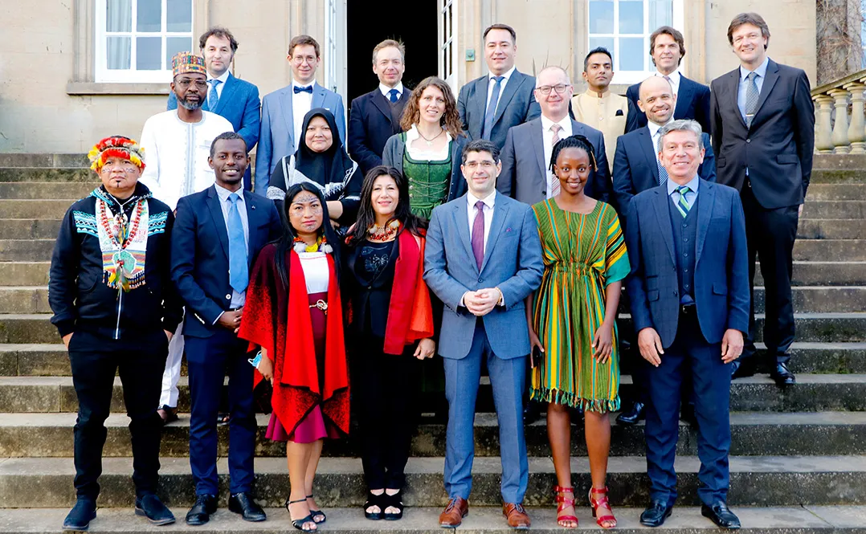
History
Established in 2020 by His Majesty King Charles III (formerly His Royal Highness The Prince of Wales)
Photos: Iain Brown, Ian Jones

Slide 4
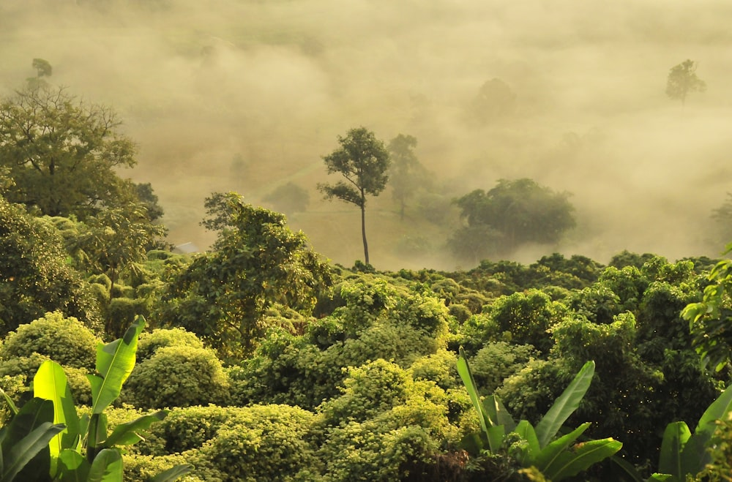
CBA Vision & Mission
Vision
The CBA’s vision is a world powered by and prospering in harmony with Nature.
CBA
The CBA’s mission is accelerating the transition to a nature-first economy.
Mission

Slide 5
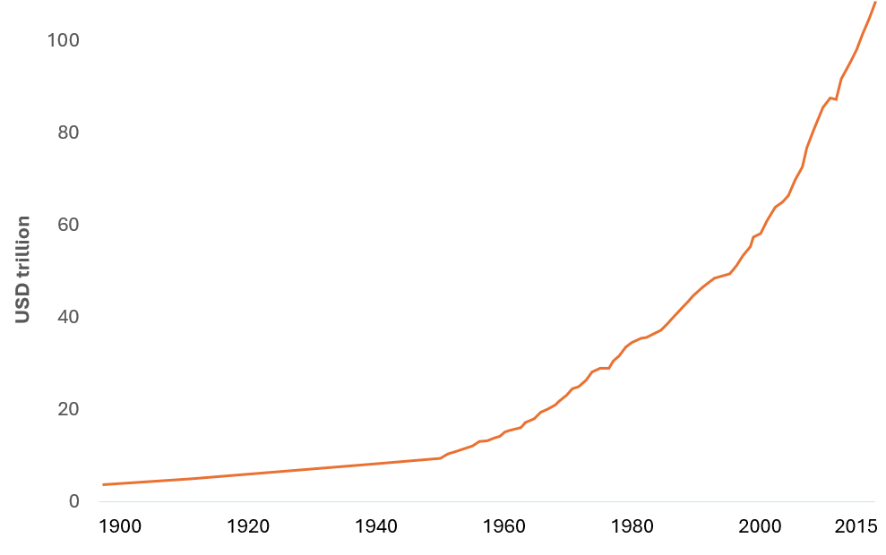
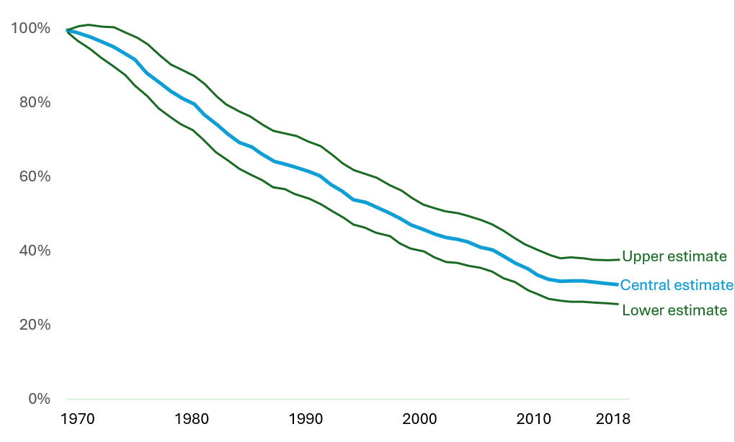
Our extractive economy powered by fossil resources has reached a tipping point
World GDP over the last two millennia
Total output of the world economy, adjusted for inflation and expressed in international-$ in 2011 prices
Living Planet Index, World
The Living Planet Index (LPI) measures the average decline in monitored wildlife populations¹. The index value measures the change in abundance in 31,821 populations across 5,230 species relative to the year 1970 (i.e, 1970 = 100%)
Source: Our World in Data / World Bank, 2024. For illustrative purposes only.

Slide 6
...crossing the safe operating space of our planetary system 6 of 9 planetary boundaries have been transgressed
Climate change
Novel entities
Biodiversity integrity
Stratospheric ozone depletion
Safe
Operating Space
Land system change (Deforestation)
Atmospheric aerosol loading
Safe operating space
High risk zone
Freshwater change
Ocean acidification
Safe operating space
Zone of increasing risk
High risk zone
Biochemical
flows
Source: LOIM analysis; based on Richardson et al. 2023.
Zone of increasing risk

Slide 7
…with increasing consequences for our economic system
Climate-related risks are accelerating at an unprecedented pace
An example of this is the 2023 Canada's wildfire season
Weather-related insurance losses (2022 prices)
2023*
2021
2017
2018
2019
2022
2016
2020
May
Jun
Jul
Aug
Sep
Oct
The 2017-2022 average insured losses due to climate-related disasters exceeded USD $110 billion, more than doubling the
$720 million in insurance damages,
the costliest event in the history of British Columbia
Source: LOIM analysis; based on Canadian Wildland Fire Information System/CBC, SwissRe (2022), In 5 charts: continued high losses from natural catastrophes in 2022 .

Slide 8
Food systems facing the perfect storm: climate change, nature degradation and inefficient value chains
Chocolate crisis
Cocoa prices have surged more than 250% over the last year, surging to $10,000 per metric ton – nearly double the record high set 46 year ago
1977 record
1960
1965
1970
1975
1980
1985
1990
1995
2000
2005
2010
2015
2024
Source: Intercontinental Exchange Inc; and Bloomberg. For illustrative purposes only.

Slide 9
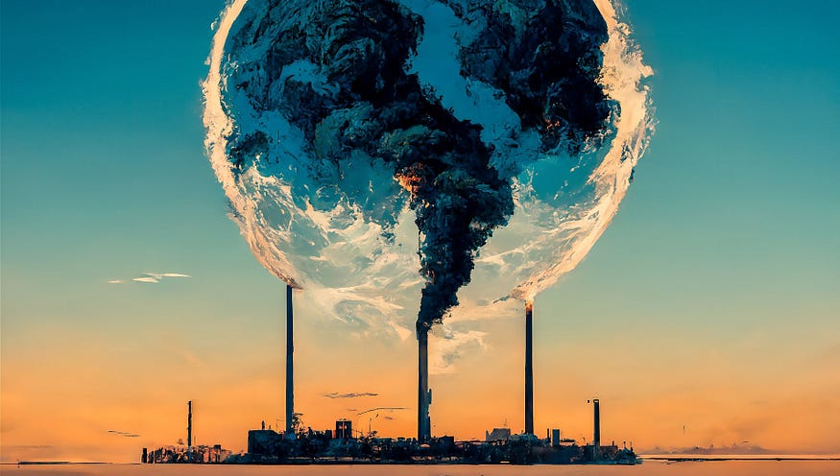
We must rethink our economy
Nature: our best strategy
Closed System
Open System

Slide 10
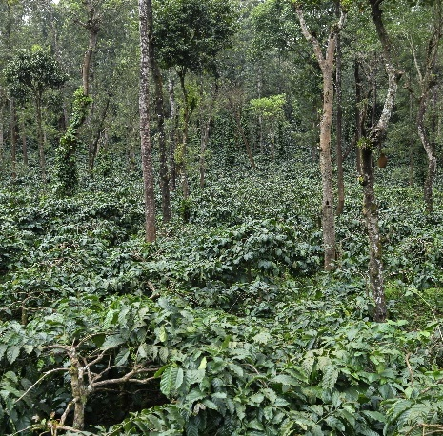
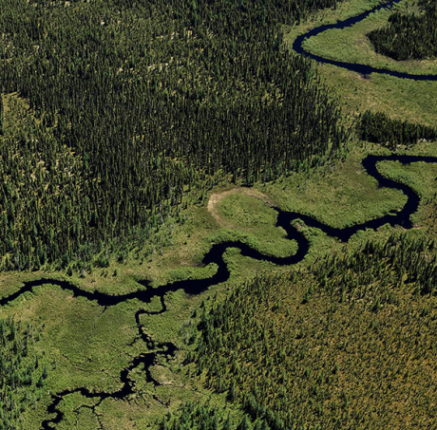
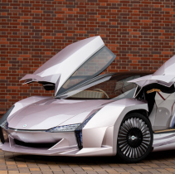
A new economy powered by nature: circular bioeconomy
nature-based solutions
Bio-based value-chains
Agroforestry & regenerative farming
Sustainable forestry
Food
Materials
Chemicals
Source: Investing in Nature as the True Engine of our Economy (2020) Circular Bioeconomy Alliance.

Slide 11
This is the circular bioeconomy…
Nature-based solutions
Degraded
ecosystems
Biodiversity
Regenerative landscapes & resilient communities
Science-based
Principles
Equitable “glocal” partnerships
Third-sectors
and final consumers
Circular bioeconomy
Primary sectors
Tourism, finance, insurances, cities
Forestry, Land Use and Agriculture (FLAG). etc
Landscape-to-value chain approaches
Secondary sectors
Food, packaging, pharmaceuticals, construction, chemicals, etc.
Ecosystem services
Provisioning services
Regulating & maintenance services
Cultural services

Slide 12
Agenda
1
Vision and background
2
Approach and activities
3
Governance

Slide 13
CBA, a science-based, action-oriented, partnership-driven alliance to catalyse transformational change
Activities
Activating and demonstrating- Living Labs Blueprints for landscape restoration and circular bioeconomy value chain development, according to the CBA Principles¹
Advancing and sharing knowledge - Grants, Research and Technical Assistance Implementing scientific research projects and capacity building and communication programs to support public and private actors, especially local communities and indigenous people, while advancing knowledge
Connecting and facilitating -Networks & Taskforces Designing partnerships, projects and networks connecting relevant stakeholders to advance and scale up action on the ground on specific thematic areas (e.g., Wildfire Resilient Landscapes Network, Fashion, Health, etc)

Slide 14
Living Lab Scaling Model
SCALING MODEL
Sustainable Value Chains
Regenerative Landscapes
Living Labs
?
CBA Charity
CBA - Advisors
Member Organisation
Scientifically underpinned labs to demonstrate landscape restoration and value-chain creation
Successfully graduated living lab projects that restore landscapes at scale and potentially generate commercial benefits
Commercially sustainable value chains that can be integrated into corporate supply chains and are investable for capital market investors

Slide 15
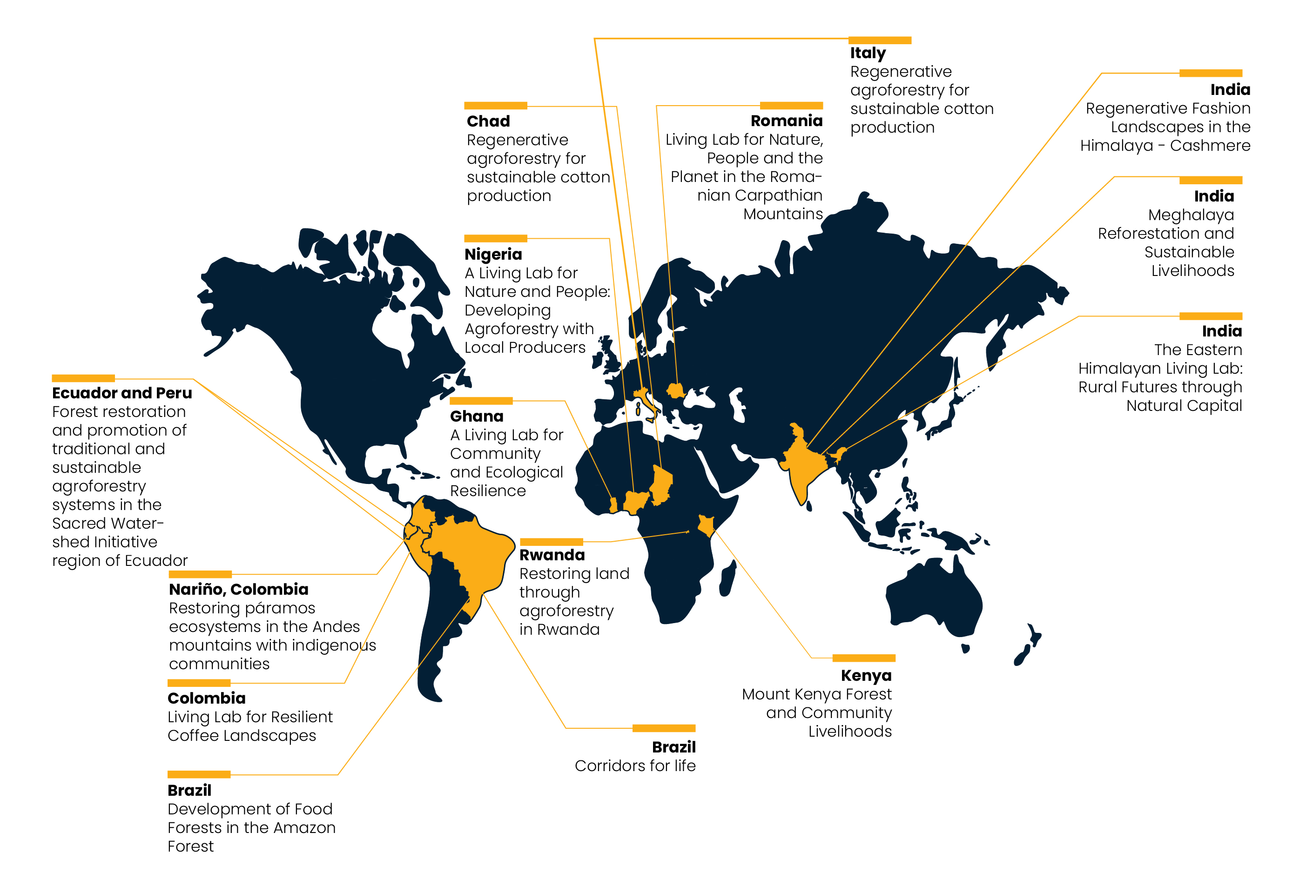
Living Labs for Nature, People and Planet (2020-2023)

Slide 16
Focus Areas
Creating blueprints in two types of regenerative landscapes: (i) aiming to protect areas of intact forest, and/or (ii) aiming to restore and sustainably manage natural and semi-natural areas that have been degraded by extractive practices
Nature-based Solutions (NbS) that rely on forests, trees and agroforestry systems
Generating ecosystem services as basis for nature-positive value chains (food, fibre, energy, medicines, carbon sequestration, water, etc.) while enhancing biodiversity

Slide 17
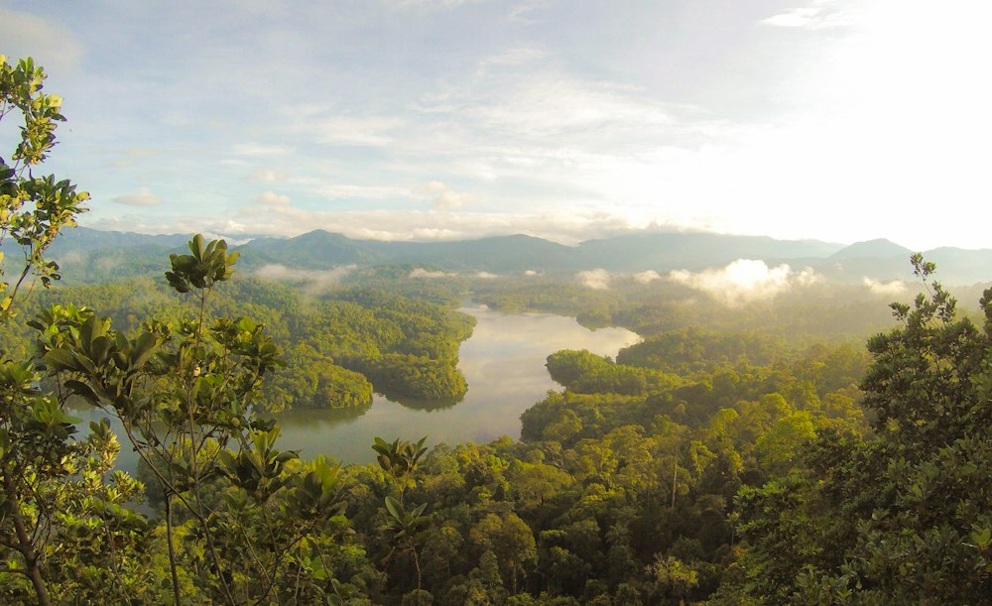
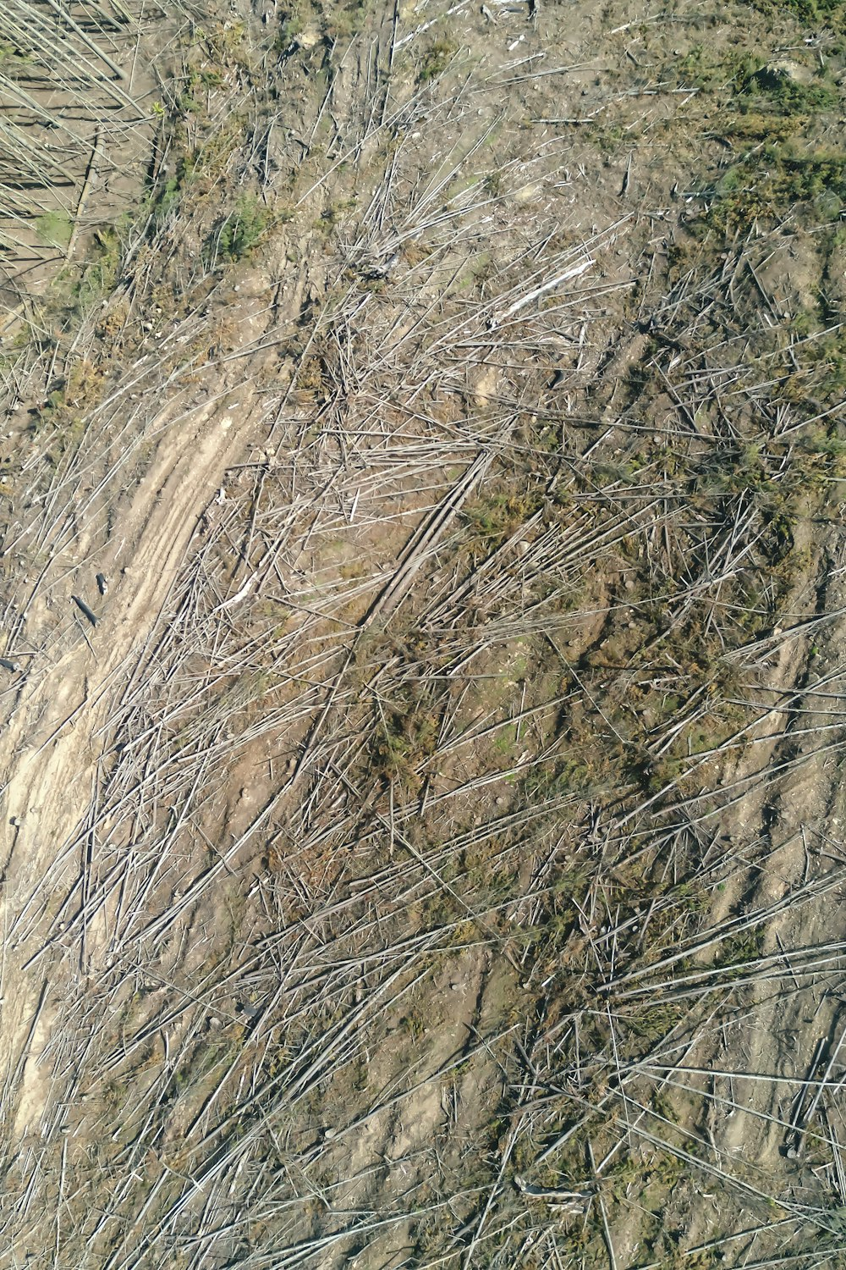
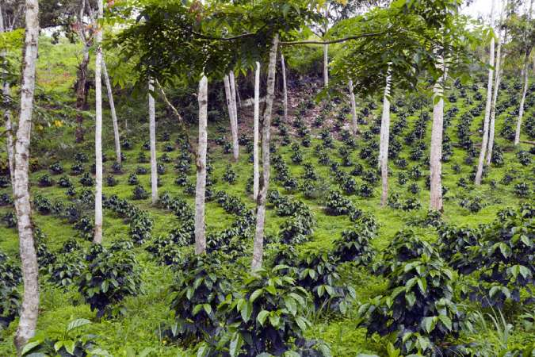
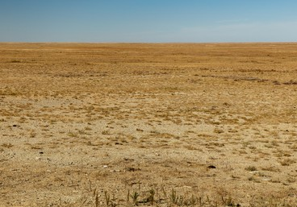
Landscape archetypes framework
State of Forest
Nature-based solutions
PROTECT
RESTORE & MANAGE
Ecotourism
Cattle
Cocoa
Coffee
Cotton
Oil palm
NTFPs
Pulp & Paper
Rubber
Soybean
Timber
Tree nuts
Timber
Biodiversity and ecosystem services
Including health benefits and managing natural disturbances

Slide 18
Map of Priority Countries
Asia
Higher Priority Geographic Areas
Priority Geographic Areas
Latin America
Africa
Darker: Brazil, Cameroon, China, Colombia, Côte d'Ivoire, Democratic Republic of the Congo, Gabon, India, Indonesia, Madagascar, Malaysia, Paraguay, Papua New Guinea, Peru, Thailand.
Lighter: Angola, Argentina, Benin, Bolivia, Burkina Faso, Cambodia, Central African Republic, Chad, Chile, Dominican Republic, Ecuador, Equatorial Guinea, Ethiopia, Ghana, Guatemala, Guinea, Honduras, Kazakhstan, Laos, Liberia, Mali, Mexico, Nicaragua, Nigeria, Pakistan, Panama, Philippines, Republic of the Congo, South Africa, Sri Lanka, Uganda, United Republic of Tanzania, Uruguay, Uzbekistan, Vietnam, Zimbabwe

Slide 19
Agenda
1
Vision and background
2
Approach and activities
3
Governance

Slide 20
CBA, a UK charity since 2023
Board of Trustees
(3 to 9 members)
Founder & Custodian Members
CEO
Advisory Council
Scientific
Advisory
Board
Ambassadors
CBA Secretariat
CBA Advisory
Programmes
Operations
Partnerships
Living Labs
CBA Affiliate Members

Slide 21
APPENDIX

Slide 22
Theory of Change
Inputs
Activities
Outputs
Outcomes
Systemic and action-oriented approach
Science-based framework
Global-to-local multi-stakeholders platform
Activating and demonstrating: Through a global network of bespoke Living labs
Advancing and sharing knowledge: Supporting research and capacity building through leading experts
Connecting and facilitating: Advocating for and building glocal partnerships from landscape-to-value chain
Scalable blueprints to catalyse the transition
New trans-disciplinary knowledge and enhanced capacities to guide and accelerate the circular bioeconomy
Collective commitments and global momentum to scale up action
Regenerative landscapes and circular bioeconomy value chains
Resilient and sustainable
Climate and nature positive
Socially inclusive
CBA MISSION
Accelerating the transition to a nature-first economy.
From
x The extractive economy powered by fossil resources is reaching ‘end of life’, depleting nature, people and the environment it depends on
To
A nature-first, circular bioeconomy that is climate neutral, inclusive and powers prosperity.

Slide 23
The CBA Principles for Regenerative Landscapes
These principles are meant to guide all development phases of a regenerative project, from design and planning to implementation and evaluation
Principle 1. Natural environment – Design for environmental sustainability, reverse Nature´s degradation and support ecosystem health.
Principle 5. Connectivity – Promote connectivity and collective impacts among nature and people.
Principle 2. Social well-being – Inclusive design aiming for equity, human health and happiness.
Principle 6. Adaptive capacity – Act for the long term based on monitoring and learning, keeping the social-ecological system flexible and adapted to upcoming challenges.
Principle 3. Economic prosperity – Design in support of the circular bioeconomy and target sustainable creation of wealth.
Principle 7. Harmony – Understand and embrace the local context, respecting laws and customary rights, including traditional knowledge, and finding balance between interests.
Principle 4. Diversity – Manage risks by diversifying species, products and markets.

Slide 24
The macro economic impact of climate shocks: six times larger than previously thought
A business-as-usual warming (3°C) scenario leads to a present value welfare loss of 31% and a Social Cost for Carbon of $1,056 per ton of carbon dioxide
Welfare (cons. eq., %)
Investment
Capital
Total factor productivity
Labor productivity
Global T, prod. and dep.
Global T, prod. only
Local T, prod. only
2100 temperature vs. pre-industrial (C)
Source: The Macroeconomic Impact of Climate Change: Global vs. Local Temperature Adrien Bilal and Diego R. Känzig NBER Working Paper No. 32450.
Notes:
results imply a SCC of $1,056/tCO2 and a 31% welfare loss from a moderate warming scenario. These effects are comparable to having a major war fought domestically, forever. Not only do our results indicate that climate change represents a major threat to the world economy, they also have salient consequences for decarbonization policy. Many decarbonization interventions cost between $27 and $95 per ton of CO2 abated (Bistline et al., 2023). A conventional SCC value of $151/tCO2 implies that these policies are costeffective only if governments internalize benefits to the entire world, as captured by the SCC. However, a government that only internalizes domestic benefits values mitigation benefits using a Domestic Cost of Carbon (DCC). The DCC is always lower than the SCC because damages to a single country are less than to the entire world. For instance, under conventional estimates based on local shocks, the DCC of the United States is $30/tCO2, making unilateral emissions reduction prohibitively expensive. Under our new estimates however, the DCC of the United States becomes $211/tCO2 and thus largely exceeds policy costs. In that case, unilateral decarbonization policy is cost-effective for the United States
Figure 10 displays our results. Global temperature shocks lead to a substantial and significant fall in the capital stock and in investment. The sluggish fall in the capital stock is consistent with the adverse impact of future extreme weather events such as storms that materialize as a sequence of capital depreciation shocks. Consistent with Hsiang and Jina (2014), we find that disasters associated with global warming do not stimulate growth. Instead, national income declines, productive capital dwindles and investment falls. We also find evidence that productivity falls significantly after global temperature shocks. This is true for Total Factor Productivity (TFP) as estimated in the Penn World Tables and for labor productivity. The impact effect, which stands at about -2%, is consistent with experimental studies on the impact of temperature on productivity (Seppanen et al., 2003). However, these effects tend to build up over time, reaching around -10% after about four years. 3.5 Regional Heterogeneit
In our framework, we define the Social Cost of Carbon as the one-time dollar amount C that households would pay at time 0 that would make them indifferent between a world with an additional ton of CO2 emitted at time 0, and a world starting in steady-state, without emissions, but having paid C.

